Slide 1

Business Retention & Expansion:
Highlights and Best Practices
2015
Jonathan Buttle
Columbia Basin Rural Development Institute,
Selkirk College

Slide 2
COLUMBIA BASIN RURAL DEVELOPMENT INSTITUTE
Multi-year partnership to support informed decision-making
The only college-based ‘rural’ RDI in Canada
Basin & Boundary catchment area
Research focus extends beyond ‘economic’
Regional approach, addressing identified regional sub-regional needs
Notes:
Community dev’t program -see community liason

Slide 3
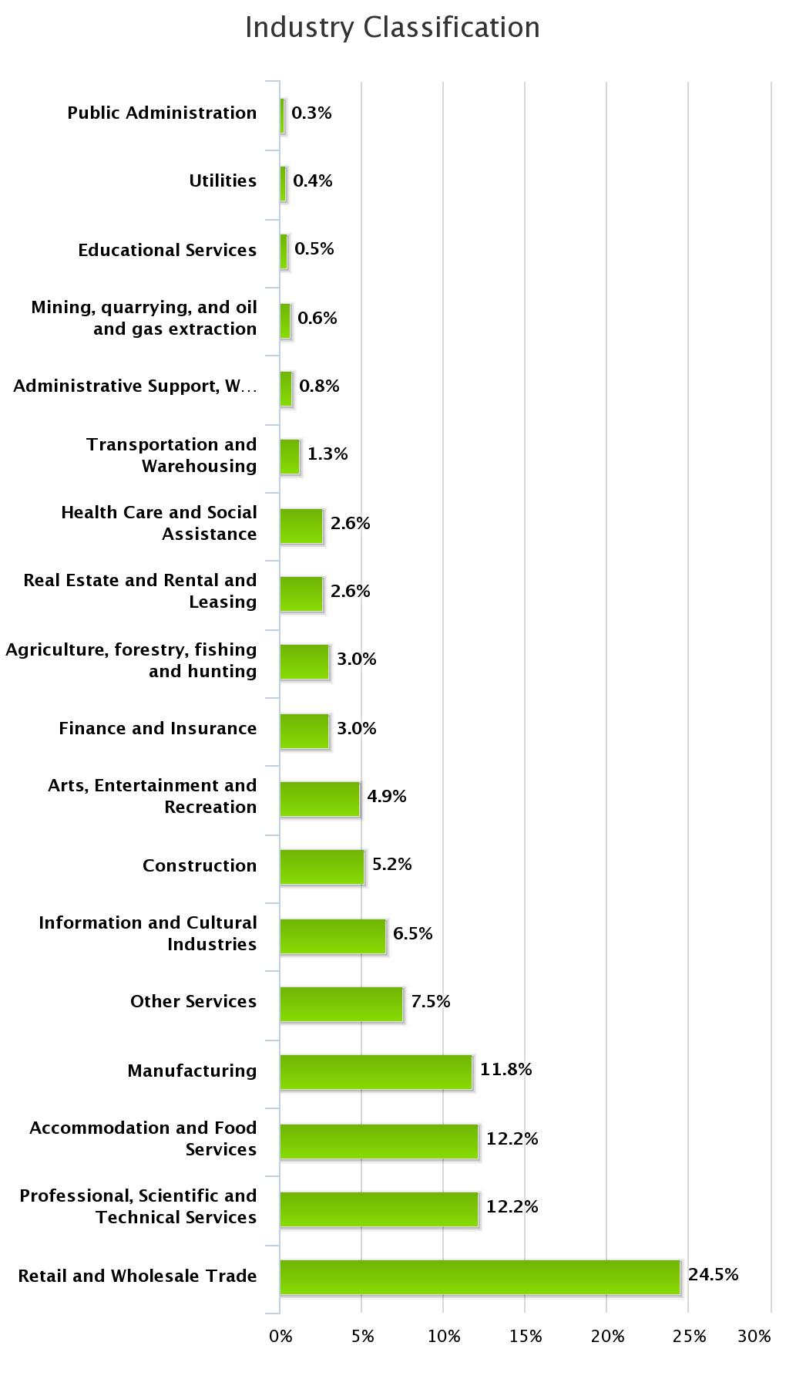
Highlights from Three Years of BRE
Re: Company Information
Biggest representation was from the Trade Sector: both Retail and Wholesale
(195 businesses)
Almost even representation from:
  Professional, Scientific, and Technical Services
  (97 businesses)
  Accommodation and Food Services
  (97 businesses)
  Manufacturing (94 businesses)

Slide 4
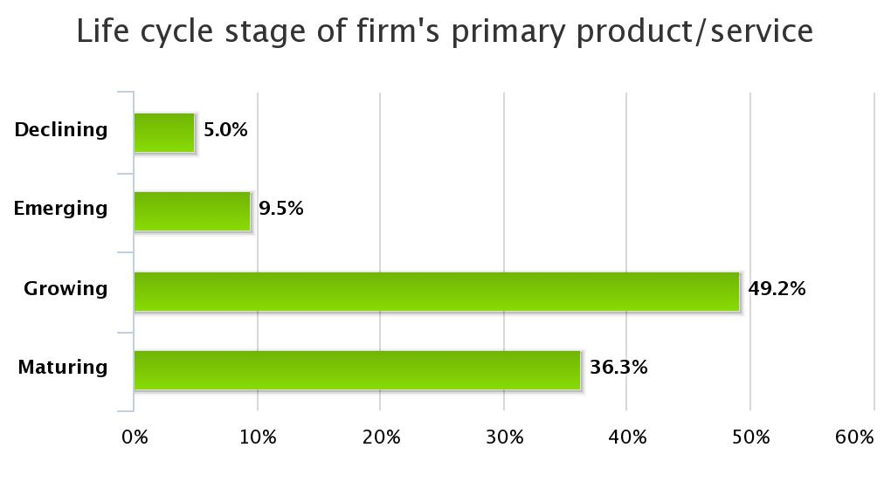
Highlights from Three Years of BRE
Re: Company Information
Almost half of businesses surveyed are in a growth phase

Slide 5
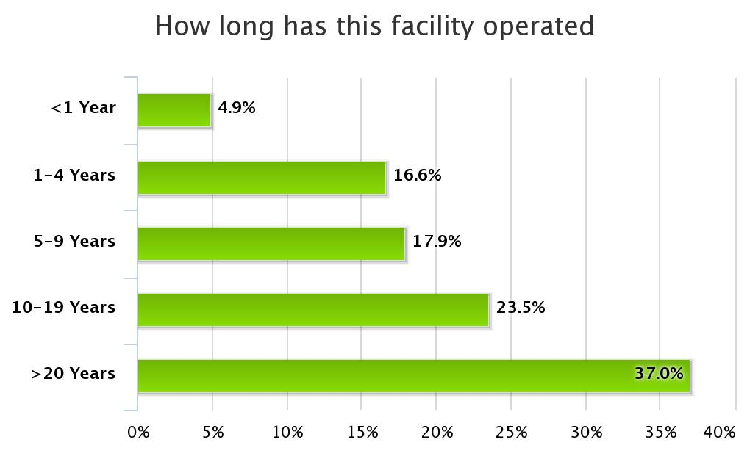
Highlights from Three Years of BRE
Re: Company Information
Impressive stability in the business climate
Over half the businesses have been operating for over 10 years!

Slide 6
Highlights from Three Years of BRE
Re: Company Information
Does your company have a current business plan?
Over half of the region’s businesses (383) have a current business plan
Only 17% (114 businesses) have a current succession plan
  125 businesses plan an ownership change in the next three years

Slide 7
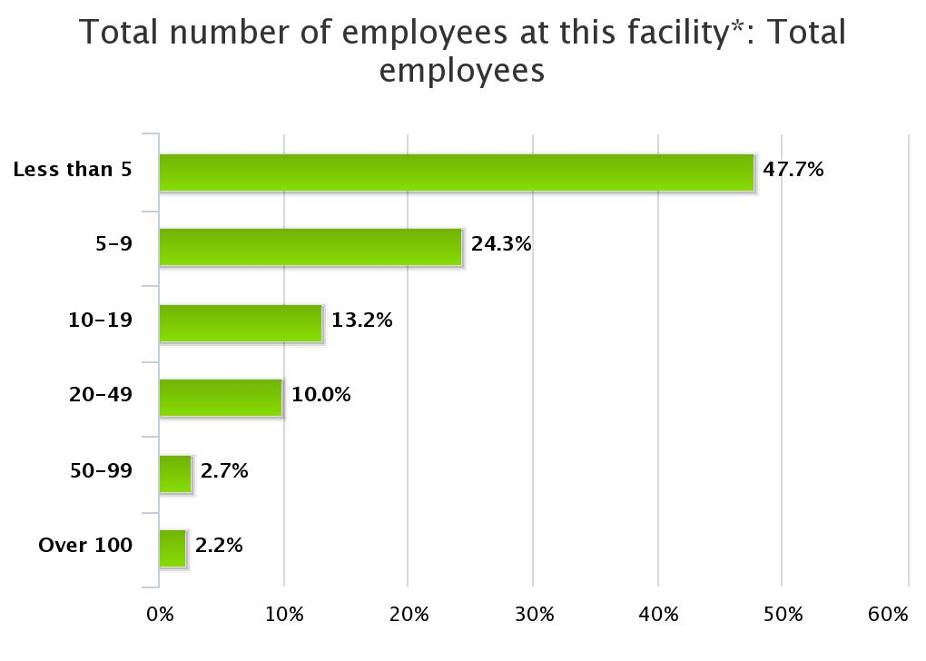
Highlights from Three Years of BRE
Re: Local Workforce
Most of the region’s businesses (373) are smaller employers (fewer than 5 employees)
2.2% (17 businesses) are large employers, with over 100 employees

Slide 8
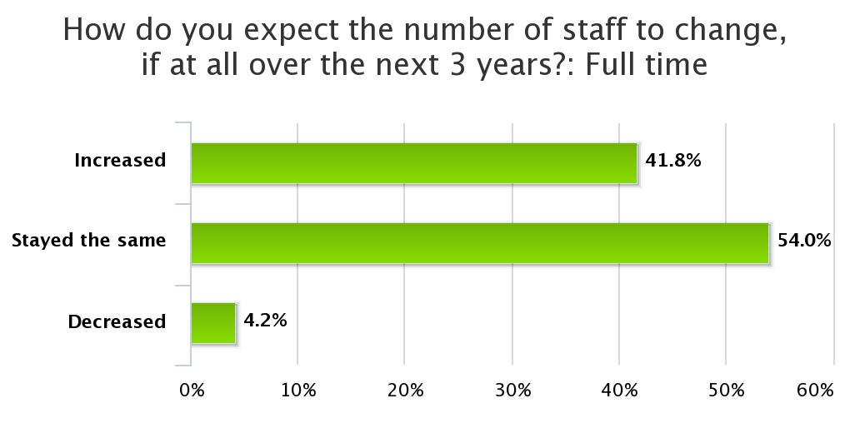
Highlights from Three Years of BRE
Re: Local Workforce
42% (266 businesses) expect the size of their full-time workforce to increase
54% (344 businesses) expect the full-time workforce to remain steady

Slide 9
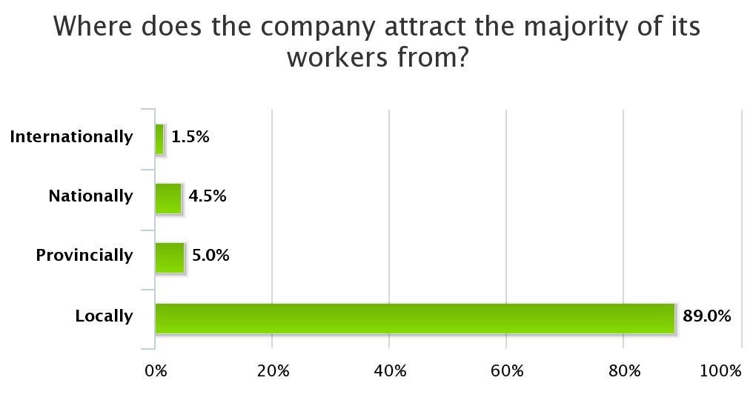
Highlights from Three Years of BRE
Re: Local Workforce
Almost all recruitment is occurring in the local job market

Slide 10
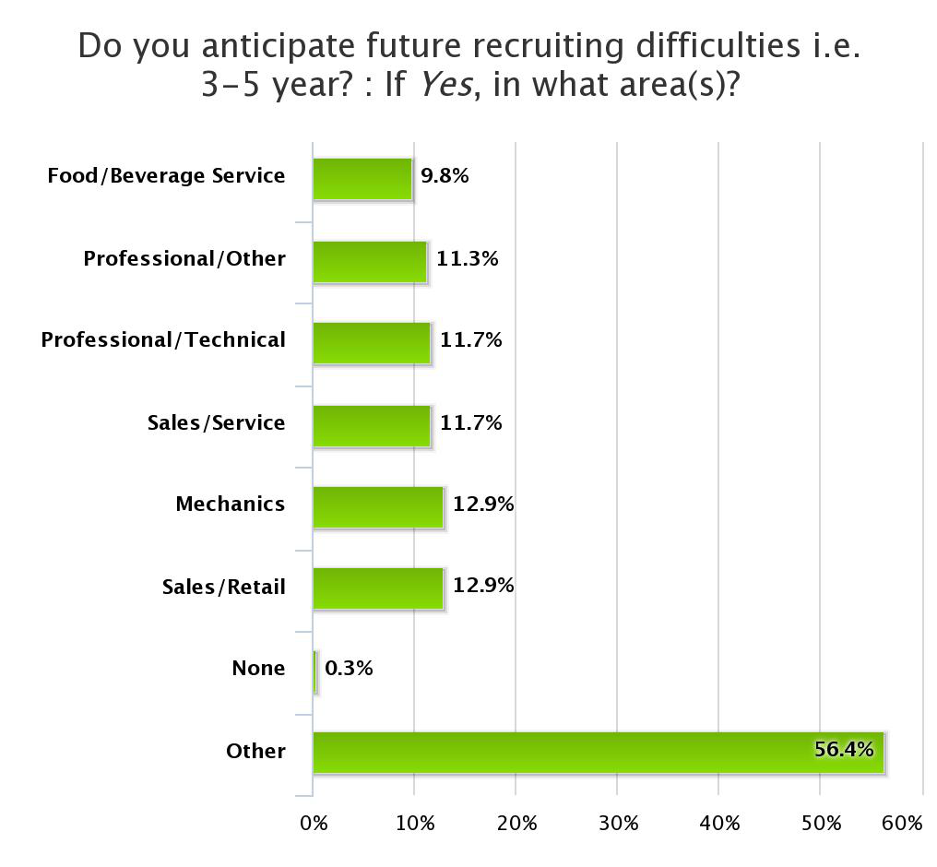
Highlights from Three Years of BRE
Re: Local Workforce
There are foreseen workforce shortages
Service industry (retail, food & bev, and service sales)
Technical training (mechanics, professional and high-tech)

Slide 11
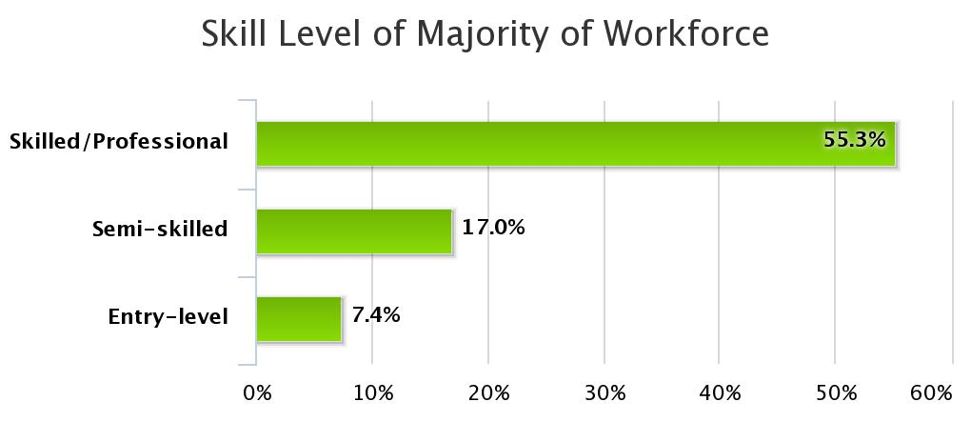
Highlights from Three Years of BRE
Re: Local Workforce
Most opportunities are in the skilled or professional category
  368 businesses say the majority of their workforce is skilled or professional

Slide 12
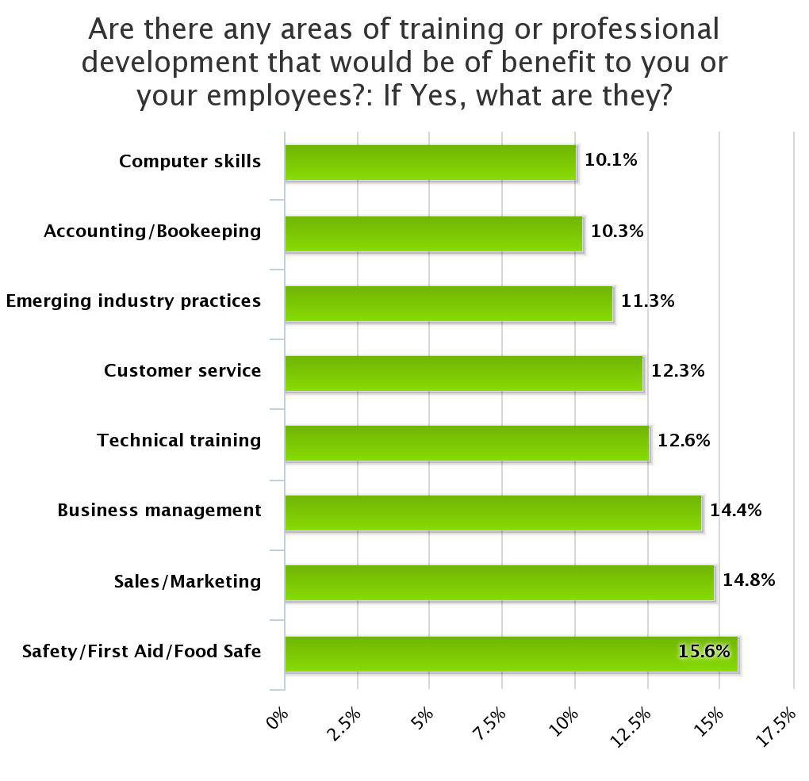
Highlights from Three Years of BRE
Re: Local Workforce
Training needs mostly line up with workforce skills shortages, but…
Support for business management skills
Emerging industry practices
  Both speak to hunger for more sophisticated management

Slide 13
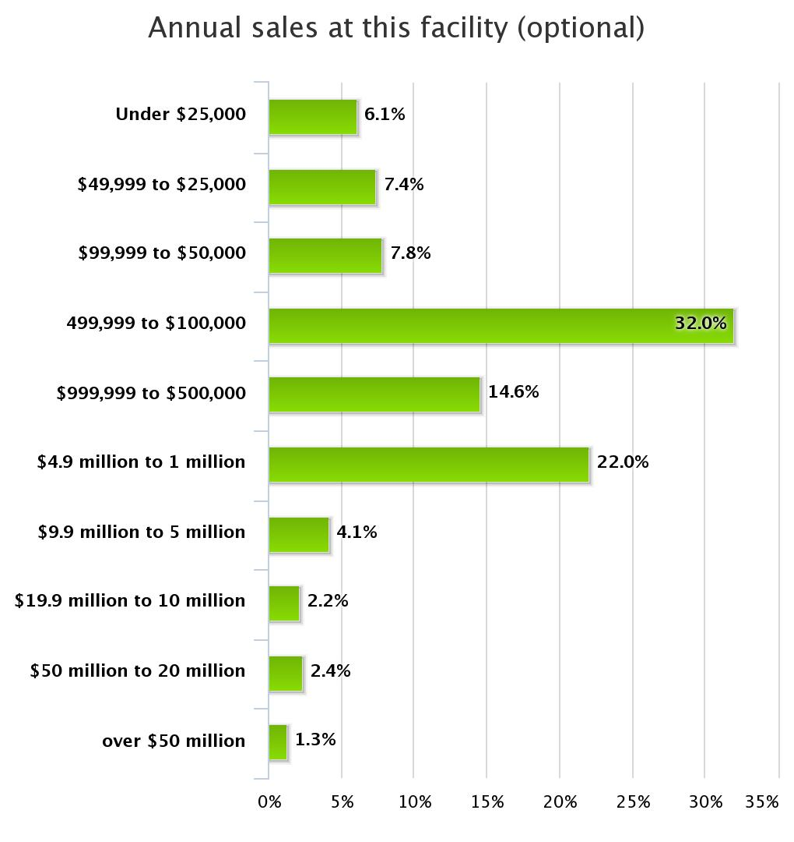
Highlights from Three Years of BRE
Re: Sales
Of the 459 businesses that responded, we see a bi-modal split
Most are $500K and smaller (in line with workforce figures)
Small spike between $1M and $5M

Slide 14
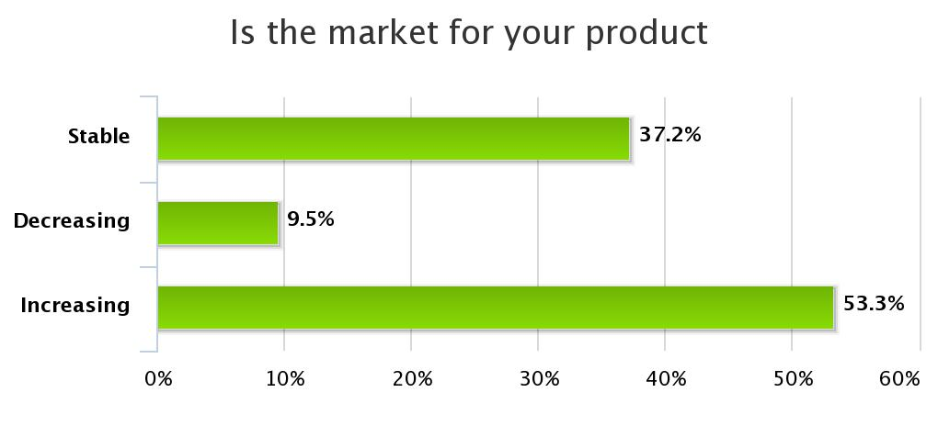
Highlights from Three Years of BRE
Re: Sales
Fairly optimistic view of the market.
  54% (410 businesses) expecting their industry to grow

Slide 15
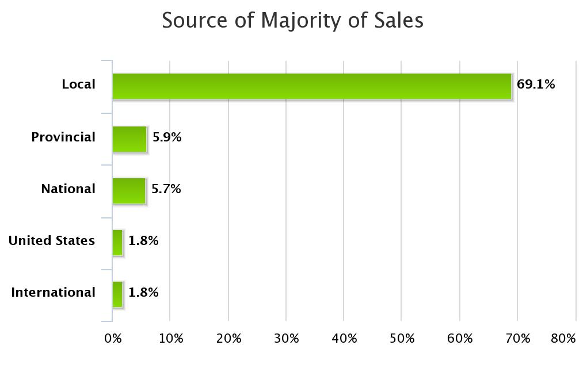
Highlights from Three Years of BRE
Re: Sales
Very local sales market
69% (505 businesses) indicate that over half of their sales are to customers in the community or region

Slide 16
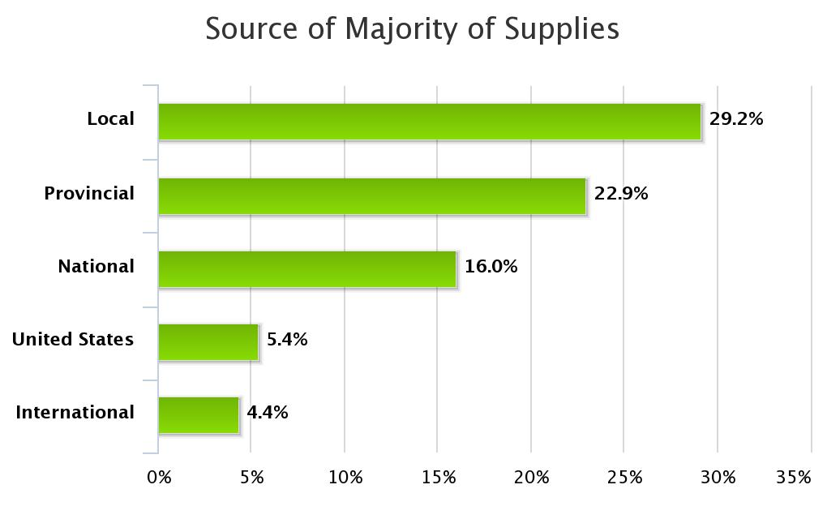
Highlights from Three Years of BRE
Re: Sales
Yet!..
Only 29% (209 businesses) buy their supplies from the local market

Slide 17
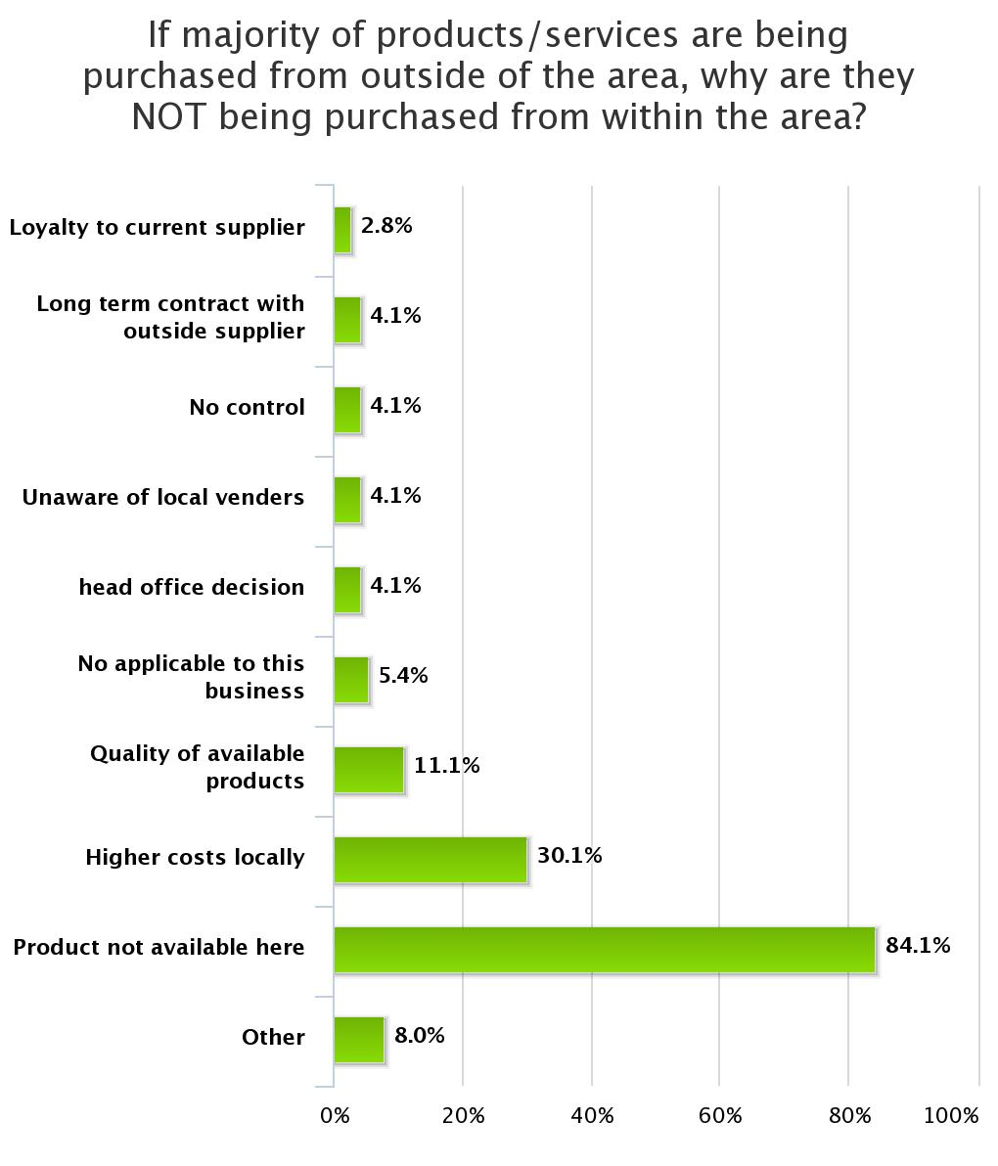
Highlights from Three Years of BRE
Re: Sales
Availability and costs drive local businesses to buy supplies out-of-region

Slide 18
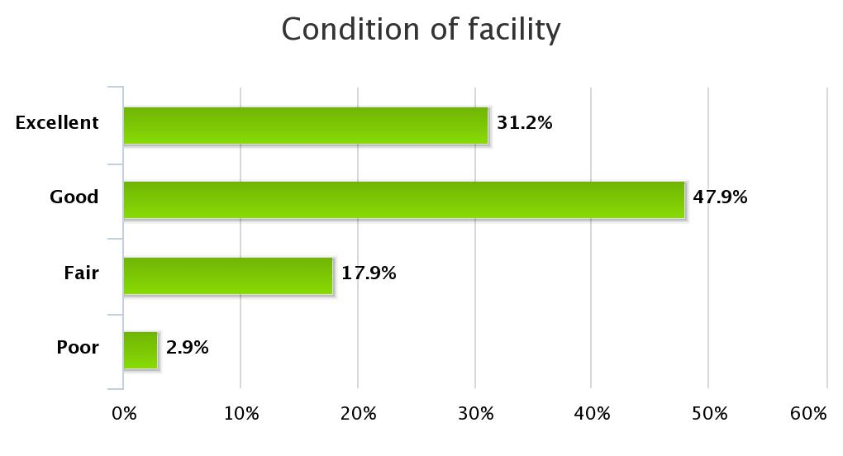
Highlights from Three Years of BRE
Re: Facilities
79% (541 businesses) state that their facilities are in good or excellent condition

Slide 19
Highlights from Three Years of BRE
Re: Facilities
61% (448 businesses) own their own facility
49% (361 businesses) plan to expand within three years

Slide 20
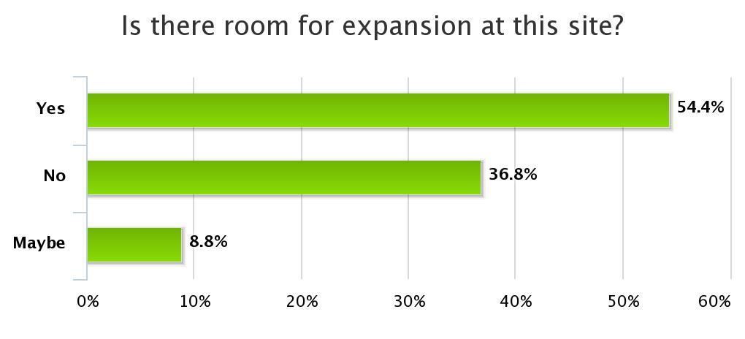
Highlights from Three Years of BRE
Re: Facilities
54% (or 358 businesses) indicate that they have room to expand at their current site
66% (or 227businesses) say their current site is adequate for expansion

Slide 21
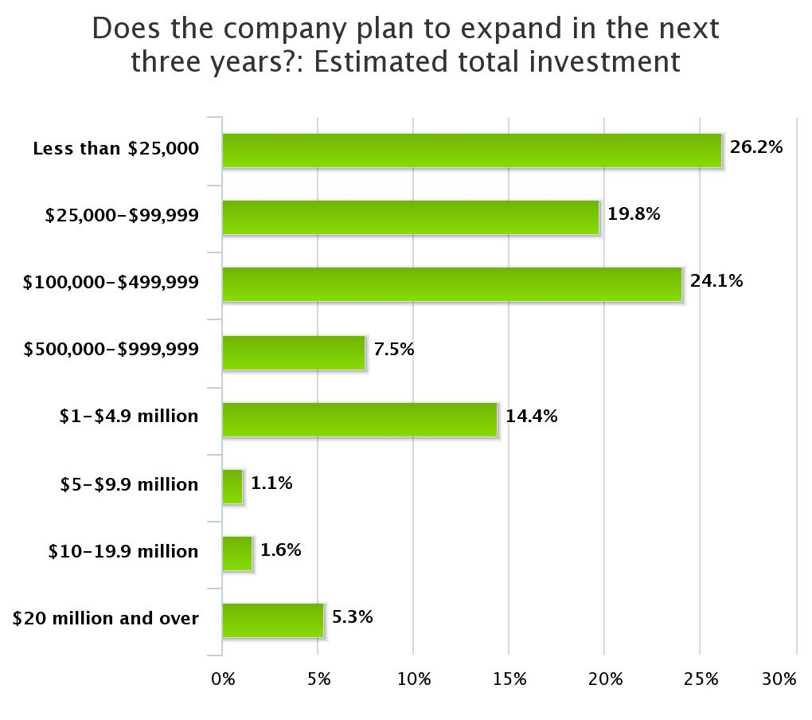
Highlights from Three Years of BRE
Re: Facilities
86% (304 businesses) are planning their expansion within their current communities
Most (70%) of the investments are modest (under $500K)
These represent roughly $420M in regional investment plans

Slide 22
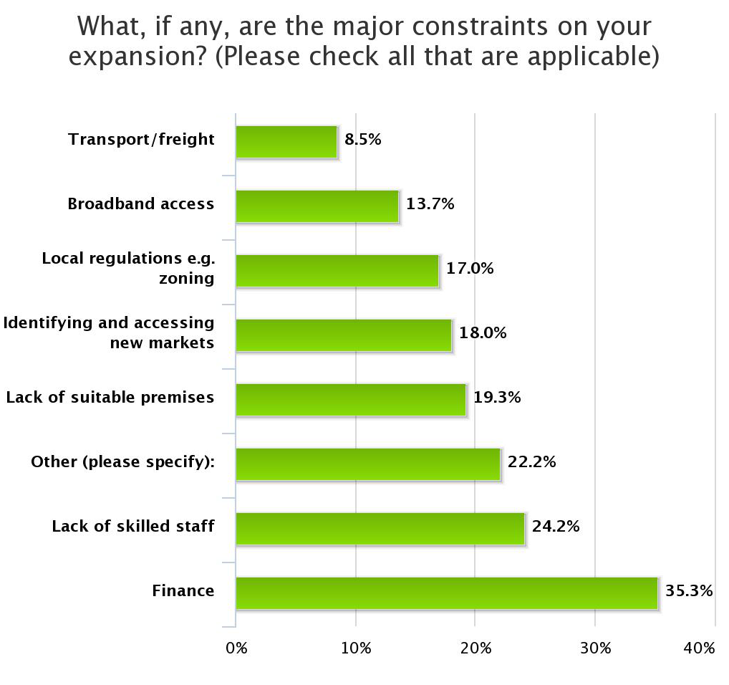
Highlights from Three Years of BRE
Re: Facilities
Finance is the leading barrier to expansion
Followed by
  Lack of skilled staff, and
  Lack of suitable premises

Slide 23
Highlights from Three Years of BRE
Re: Government Services
The services that received the highest number of POOR ratings were:
  Access to airports (27% or 215 businesses),
  Telecommunications (19% or 148 businesses), and
  Availability of buildings for lease or purchase (17% or 133 businesses).

Slide 24
Highlights from Three Years of BRE
Re: Government Services
The services that received the highest number of FAIR ratings were:
  Access to Suppliers (31% or 20 businesses),
  Telecommunications (21% or 170 businesses), and
  Access to markets (21% or 165 businesses).

Slide 25
Highlights from Three Years of BRE
Re: Government Services
The services that received the highest number of GOOD ratings were:
  Access to highways/roads (44% or 349 businesses),
  Water and sewerage (42% or 332 businesses), and
  Recycling (41% or 324 businesses).

Slide 26
Highlights from Three Years of BRE
Re: Government Services
The services that received the highest number of EXCELLENT ratings were:
  Access to highways/roads (26% or 203 businesses),
  Access to markets (15% or 116 businesses), and
  Recycling (14% or 115 businesses).

Slide 27
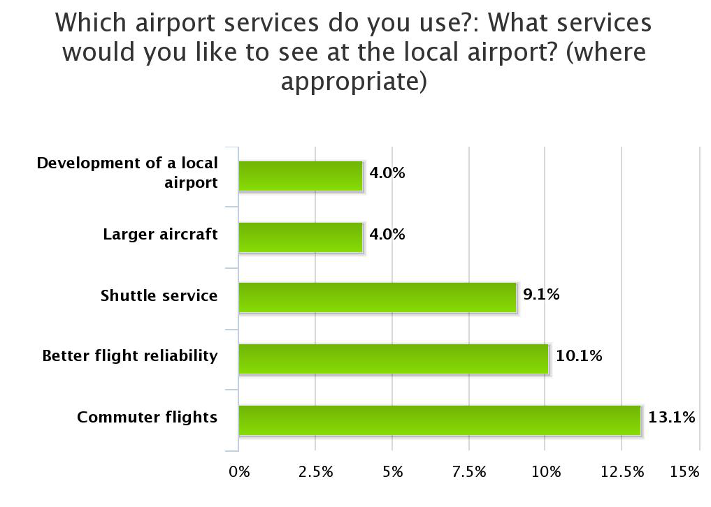
Highlights from Three Years of BRE
Re: Government Services
Kelowna is the most frequently used airport (36% of reporting businesses)
Business would like to see increased commuter flights and improved flight reliability

Slide 28
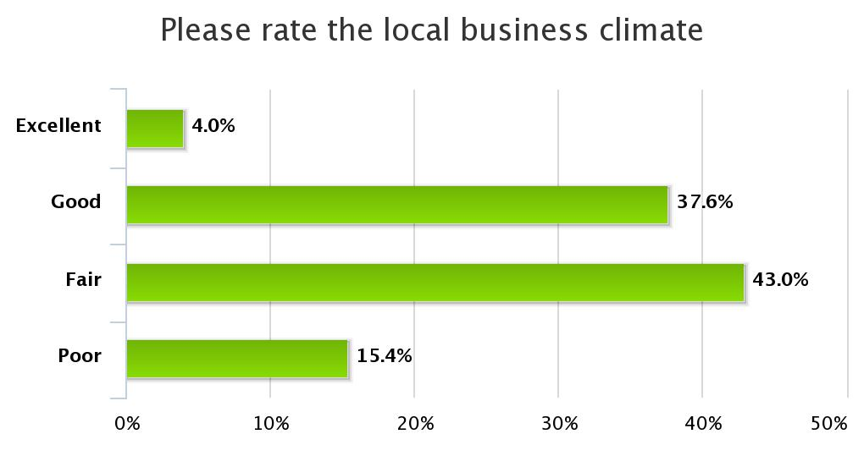
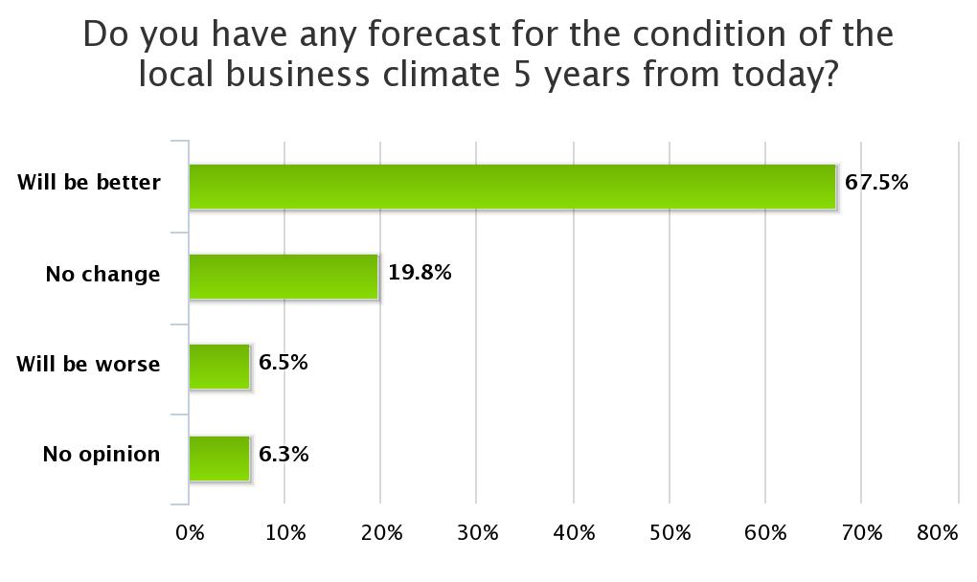
Highlights from Three Years of BRE
Re: Business Climate
An equal number of businesses (323) rate the business climate as “fair”, as those rating it “good” or “excellent”
But…
There is a high degree of optimism, with 67% (502 businesses) expecting improvements

Slide 29
Highlights from Three Years of BRE
Re: Business Climate
The business climate factors that received the highest number of POOR ratings included:
  Technical training (29% / 230 businesses),
  Economic development (26% or 208 businesses), and
  Workforce availability (24% / 192 businesses).

Slide 30
Highlights from Three Years of BRE
Re: Business Climate
The business climate factors that received the highest number of FAIR ratings included:
  Housing (33% / 260 businesses),
  Workforce availability (32% or 253 businesses), and
  Local tax structure (31% / 249 businesses)

Slide 31
Highlights from Three Years of BRE
Re: Business Climate
The business climate factors that received the highest number of GOOD ratings included:
  K-12 education (42% / 335 businesses),
  Cultural and recreational opportunities (38% or 303 businesses), and
  Colleges and universities (33% / 265 businesses).

Slide 32
Highlights from Three Years of BRE
Re: Business Climate
The business climate factors that received the highest number of EXCELLENT ratings included:
  Cultural and recreational opportunities (23% / 184 businesses),
  Workforce quality (11% or 85 businesses), and
  K-12 education (10% / 81 businesses)

Slide 33
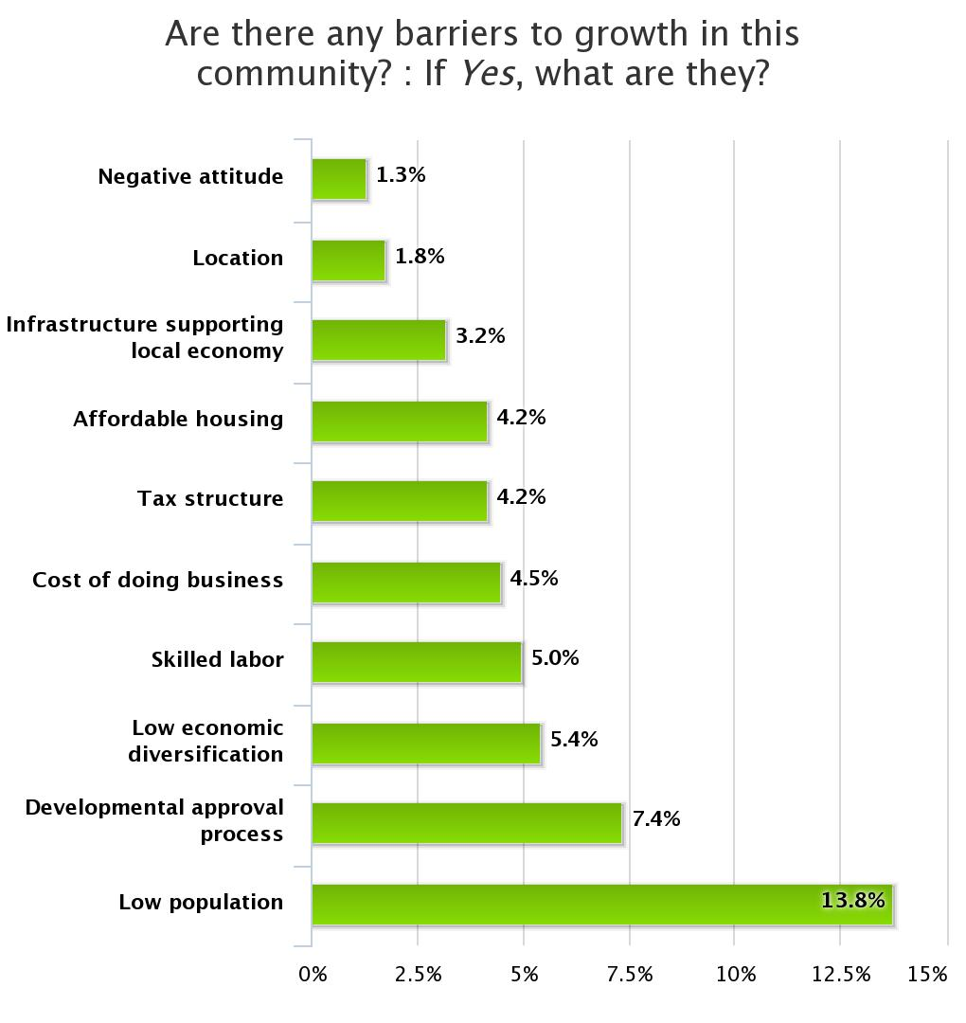
Highlights from Three Years of BRE
Re: Business Climate
Barriers to growth are focused on
  demographics,
  red-tape,
  economic diversity,
  workforce skills and
  high-costs of rural setting

Slide 34
Highlights from Three Years of BRE
Re: Business Climate
The competitiveness factors that received the highest number of Not At All Important ratings included:
  Accessing International Markets (17% / 85 businesses),
  Reliable Airport Service (15% or 76 businesses), and
  Capital Access (11% / 55 businesses).

Slide 35
Highlights from Three Years of BRE
Re: Business Climate
The competitiveness factors that received the highest number of Not Very Important ratings included:
  Reliable Airport Service (19% or 99 businesses),
  Expanding the Workforce (19% or 97 businesses), and
  Capital Access (17% / 85 businesses).

Slide 36
Highlights from Three Years of BRE
Re: Business Climate
The competitiveness factors that received the highest number of Somewhat Important ratings included:
  Adding or Changing Products & Services (41% / 211 businesses),
  Strategic Alliances (39% or 196 businesses), and
  Expanding the Workforce (36% / 186 businesses).

Slide 37
Highlights from Three Years of BRE
Re: Business Climate
The competitiveness factors that received the highest number of Very Important ratings included:
  Telecommunications (62% / 316 businesses),
  Customer Service (58% or 298 businesses), and
  Workforce Skill Development (56% / 283 businesses).

Slide 38
Highlights from Three Years of BRE
Re: Business Climate
The productivity drivers that received the highest number of POOR ratings included:
  Networking and collaboration with other businesses (6% or 24 businesses),
  Measuring impact of productivity efforts/investments (5% or 22 businesses), and
  Investing in people and skills (3% or 11 businesses).

Slide 39
Highlights from Three Years of BRE
Re: Business Climate
The productivity drivers that received the highest number of FAIR ratings included:
  Measuring impact of productivity efforts/investments (25% or 107 businesses),
  Networking and collaboration with other businesses (23% or 99 businesses), and
  Innovation & the use of technology (21% or 88 businesses).

Slide 40
Highlights from Three Years of BRE
Re: Business Climate
The productivity drivers that received the highest number of GOOD ratings included:
  Productive workplace culture (58% or 250 businesses),
  Leadership and management capacity (56% or 240 businesses), and
  Organizing work (structures & processes) (52% or 220 businesses).

Slide 41
Highlights from Three Years of BRE
Re: Business Climate
The productivity drivers that received the highest number of EXCELLENT ratings included:
  Leadership and management capacity (31% or 134 businesses),
  Productive workplace culture (31% or 131 businesses), and
  Innovation & the use of technology (30% or 126 businesses).

Slide 42
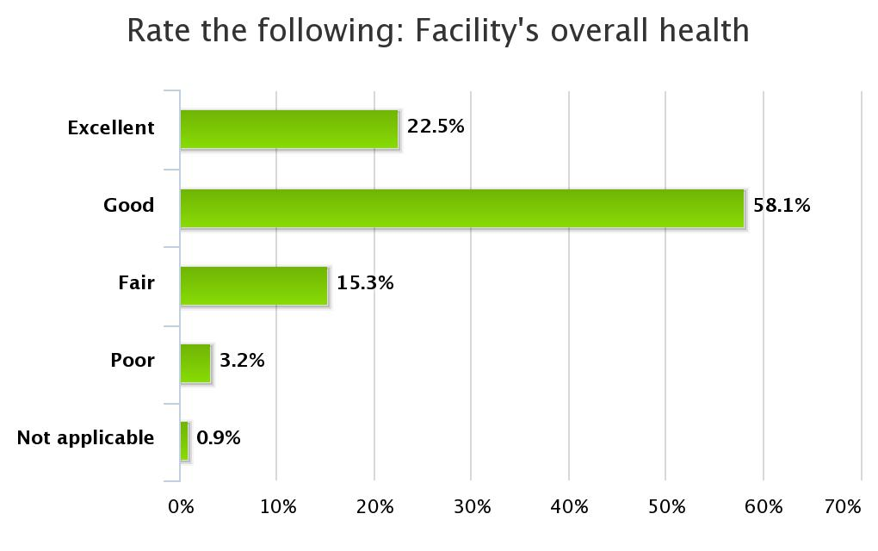
Highlights from Three Years of BRE
Re: Assessments & Plans
80% (552 businesses) rate their health as “Excellent” or “Good”

Slide 43
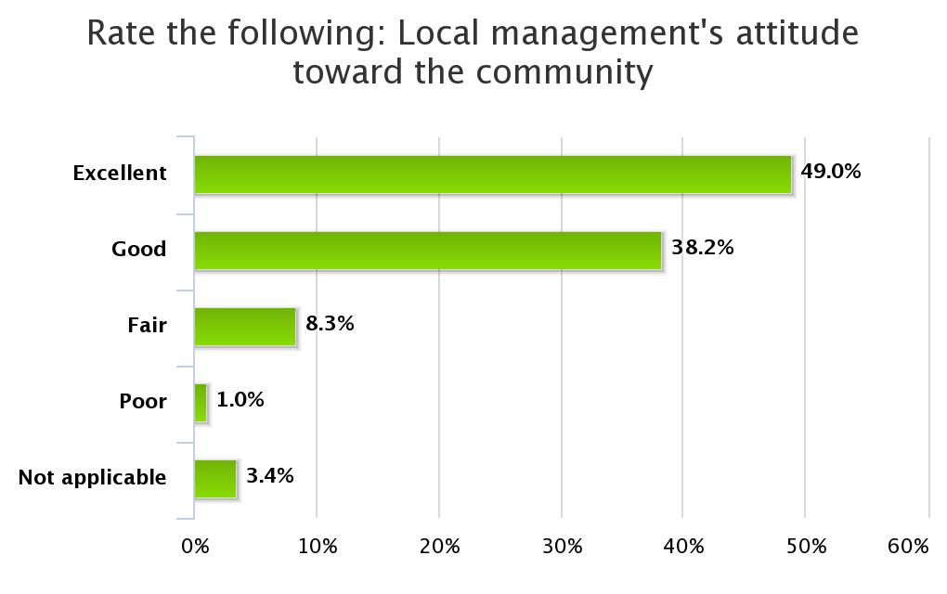
Highlights from Three Years of BRE
Re: Assessments & Plans
Almost half of the respondents (329 businesses) rate their management’s attitude toward the community as excellent

Slide 44
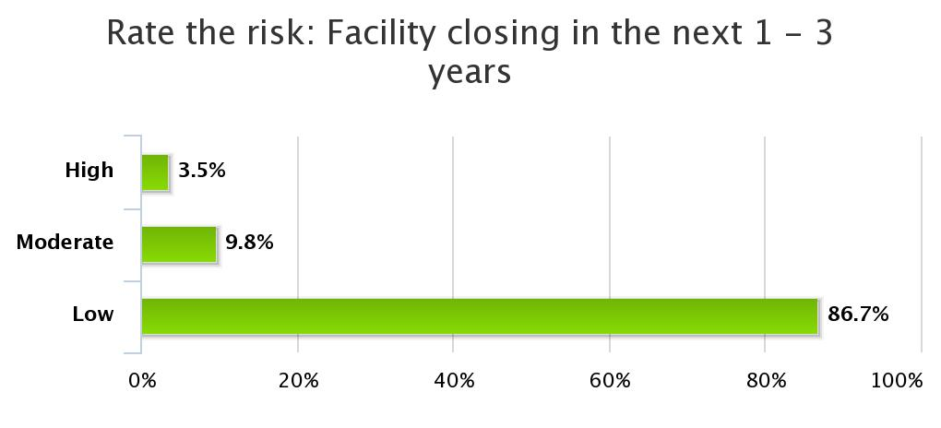
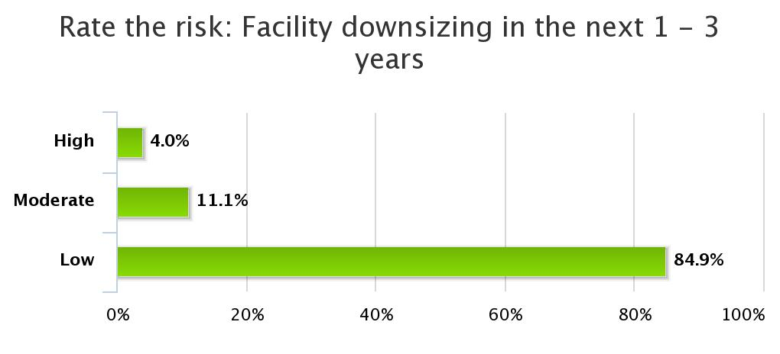
Highlights from Three Years of BRE
Re: Assessments & Plans
Risk of closure is low for 87% (619) of businesses
Rates of downsizing are similarly low, with 85% (591 businesses) rating the risk as “low”

Slide 45
BRE BEST PRACTICES
1
PLANNING AND SURVEYING
Building support
Critical partnerships
Conditions for success
2
ACTION AND UPTAKE
Typically successful actions
Who should be involved
Managing uptake
3
FOLLOW THROUGH
Commitment
Why it matters
Conditions for success
4
ECONOMIC DEVELOPMENT PLANNING
You’re already doing it!
Essential stakeholders
Important tips

Slide 46
LEARNING OUTCOMES
PLANNING AND SURVEYING
ACTION AND UPTAKE
FOLLOW-THROUGH
ECONOMIC DEVELOPMENT PLANNING
Understand how to get your community ready
How to get results
Why this is the most important step
Understanding your role in the big picture and why it matters

Slide 47
PLANNING AND SURVEYING
Establishing Support – Understanding your goals
A BRE creates a number of outcomes
  Improved relationships
  Basis for ED planning and action
  Data for evidence based decision making
A BRE can be focused according to your needs
  Geographically (is part of your jurisdiction particularly interesting?)
  Sectorally (is there a sector that is particularly interesting?)
Deciding on your focus and purpose makes it easier to establish support for your project

Slide 48
PLANNING AND SURVEYING
Establishing Support – Communications
Start early
  Get stakeholders involved in communicating
Clear messaging
  Tailor your message to your audience
    Local Government, Business Community, Partner Stakeholders
    Each may require different communications
  Choose your medium well
    Newspapers, electronic newsletters, posters, face to face discussions
    Different demographics respond better to different media
    Understand your audience!
Never miss an opportunity to raise the profile of your project!

Slide 49
PLANNING AND SURVEYING
Establishing Support – Education
Local Government and Staff
  What they will get out of it / Why they should care
  What resources will be required for different levels of participation
  What support and networks are available to them
  How the program will be stronger with their involvement
Local Business Community
  How will their safety / privacy be assured
  How will the information be used (potential programming)
  Address “Survey Fatigue” -> this one will result in action
Start setting the stage to entice project CHAMPIONS

Slide 50
PLANNING AND SURVEYING
Establishing Support – Commitment
Approach potential partners
  Match expected commitment to capacity
  Invite local government to the table (they are a key player)
  Look for Executive Sponsors, or CHAMPIONS
Key roles
  BRE Lead -> Should be paid position to ensure focus
  BRE Researchers -> Those performing interviews (paid)
  Red Flag / Green Flag Coordinator -> Not the BRE Lead
  Advisory Committee -> Can include: government, chamber, CF etc.
  CHAMPIONS -> Visible, high-profile, respected members of community

Slide 51
PLANNING AND SURVEYING
Establishing Support – Relationships / Networks
Leverage existing relationships
  From Business and Government
  Establish participation in the entire process -> Create OWNERSHIP
Network weaving
  Reach out to ED support networks
    Community Futures, Selkirk College, COTR, KRIC, KAST, CBT, IRAP, WorkBC, Credit Unions, EDCs, Community Service Centers, Tourism BC (and affiliates), Chambers of Commerce, Invest Kootenay, LCIC, RDI, First Nations, SIDIT
  The strength of these networks is cited as key ingredient for success
SWOT analysis of stakeholders
  Build strategies to deal with individuals or organizations that may derail

Slide 52
PLANNING AND SURVEYING
Survey Considerations
Understand that business owners first priority is ALWAYS doing business
Be tenacious without being aggressive
Be aware of seasonality – busy seasons are unlikely to yield interviews but more likely to create optimism
Momentum and inertia are critical
  Linking the BRE to action must be done as fast as possible.
Pass on Red-Flag and Green-Flag issues IMMEDIATELY
Understand the importance of listening

Slide 53
ACTION & UPTAKE
Conditions that contribute to success
Retention Efforts: Red-Flags / Green-Flags
KING OF ACTION
  Of all action you could take, this is the single most important
  Up to 80% of jobs are generated by existing businesses -> try not to lose any!
Information concerning an IMMEDIATE issue
Opportunity to dispel “Survey Fatigue”
You have a ready audience for all “flag” focused actions

Slide 54
ACTION & UPTAKE
Conditions that contribute to success
Training Programs
  Marketing
    Tailor medium to audience (is this group more likely to read the paper or answer emails?)
  Timing
    When will this group be able to attend
    Certain groups are just unavailable during certain hours
  Group Delivery or Individual Delivery
    Short, focused follow up with target businesses to find out WHEN to offer training
    Owners often do not want to reveal sensitive information in groups
    Be sensitive to these pressures versus the benefits of sharing in a group setting
  Subsidies
    If programming is subsidized, participation is generally higher
  Promotion Promotion Promotion!

Slide 55
ACTION & UPTAKE
Conditions that contribute to success
Improved relationships and potential partnerships
  Most common “Success Story”
    Every jurisdiction surveyed commented on the improved relationships
  Nurture these relationships
    Understand the process does not end after the BRE
    You are opening your doors to communication -> be prepared (for the good and the bad)
  Opportunity to celebrate your community’s strengths and successes
    Business owners are not often praised for their contributions
    Hold events, publish web-stories, tell the press!!!
  Business ←→ Council
    Foster the open communications between the business sector and local government
    This is an opportunity to streamline communications

Slide 56
ACTION & UPTAKE
Conditions that contribute to success
Shared Service Models
  There will be service gaps common to many businesses in your community
    These may point to a business opportunity for a new enterprise
    These may point to a shared delivery model for the existing businesses
  Co-Location
    Particularly with NGOs, there may be opportunities to lower overhead costs
    Related organizations may have a “synergy” benefit to co-locating (one-stop shopping for support operations)
  Community Marketing
    Attract skilled workers, new investors, enterprises to fill supply chain gaps
    Part of a branding exercise to celebrate local economic strengths

Slide 57
ACTION & UPTAKE
Conditions that contribute to success
Celebration of Local Expertise (not to belabour the point…)
  There are people in your community that have a LOT to SHARE
    Specific skill-sets
      Within a sector, the best performers may be able to help the “juniors”
      If you can get past the “competitive” constraints -> opportunities for partnership and growth
      The healthier the local sector, the more regional attention it will get
    General skill-sets
      Small communities tend to suffer management skills deficits
      There is an opportunity for sharing these skills and strategies between sectors
      Celebrate your experts
    Case-Study: Vernon’s “Dragon Den”
    Coaches/judges drawn from local experts
    Sponsorship drawn from local economy
    Contestants drawn from local innovators
    Great PR for all involved, while building on relationships!

Slide 58
ACTION & UPTAKE
Conditions that contribute to success
Learn how to work with Data
  Policy built on hard evidence is defensible
    In the absence of evidence, we rely on anecdotal evidence – storytime
      Whoever has the most believable story wins the debate
    Data gives us confidence that policy is being directed well
  Reliance on data is a skill that must be developed
    There is a strong resistance to change
    It may be difficult for some to abandon the common story (anecdotal evidence)
  Great opportunity to bridge communications between councils and chambers
    Use of data provides both parties a common tool
    A good focus for discussion

Slide 59
FOLLOW THROUGH
The Simple
Thank you cards
  Let your business community know that their participation matters
  This is a simple practice that requires no capacity
    Reminds people that they’ve been involved
    Reminds business that they matter
    Costs virtually nothing
Keep talking about it
  Remind your community that you’ve been listening
  Walk around and talk to owners about their experiences and expectations

Slide 60
FOLLOW THROUGH
Commitment
Function of preparation
  Ownership of the process will drive commitment levels
    The time spent engaging local government pays off
    Participation by other stakeholders (CFs, EDCs, Chambers etc.) will pay off
  CHAMPIONS are essential to establishing commitment
    Leaders can inspire
    These people push our imaginations
  Push organizations to put their resources where their mouths are
    Push for commitment of resources
    Strength of Follow-Through depends on it

Slide 61
FOLLOW THROUGH
Capacity
Resources
  Human Resources
    Establish Roles & Responsibilities early on
  Financial Resources
    Establish a fund for follow-through activities
    Can be very modest → YOU MUST TAKE SOME ACTION TO FOLLOW-THROUGH
Build mandate/capacity/culture for Economic Development
  Begin educating all stakeholders how they can participate
  Build case why it is important (essential) to all stakeholders
Leverage existing networks
  Take full advantage of all local/regional resources
  You don’t need to do everything on your own

Slide 62
FOLLOW THROUGH
Filtering and Focusing
Working with the willing
  Must try to recognize the difference between the resistant and the ready
    There will be strong up-take and support from the latter
  Focus efforts on those who are prepared to grow
    These are the enterprises that will realize the potential
    These are the enterprises that will create jobs
    Participation by these enterprises will create strength and momentum
  Be prepared for some pettiness and jealousy
    Craft communications and programming to minimize this impact
    Do not underestimate the potential for derailment

Slide 63
FOLLOW THROUGH
Communications
Tell them what you’re going to do
  Get your constituency ready
  Boost the expectations and level of preparedness
Tell them you’re doing it
  Continue to update your community as you go through the process
  Let them know how it is going and what activities you’re engaged in
  Make sure to link the planning to the action in all communications
Remind them what you did
  Keep sending out the message
  The strength of your communications and strategies will determine how effectively you demonstrate that “This survey resulted in action”

Slide 64
FOLLOW THROUGH
Expectations
Potential for growth FAR exceeds expectations
  In most cases this is the reality
    How prepared is your community to take advantage of the opportunities?
  Plans for investment in land, buildings and machinery
  Unfilled jobs that are not being matched within the community
  Labour retention issues
    There are often LOW-COST measures that can address these issues
    Be prepared for some easy fixes
      These can REALLY fight the “Survey Fatigue” problem

Slide 65
ECONOMIC DEVELOPMENT PLANNING
Education
Economic Development is not well understood
  Must educate your stakeholders
Stakeholders need to know where they fit and their importance
  Government
    Elected Officials
    Staff
  Business Community
  Support Networks

Slide 66
ECONOMIC DEVELOPMENT PLANNING
ED 101
What does local Economic Development look like?
Know Strengths & Weaknesses
  A BRE study checks this box
Know where you fit regionally
Develop ED Vision & Goals
Build an ED Strategy
Connect ED to existing policy
Know your regulatory environment
Engage ED stakeholders
Get to know business needs
Build an community ED message
Establish ED staff

Slide 67
ECONOMIC DEVELOPMENT PLANNING
Participation
Everyone is affected… Everyone has a role
  Government
    Establish capacity limitations -> work within them
    Understand they are CRITICAL to ED (if only as CHAMPIONS)
  Business Community
    Bring them to the table for input and guidance
  Greater Community
    ED Planning affects all residents, invite their participation
  Other Stakeholders & Support Networks
    Understand the breadth of your ED network
    You are not in this alone
    This is an opportunity to establish &/or strengthen your ED networks

Slide 68
ECONOMIC DEVELOPMENT PLANNING
Data Driven Planning
Your BRE can:
  Bolster an existing ED Plan
    Use the data:
      Confirm or refute plans based on anecdotal evidence
      Build confidence that action is being directed well
    Fill in missing sections of ED plan with BRE data
      SWOT Analysis for example
    Identify ED gaps
  Proxy for an ED Plan where none exist
    Establish the use of data to guide policy
      Part of a long-term strategy to train your policy environment
    Take the priority issues from the BRE findings and take action (immediately)
      Generalized findings from Red Flags / Green Flags to guide immediate pressure relief
    Use the structure of the BRE as a starting point to a real ED Plan.
    Identify development bottle-necks

Slide 69
ECONOMIC DEVELOPMENT PLANNING
Build Enthusiasm
This is a HUGE opportunity for positive growth
  Raise the profile of your ED organizations
  Begin benchmarking outcomes
  Engage the entire community
  Let community CHAMPIONS play a positive role

Slide 70
COLUMBIA BASIN RURAL DEVELOPMENT INSTITUTE
CONNECT • UNDERSTAND • MOBILIZE
www.cbrdi.ca

