Slide 1



CONNECT • UNDERSTAND • MOBILIZE
_________________________________________________________
Research Supporting Regional Collaboration:
The Case of the Columbia Basin RDI
October 12, 2012
Terri MacDonald, Ph.D
Regional Innovation Chair in Rural Economic Development
Selkirk College

Slide 2
Agenda
The Regional Context
Establishing the Rural Development Institute
Research in Partnership
Lessons Learned from Year 1
Understanding Sustainability Trends
Rural Revitalization
Innovation & Knowledge Transfer

Slide 3
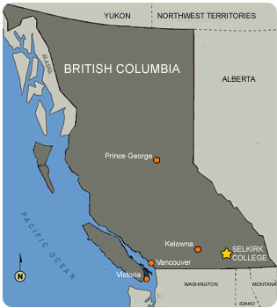
The Kootenay Region
‘Stabilized’ population of approx. 170,000
Resource-based economy
Amenity rich
‘Fracturing’ geography

Slide 4
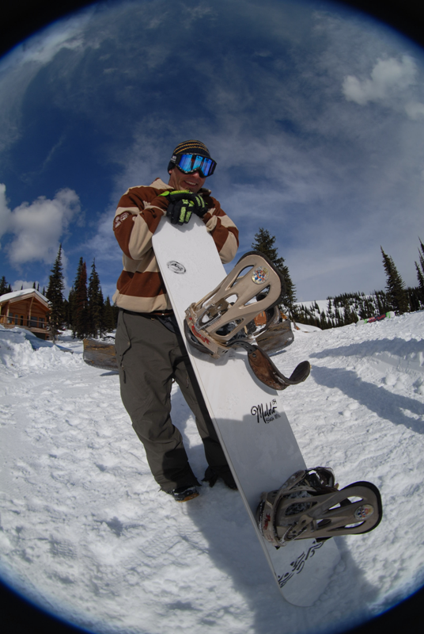
The Kootenay Context
Need for sustainability trends analysis
Communities with limited & varying capacity
Community-based research overlaps and support needs
Increase in regional collaboration but historic challenges remain
No university in the region

Slide 5
Preferred Future Scenarios

Slide 6
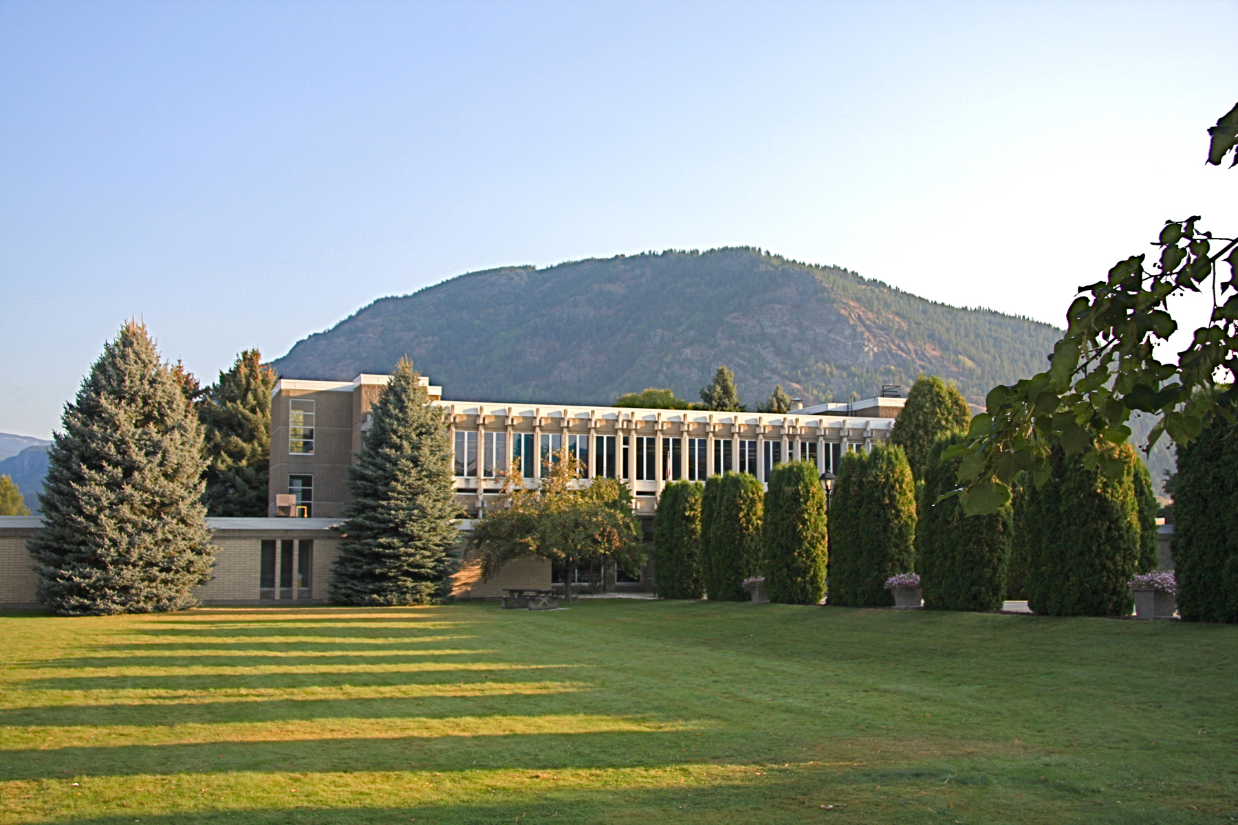
Selkirk College
Over 2,000 students
70 certificate, diploma and degree programs
Oldest regional college in BC
Aviation • Contemporary Music & Technology • School of the Arts • School of Environment & Geomatics • Golf Operations & Ski Resort Management • Health & Human Services

Slide 7
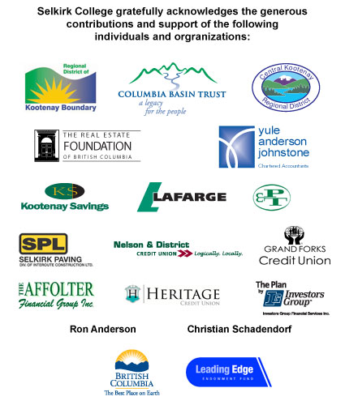
Regional Innovation Chair in Rural Economic Development
$1.5 million in matching funds from within the West Kootenay-Boundary
21 BC Research Chairs (Health-7, Technology-2, Enviro-3, Social-5, Economic-4)
One of only 2 RICs located at a college
Extensive affordable housing research in first 5 years ($10m over 3 years)

Slide 8
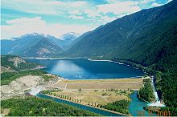
The Columbia Basin Trust
Provincial crown corporation to support region impacted by Columbia River Treaty
Support economic, social and environmental well-being
$321m endowment - $276m for hydroelectric projects & $45m for other projects
$20m annually to support well-being & self-sufficiency

Slide 9
Columbia Basin Rural
Development Institute
Multi-year partnership to support informed decision-making
The only college-based, ‘rural-placed’ RDI in Canada
Regional catchment area, well-positioned as a regional rural research incubator
Understanding rural revitalization in sustainability terms
Regional approach, addressing identified regional & sub-regional needs
Notes:
Includes the CBT defined ‘Basin’ region in addition to the Boundary area, serving 26 communities crossing 5 Regional Districts (Regional Districts of East Kootenay, Central Kootenay, Kootenay Boundary, Columbia Shuswap Areas A & B, and Fraser Fort George Area H) and 4 College regions (Selkirk College, College of the Rockies, Okanagan College and College of New Caledonia).

Slide 10
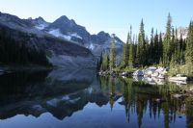
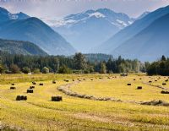
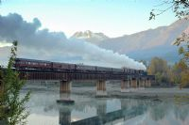
RDI Goals
SUPPORTING INFOMED DECISION-MAKING THROUGH RELEVANT & TIMELY RESEARCH
PROMOTING INNOVATION & BEST PRACTICE TOOLS
MOBILIZING KNOWLEDGE TO SUPPORT RURAL REVITALIZATION

Slide 11



Research Snap Shot
Monitoring Sustainability Trends
Rural Revitalization
Innovation & Knowledge Transfer
RURAL COMMUNITY SERVICE LEARNING PARTNERSHIP
________________
STATE OF THE BASIN & RDI WEBSITE
______________________
ATTRACTING YOUNG ADULTS TO RURAL REGIONS KBM PROJECT
____________________
STATE OF THE ENVIRONMENT: PILOTING BEST PRACTICES & DIGITAL TECHNOLOGIES
_________________
SME ADOPTION OF DIGITAL TECHNOLOGIES PROJECT
________________
GEOSPATIAL EMPLOYMENT LANDS PROJECT
_________________
MANUFACTURING & TECHNOLOGY SECTOR DEVELOPMENT
___________________
BUSINESS RETENTION & EXPANSION REGIONAL PILOT
______________________
= RDI led initiative
PRODUCTIVITY INITIATIVE
_____________________

Slide 12
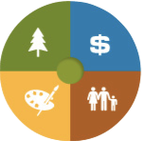
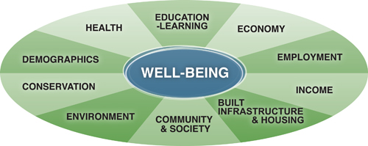
State of the Basin: 2008 Framework

Slide 13
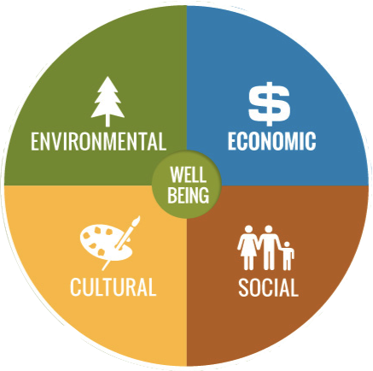
State of the Basin:
Transitioning to an Integrated Framework
Conservation
Demographics
Employment
Environment
Economy
Income
Built Infrastructure & Housing
Health
Education & Learning
Community & Society

Slide 14
State of the Basin:
Indicator Thematic Areas
Water
Workforce
Air
Economy
Land
Infrastructure & Housing
Biodiversity
Transportation
Recreation
Demographics
Heritage
Education & Learning
Arts
Civic Engagement & Safety
Culture
Health, Wellness & Affordability

Slide 15
Communities & Corridors for Analysis
Trail & Area (Fruitvale, Warfield, Montrose, RDKB Areas A &B)
Rossland
Castlegar & RDCK Areas I & J
Nelson & RDCK Areas E & F
Kaslo & RDCK Area D
Salmo & RDCK Area G
Slocan Valley (Slocan, Silverton, New Denver, RDCK Area H)
Nakusp and RDCK Area K
West Kootenay Corridor
Creston & RDCK Area A, B & C
Kimberley & RDEK Area E
Cranbrook & RDEK Area B & C, Indian Reserves
South East Kootenay Corridor
Fernie & RDEK Area A
Elkford
Sparwood
Elk Valley Corridor
Canal Flats
Invermere
Radium Hot Springs
RDEK Area F
RDEK Area G
Golden & RDCS Area A
Columbia Valley Corridor
Grand Forks
Greenwood
Midway
RDKB Area C
RDKB Area D
RDKB Area E
Boundary Corridor
Valemount
Revelstoke & RDCS Area B

Slide 16
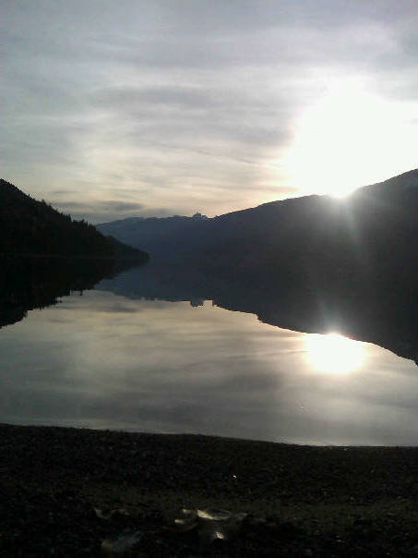
State of the Basin: Approach
  Integrated ‘well-being’ & ‘sustainable development’ framework
  Prioritize analysis of interrelationship between ‘dimensions’
  Inclusion of objective and subjective measures
  Online tool with geospatial mapping and ongoing trends analyses

Slide 17
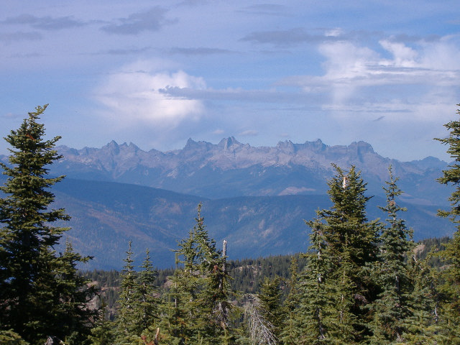
State of the Basin: Approach
  Search and compare indicators by community and corridor
  Mixed method, quantitative and qualitative methodologies
  Focus on indicators that can inform decision-making
  Long term focus on community-based research & direct support

Slide 18
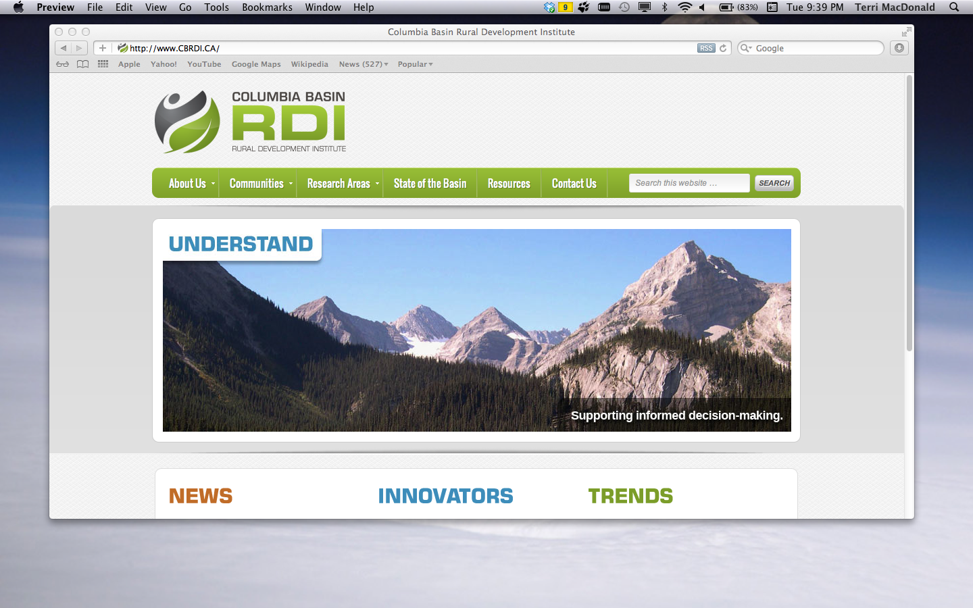
RDI Website

Slide 19
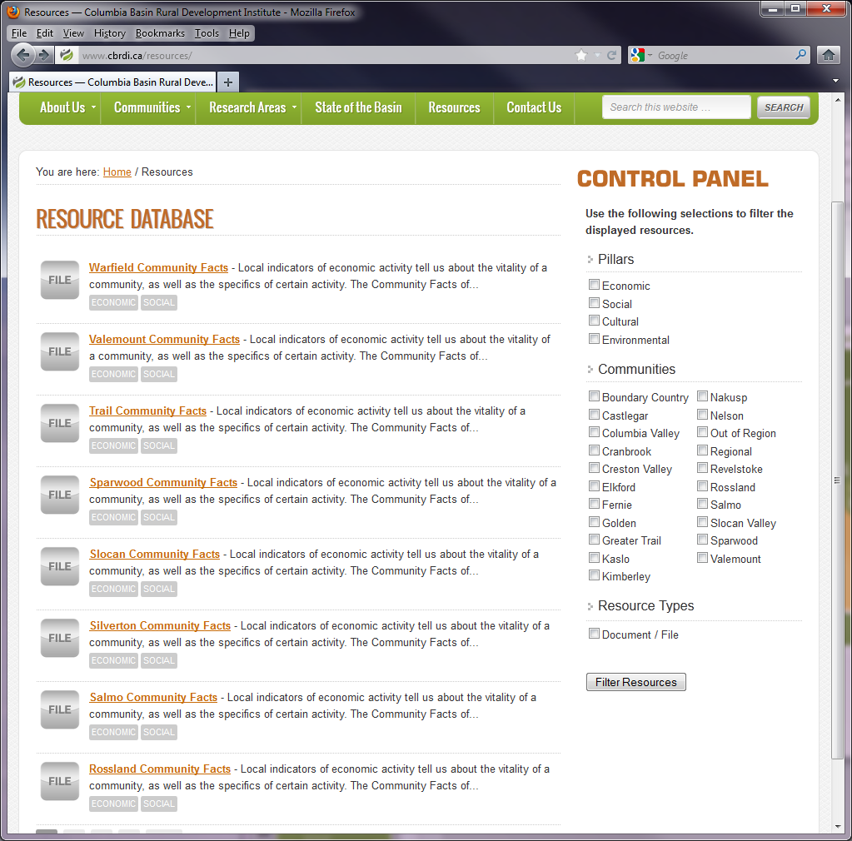

Slide 20
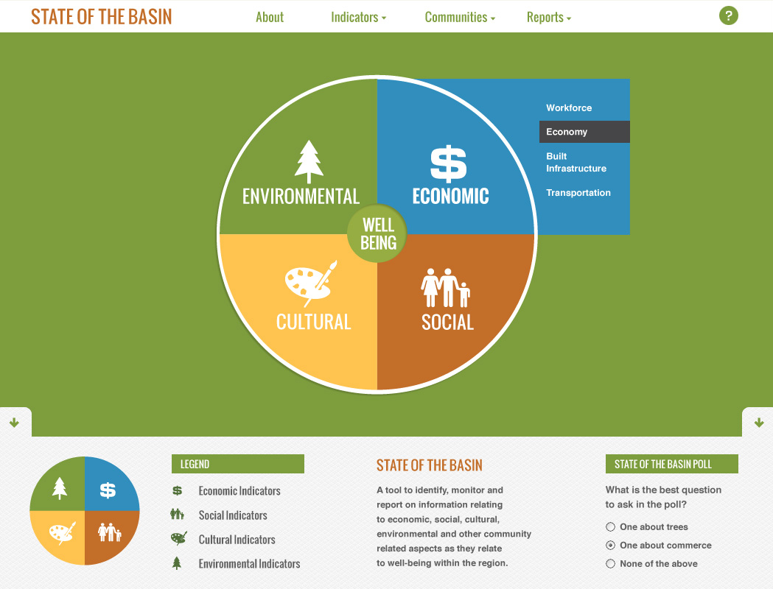

Slide 21
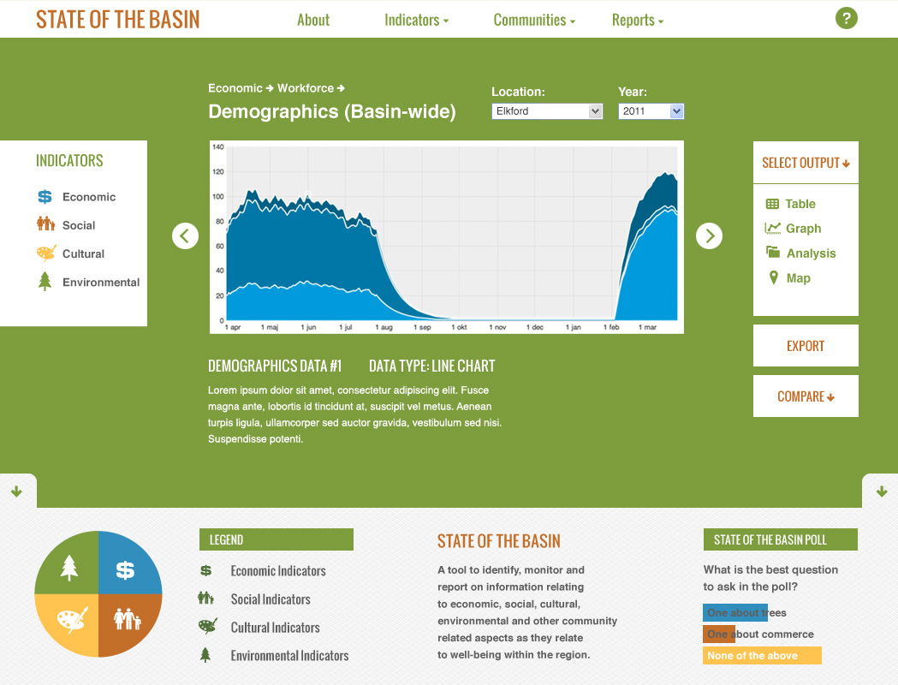

Slide 22
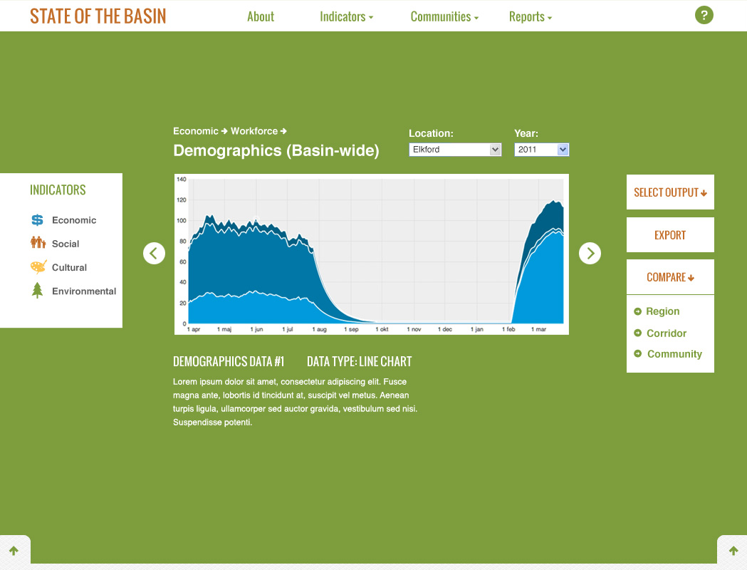

Slide 23
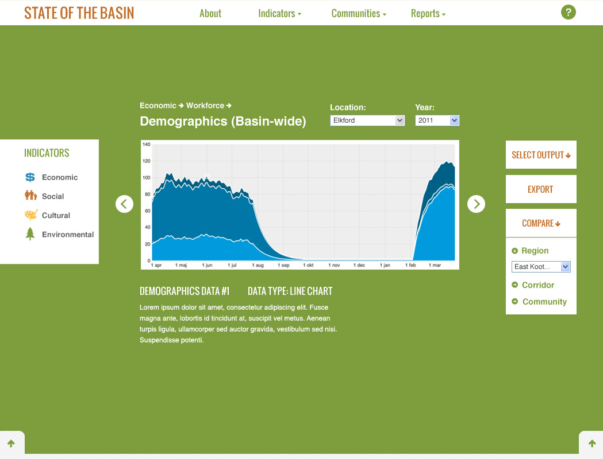

Slide 24
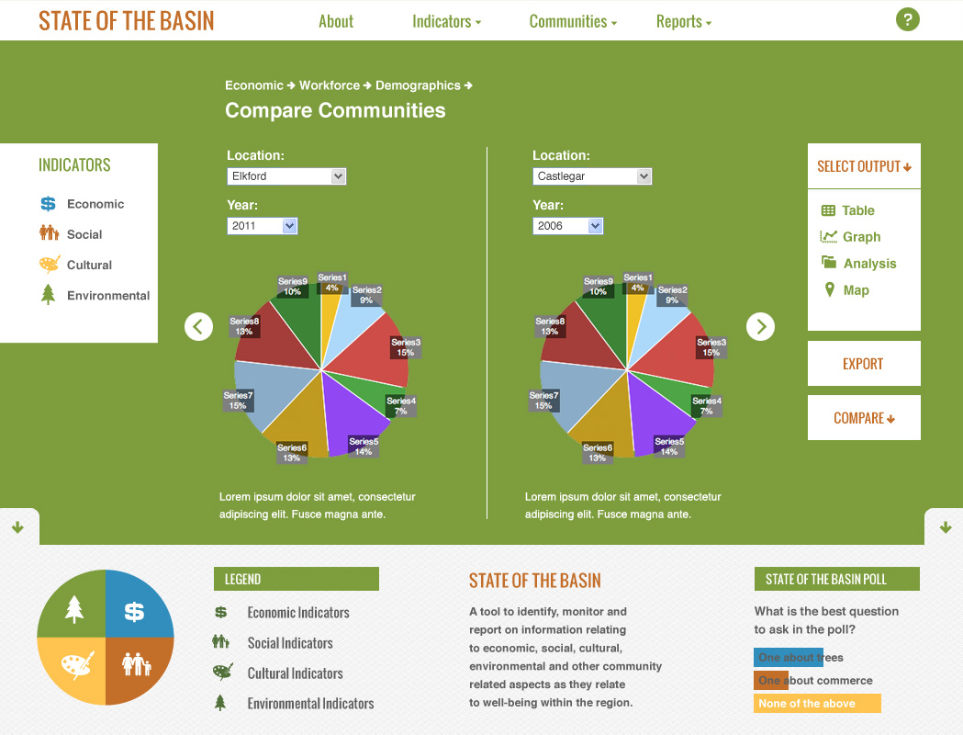

Slide 25
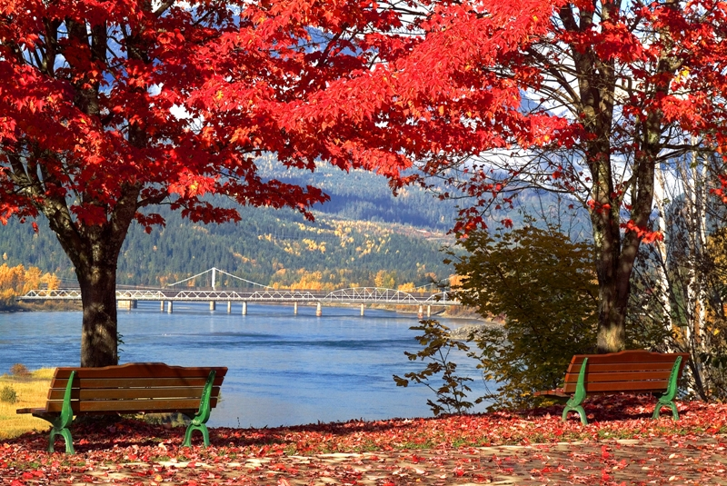
State of the Environment: Piloting Best
Practices & Digital Technologies
  Explore the landscape of enviro & sustainability research & planning
  Expand existing SoTB enviro indicators
  Develop web-based geospatial portal
  Build capacity of stakeholders to support data collection efforts & link research planning & implementation

Slide 26
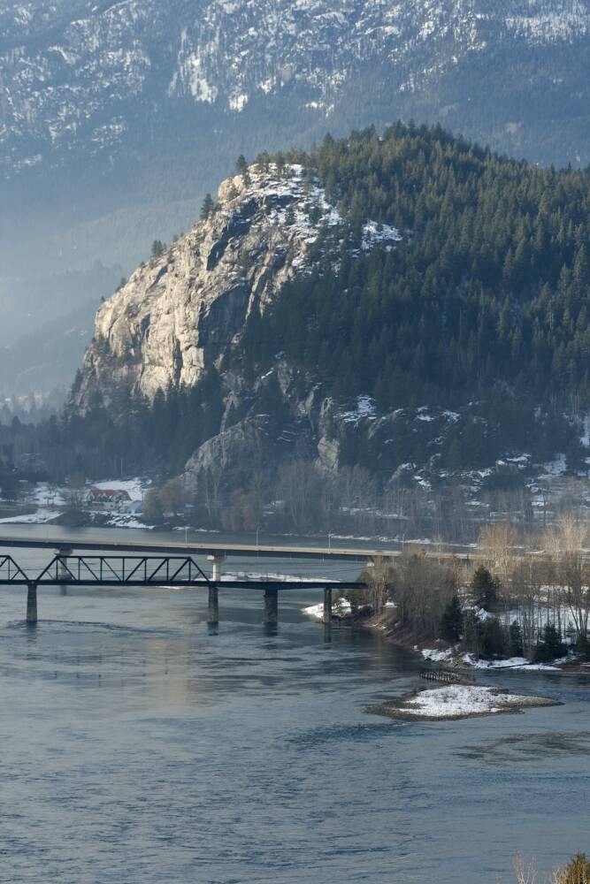
Geospatial Employment Lands Project
Purpose is to better understand the supply, demand and use of employment lands in the region
Compiling all available GIS data & identifying gaps
Providing an integrated geospatial / economic development analysis
Hosting series of forums to link research to planning
Creating a sustainable, web-based geospatial portal with site selection query functionality

Slide 27
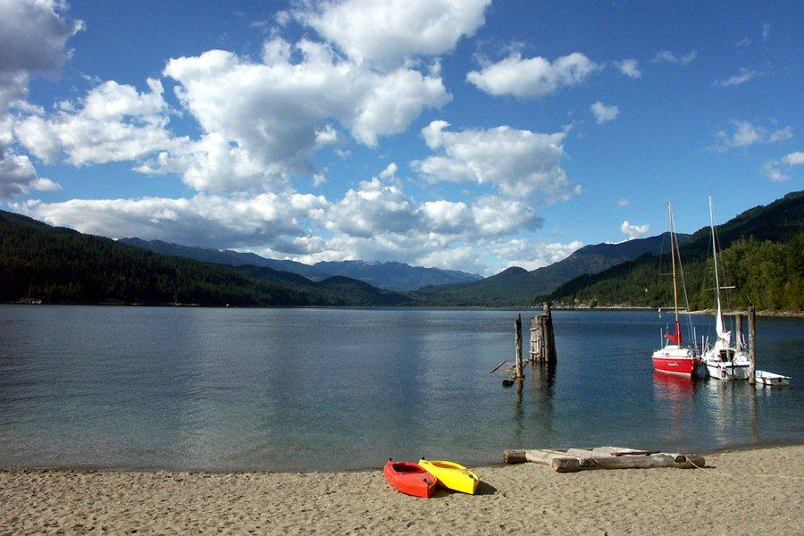
Business Retention & Expansion
Rural Pilot Project
  Best practice research & development of regional model
  Formation of a regional support network
  Pilot in 8 communities and build capacity through tools & training
  Conduct local, sub-regional and regional analysis & support related follow up and planning

Slide 28

Selkirk-SME Adoption of Digital Technologies Pilot Project
Link college expertise to SMEs in an effort to accelerate ADT
Better understand SME needs and college capacity to address these needs
Deliver ADT training through a series of workshops, short courses and online GIS courses
Provide advisory and direct support to SMEs
Notes:
Urban:
Cadastre (property fabric) with ownership
Zoning
OCP (official community plan)
Building points
Square footage of different building types (commercial, recreation, other public etc)
Transportation (road, rail)
Communications infrastructure (fibre, copper cables, radio towers, cell towers)
Front Country:
(not all places will have OCP or zoning)
Golf courses
Resorts (including ski resorts)
Other front country recreation & tourism
Border crossing, highway scales? as measures of transportation & ins and outs of resources
Agricultural land
Backcountry:
Forestry tenures
Backcountry tenures and lodges Trapping tenures
Mining tenures
Hydro-electric tenures including Independent Power Producers (IPPs).
Infrastructure ( information & communications like fibre backbones, hydro corridors, pipelines, radio towers, cell towers)

Slide 29
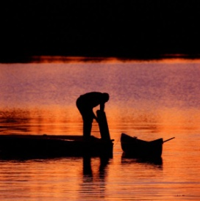
Attracting & Retaining Young Adults to Rural Regions KBM Project
  Identify & consolidate different forms of knowledge on young adult A&R
  Engage & profile young adult perspectives
  Identify & profile ‘best practice’ policies & programs
  Host a national conference to share perspectives & best practices

Slide 30
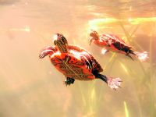
Rural Community Service Learning Partnership
Build the capacity of post-secondary institutions to support rural CSL
Provide opportunities for students to engage in rural CSL
Support regional rural development through rural CSL
Develop rural CSL partnership model that is replicable and sustainable
Notes:
Urban:
Cadastre (property fabric) with ownership
Zoning
OCP (official community plan)
Building points
Square footage of different building types (commercial, recreation, other public etc)
Transportation (road, rail)
Communications infrastructure (fibre, copper cables, radio towers, cell towers)
Front Country:
(not all places will have OCP or zoning)
Golf courses
Resorts (including ski resorts)
Other front country recreation & tourism
Border crossing, highway scales? as measures of transportation & ins and outs of resources
Agricultural land
Backcountry:
Forestry tenures
Backcountry tenures and lodges Trapping tenures
Mining tenures
Hydro-electric tenures including Independent Power Producers (IPPs).
Infrastructure ( information & communications like fibre backbones, hydro corridors, pipelines, radio towers, cell towers)

Slide 31
Challenges & Solutions from Year 1 of the RDI
Institutional constraints & limited capacity
→ projects to advance institutional culture
Perceived competing interests
→ build trust ‘by doing’ on ‘common ground’
Fracturing geography
→ strategic outreach, video conferencing
Limited awareness & managing expectations
→ communications plan, strategic outreach & build capacity ‘by doing’

Slide 32
Challenges & Solutions from Year 1 of the RDI
Single funding source
→ diversify, strategically leverage funds
Varying levels of rural community capacity
→ context-driven models & direct support
Rapidly growing research institute
→ build foundation based on year 1 needs
Integrating efforts of leading partners
→ governance group to co-create

Slide 33
The RDI Moving Forward… What is Needed?
Creating the Research Hub at www.cbrdi.ca
Growing Rural Researchers & Supporting Community-Based Research
Informing & Supporting Regional Collaboration
Brokering research partnerships with the colleges, universities & industry
Growing the Institute and further leveraging funding

Slide 34
Critical Ingredients
Purposeful & ongoing community engagement
Responsiveness & answering ‘so what’ questions
RDI to take a leadership role, colleges and CBT to do the same
Manage expectations & effectively communicate impact
Flexibility to ‘get things done’ is key & focus on ‘glass half full’
Leverage funding & focus on building capacity

Slide 35
Help Inform RDI Moving Forward
Are we on the right track? – Do the RDI research priorities resonate?
Inform SoTB analysis – feedback on analytic corridors & framework
Regional Online Research Library – out of region resources
Contact us – cbrdi@selkirk.ca Visit us: www.cbrdi.ca
Join us – sign up for our quarterly e-newsletter via website

Slide 36
CONNECT • UNDERSTAND • MOBILIZE
_________________________________________________________
Research Supporting Regional Collaboration:
The Case of the Columbia Basin RDI
October 12, 2012
Terri MacDonald, Ph.D
Regional Innovation Chair in Rural Economic Development
Selkirk College

