Slide 1
Restructuring of Rural Governance in a Rapidly Growing Resource Town: The Case of Kitimat, BC, Canada
Laura Ryser¹, Greg Halseth¹, & Sean Markey²
¹University of Northern BC, ²Simon Fraser University
CRRF 2017 – Nelson, BC

Slide 2
Outline
Background
Case study context: Kitimat, BC
Findings
Broader shifts in the neoliberal policy environment
From managerialism to entrepreneurialism
From government to governance

Slide 3
Background I
Post-war period
High demand for resources and limited competition
Prompted significant state investments.
New highways, instant towns, facilities, and services
Goal: improve quality-of-life to attract workforce

Slide 4
Background II
1980s recession
Senior governments / industries reduced their role in resource-dependent regions
Industry transformation
Automation, transportation / communication improvements, global competition, fluid capital / labour
Communities left with fewer job benefits / more exposed to commodity market fluctuations

Slide 5
Background III
2010s bursts of rapid growth
Neoliberal public policies had limited infrastructure and program investments
Absence of a comprehensive strategy for rapidly growing communities
Prompted pursuits for greater voice in decision-making / governance arrangements

Slide 6
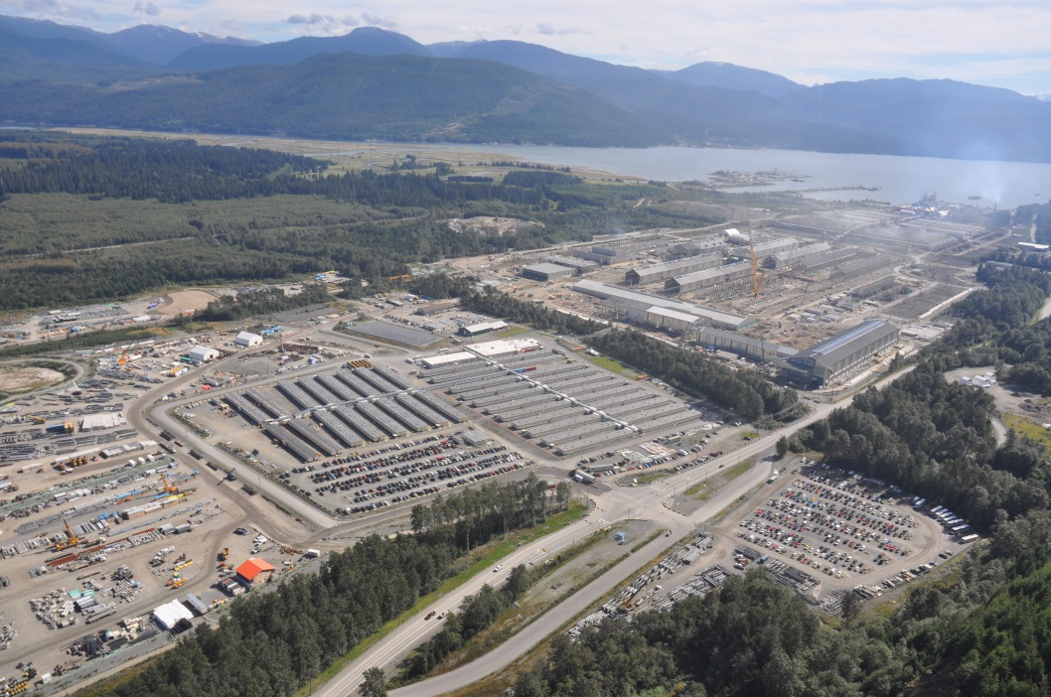
Case Study: Kitimat, BC

Slide 7
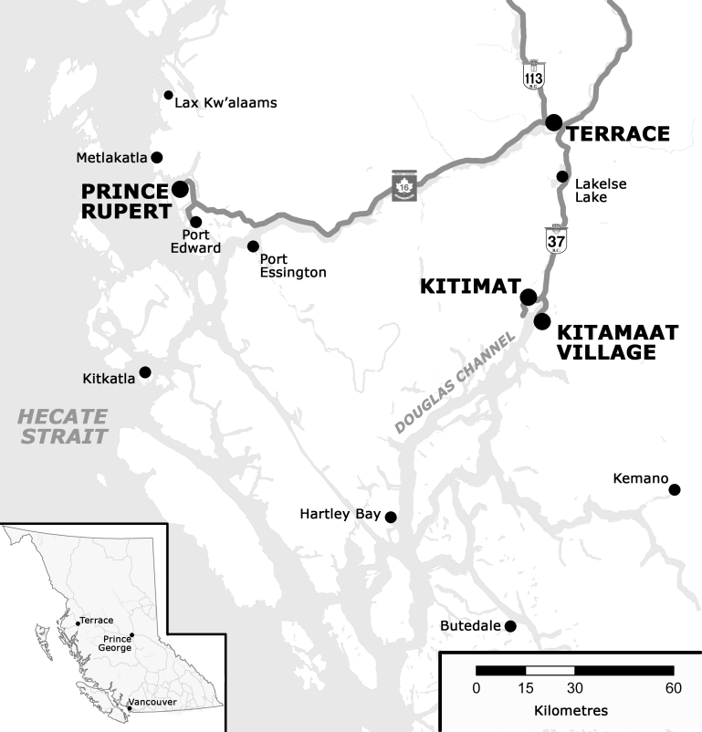

Slide 8
Context: Kitimat, BC
Industrial base : Alcan aluminum smelter (1950s), Eurocan’s pulp and paper mill (1967), and Methanex methanol and ammonia production (1980s)
Methanex (2005) and Eurocan (2010) closures – loss of 662 jobs
In 2010, Rio Tinto Alcan (RTA) announced the Kitimat Modernization Project at a cost of $4.8 billion
Required roughly 3,500 construction workers
Roughly 1,000 permanent jobs
Other proposed industry projects:
Port for proposed oil / bitumen / condensate pipeline / LNG projects

Slide 9
Study Design
Since 2012, 5 annual field research visits
During each visit, conducted between 37 and 45 interviews, for a total of 204 interviews
Residents, service providers, local government leaders / staff, industry reps, business leaders, and community groups
Tracked changes in community engagement and capacity, collaborative working and governance relationships, and strategic actions and investments
Latent and manifest content analysis

Slide 10
Findings
Neoliberal public policy shift
From managerialism to entrepreneurialism
From government to governance in decision-making / planning

Slide 11
Neoliberal Public Policy Shift I
Economic recession prompted local gov’t cuts
BC gov’t: any local gov’t effort to raise industry taxes would jeopardize LNG projects
Threat to apply port taxation policy to Kitimat
Difficult to re-establish provincial / federal funding
Local gov’t provided $200,000 emergency fund for social services
BC gov’t reluctant to invest in social housing
Local gov’t allocated funding to hire 2 housing support workers
Cold weather response shelter established by local gov’t, community groups, churches, BC Housing

Slide 12
Neoliberal Public Policy Shift II
The traffic on the roads…the bridge. I mean how many times has the bridge acted as a bottleneck over the last four years. How many years has the District of Kitimat been pounding on everybody’s door to upgrade that bridge? Probably we’ll be upgrading during the time of the next boom. We still, from a liability point of view, we still have an old bridge that if it went down right now, you and I would take two hours to get to the same place that we would normally get to in four minutes. Billions of dollars’ worth of industry would be isolated on the other side. (Kitimat Participant #15, 2015)

Slide 13
Managerialism to Entrepreneurialism I
Local government, Chamber of Commerce, and regional economic alliances
Strategic investments in long-term planning through gap analyses and worker attraction surveys, organizing an energy conference, and delivering procurement workshops
Enhanced understanding of industry criteria used to evaluate procurement bids
Financial and technical capacity, management structures, and past performance to determine the stability of the supplier

Slide 14
Managerialism to Entrepreneurialism II
Local gov’t introduced 5 year tax exemption on increase in assessed value for renovated commercial buildings with $25,000 investment in exterior
Pursued investments for aging housing assets
Strata conversion
Secondary suite incentive program provides 5 year forgiveable loan program to expand affordable / accessible units

Slide 15
District of Kitimat Secondary Suite Incentive Program
Type of Secondary Suite | Allowable Forgivable Loan
Any suite | $2,500
Level 1 affordable | $5,000
Level 2 affordable | $7,500
Any suite that is accessible for disabled | $2,500 (bonus)
District of Kitimat. N.d.

Slide 16
Managerialism to Entrepreneurialism III
Local gov’t introduced 5 year tax exemption on increase in assessed value for renovated commercial buildings with $25,000 investment in exterior
Pursued investments for aging housing assets
Strata conversion
Secondary suite incentive program provides 5 year forgiveable loan program to expand affordable / accessible units
Density bonusing scheme requires construction camps to make contributions to an affordable housing fund

Slide 17
From Government to Governance I
Eurocan closure and KMP prompted new governance groups
Tier One Dialogue Group focused on economic development
Tier Two Dialogue Group focused on social issues

Slide 18
Kitimat/Terrace Tier 2 Impact Dialogue Group Membership
Adult Literacy | Kitimat Victim Services
Adult Mental Health | Make Children First (Terrace)
Alcan | Ministry of Children and Family Development
Axis Family Resources | Ministry of Employment and Income Assistance
BC Schizophrenia Society | Northwest Community College
Child Care Resource and Referral | Northwest Regional Hospital
Coast Mountains School District #82 | Public Library
Community Development Institute, UNBC | RCMP
District of Kitimat – Council | MLA
District of Kitimat - Recreation | School Trustee
Family Justice Center | Skeena Diversity Committee (Terrace)
Kitamaat Village Council | Tamitik Status of Women
Kitimat Chamber of Commerce | Terrace Child Development Center
Kitimat Child Development Center | UNBC – Terrace Campus
Kitimat Community Services

Slide 19
From Government to Governance II
Eurocan closure and KMP prompted new governance groups
Tier One Dialogue Group focused on economic development
Tier Two Dialogue Group focused on social issues
Interagency Group (voluntary groups, service providers, local gov’t, industry, and chamber)
Early warning system to understand scope, scale, and timing of potential effects from KMP and smaller / related proposed projects
Led to: Housing Committee, the Violence Against Women in Relationships Coordination Committee, the Community Response Network, the Early Years Initiative, Integrated Case Management teams, etc.

Slide 20
From Government to Governance III
Collaborative structures:
Improved communication and access to information
Improved their understanding of protocols and procedures
Improved access to a broader range of resources and expertise
Shared human resources to deliver joint events
Achieved greater efficiency through joint service agreements and new protocols
Determined who could best address local gaps

Slide 21
From Government to Governance IV
Challenges:
Difficult to move beyond sharing information towards action
Different expectations and scales of operation
Different mandates and regulations
Conflicting approaches to partnership management and activities
Unwillingness to share resources, and a limited understanding of industry / Aboriginal protocols
Lack of funding, staff, and space to support collaboration at a local and regional level

Slide 22
Discussion: Senior Government
Neoliberal policy shifts have hampered capacity to respond to the rapid changes
Delayed investments and limited mobilization of adequate staff resources
No coherent senior government policy response to address new political economy

Slide 23
Discussion: Community Governance
Combined local resources may not be enough to maintain services and adapt
More symbolic of senior government abandonment than local empowerment
Governance mechanisms must better understand gaps and limitations
Become areas for senior government involvement and negotiation
Importance of pairing industrial investments with top-down supports to strengthen the viability of local and regional governance structures

Slide 24
Canada Research Chair, Rural and Small Town Studies
www.unbc.ca/greg-halseth/canada-research-chair-rural-and-small-town-studies
Resources:
Resource Royalties: Returns to Resource Producing Rural Regions
On the Move: Community Impacts of Long Distance Labour Commuting
Tracking the Social and Economic Transformation Process in Kitimat, BC
www.unbc.ca/community-development-institute
Resources: Lessons Learned in Work Camp – Community Relations: Practices Making a Positive Difference
www.onthemovepartnership.ca

