Slide 1
UNDERSTAND • CONNECT • MOBILIZE
Colleges Supporting Economic Development
The Case of a Regional Business Retention and Expansion Pilot Project
Dr. Terri MacDonald
Regional Innovation Chair in Rural Economic Development
Selkirk College

Slide 2
Agenda
The BRE Project
What You Can Learn from BRE
Economic Development Capacity Considerations
BRE in Action (within context)

Slide 3
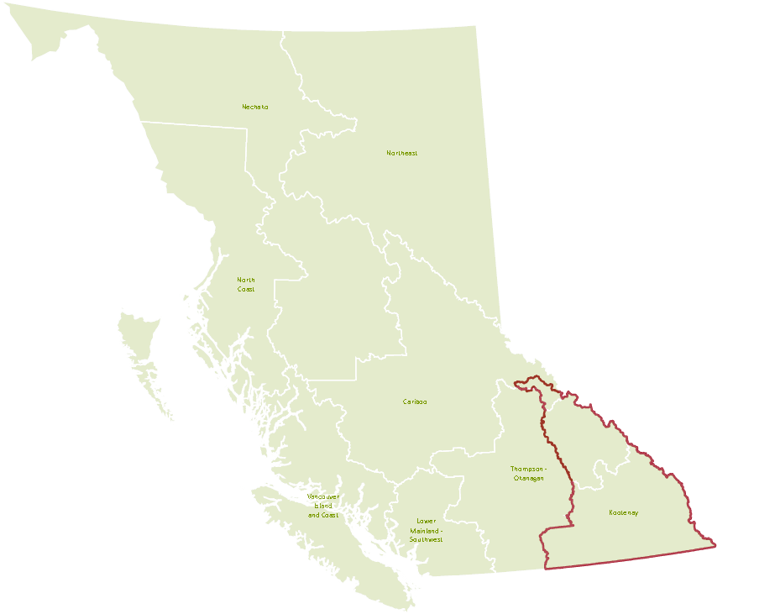
The Columbia Basin Rural Development Institute
Promote evidence-based decisions that lead to enhanced regional well-being through research and information provision

Slide 4
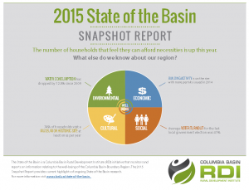
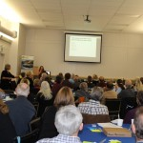
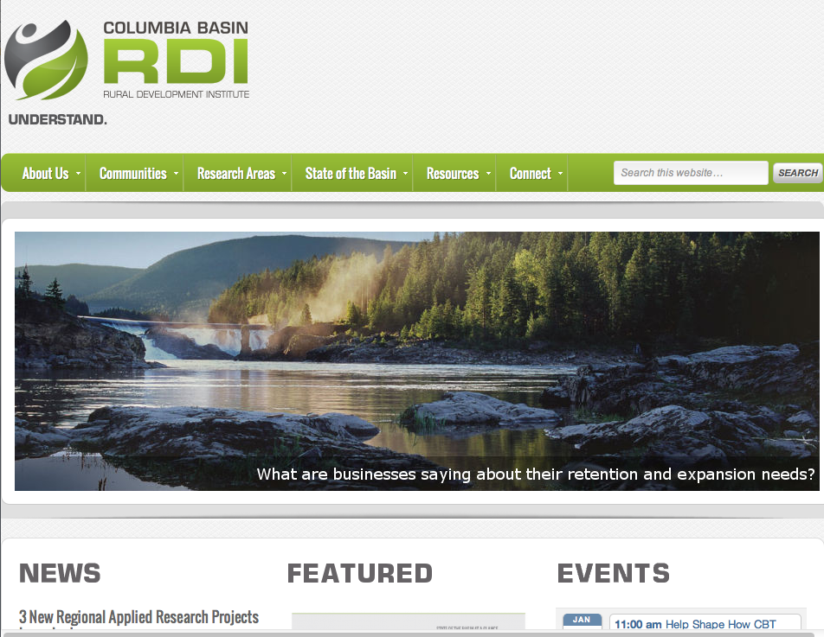
Rural Development Institute
Consolidate, Identify Gaps & Build Regional Knowledge
Regional Revitalization-Focused Applied Research
Innovation, Knowledge Transfer, Capacity Building & Collaborative Learning

Slide 5
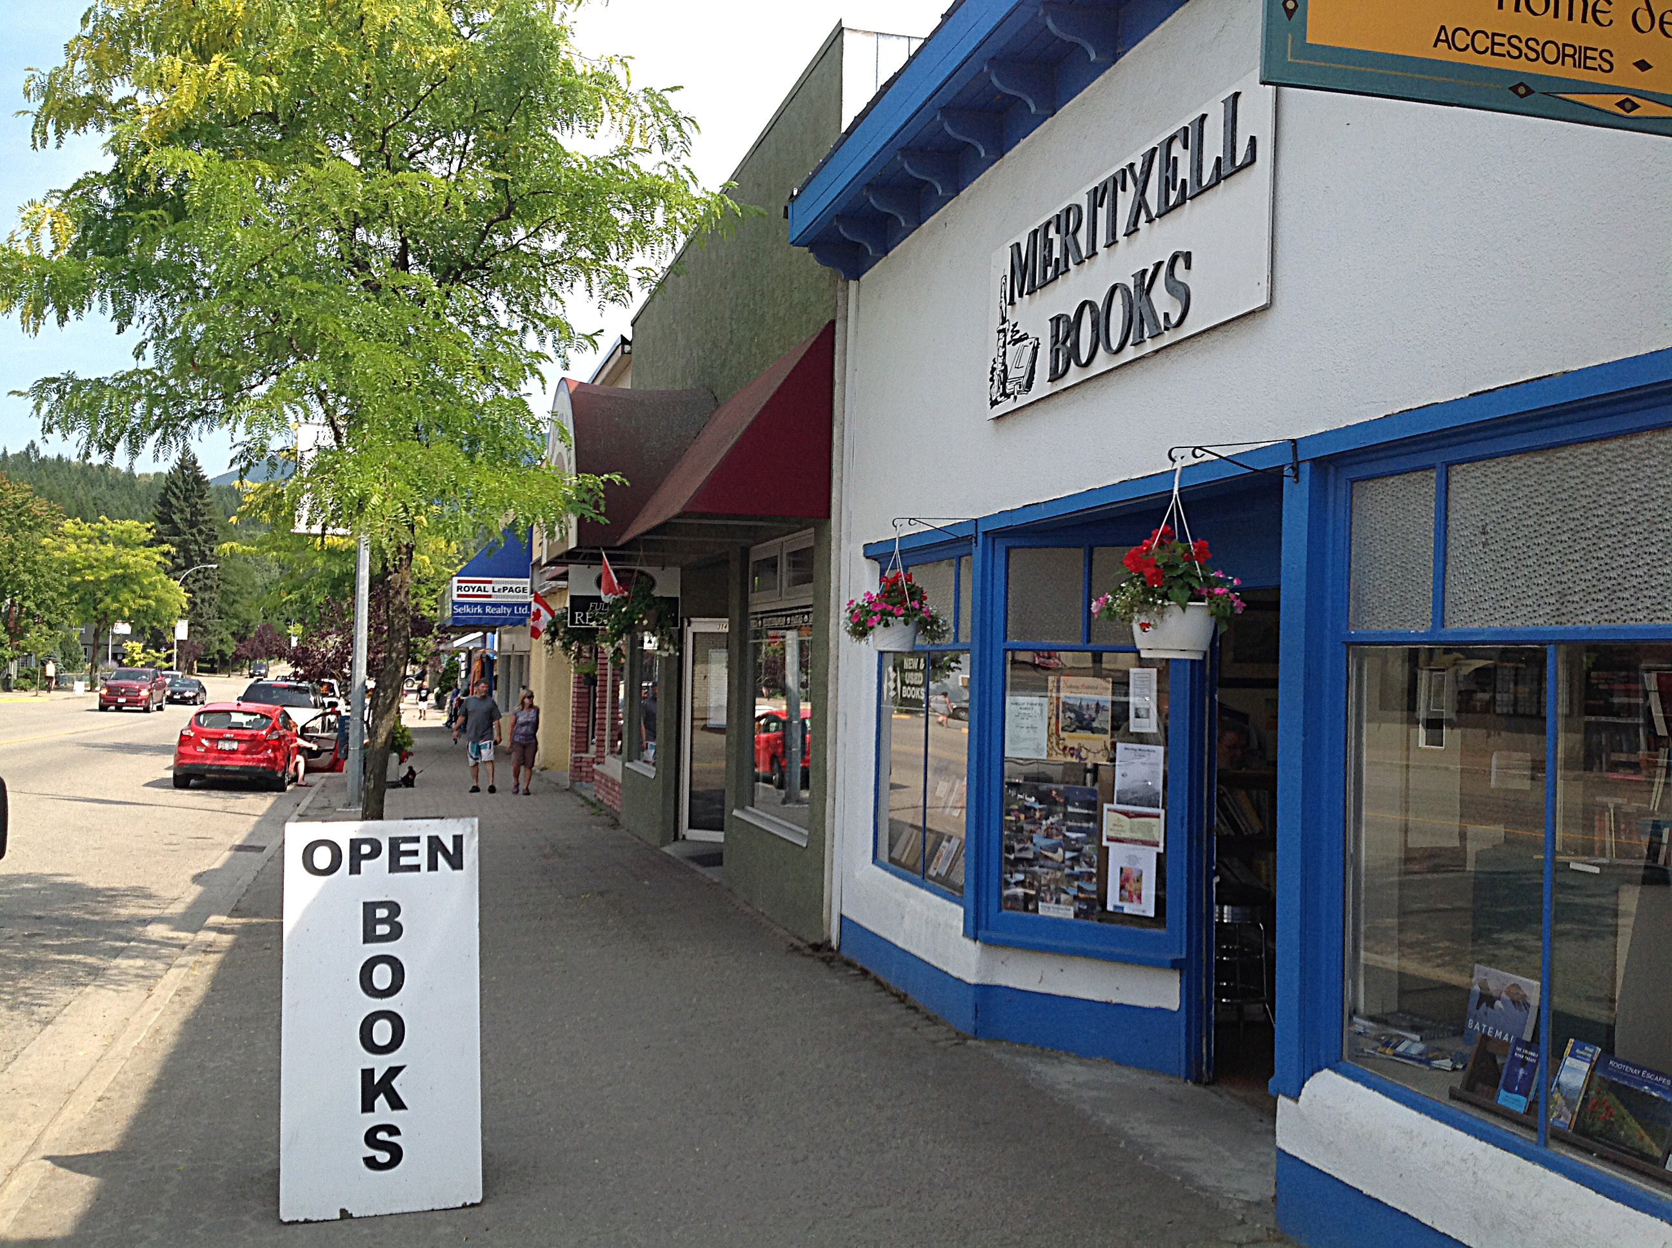
Region-wide priority resulting in applied research regional 3 year pilot
Community-driven, economic development ‘capacity inclusive’ & regional partnership framework (communities supporting each other)
‘Process’ support to communities based on best practices
Research support to off-set implementation costs and offer standard of analysis and reporting
Ties to provincial efforts via regional license to the BC Business Counts program (EDABC)
Regional and sub-regional level and sector specific analysis
The Need & Opportunity

Slide 6
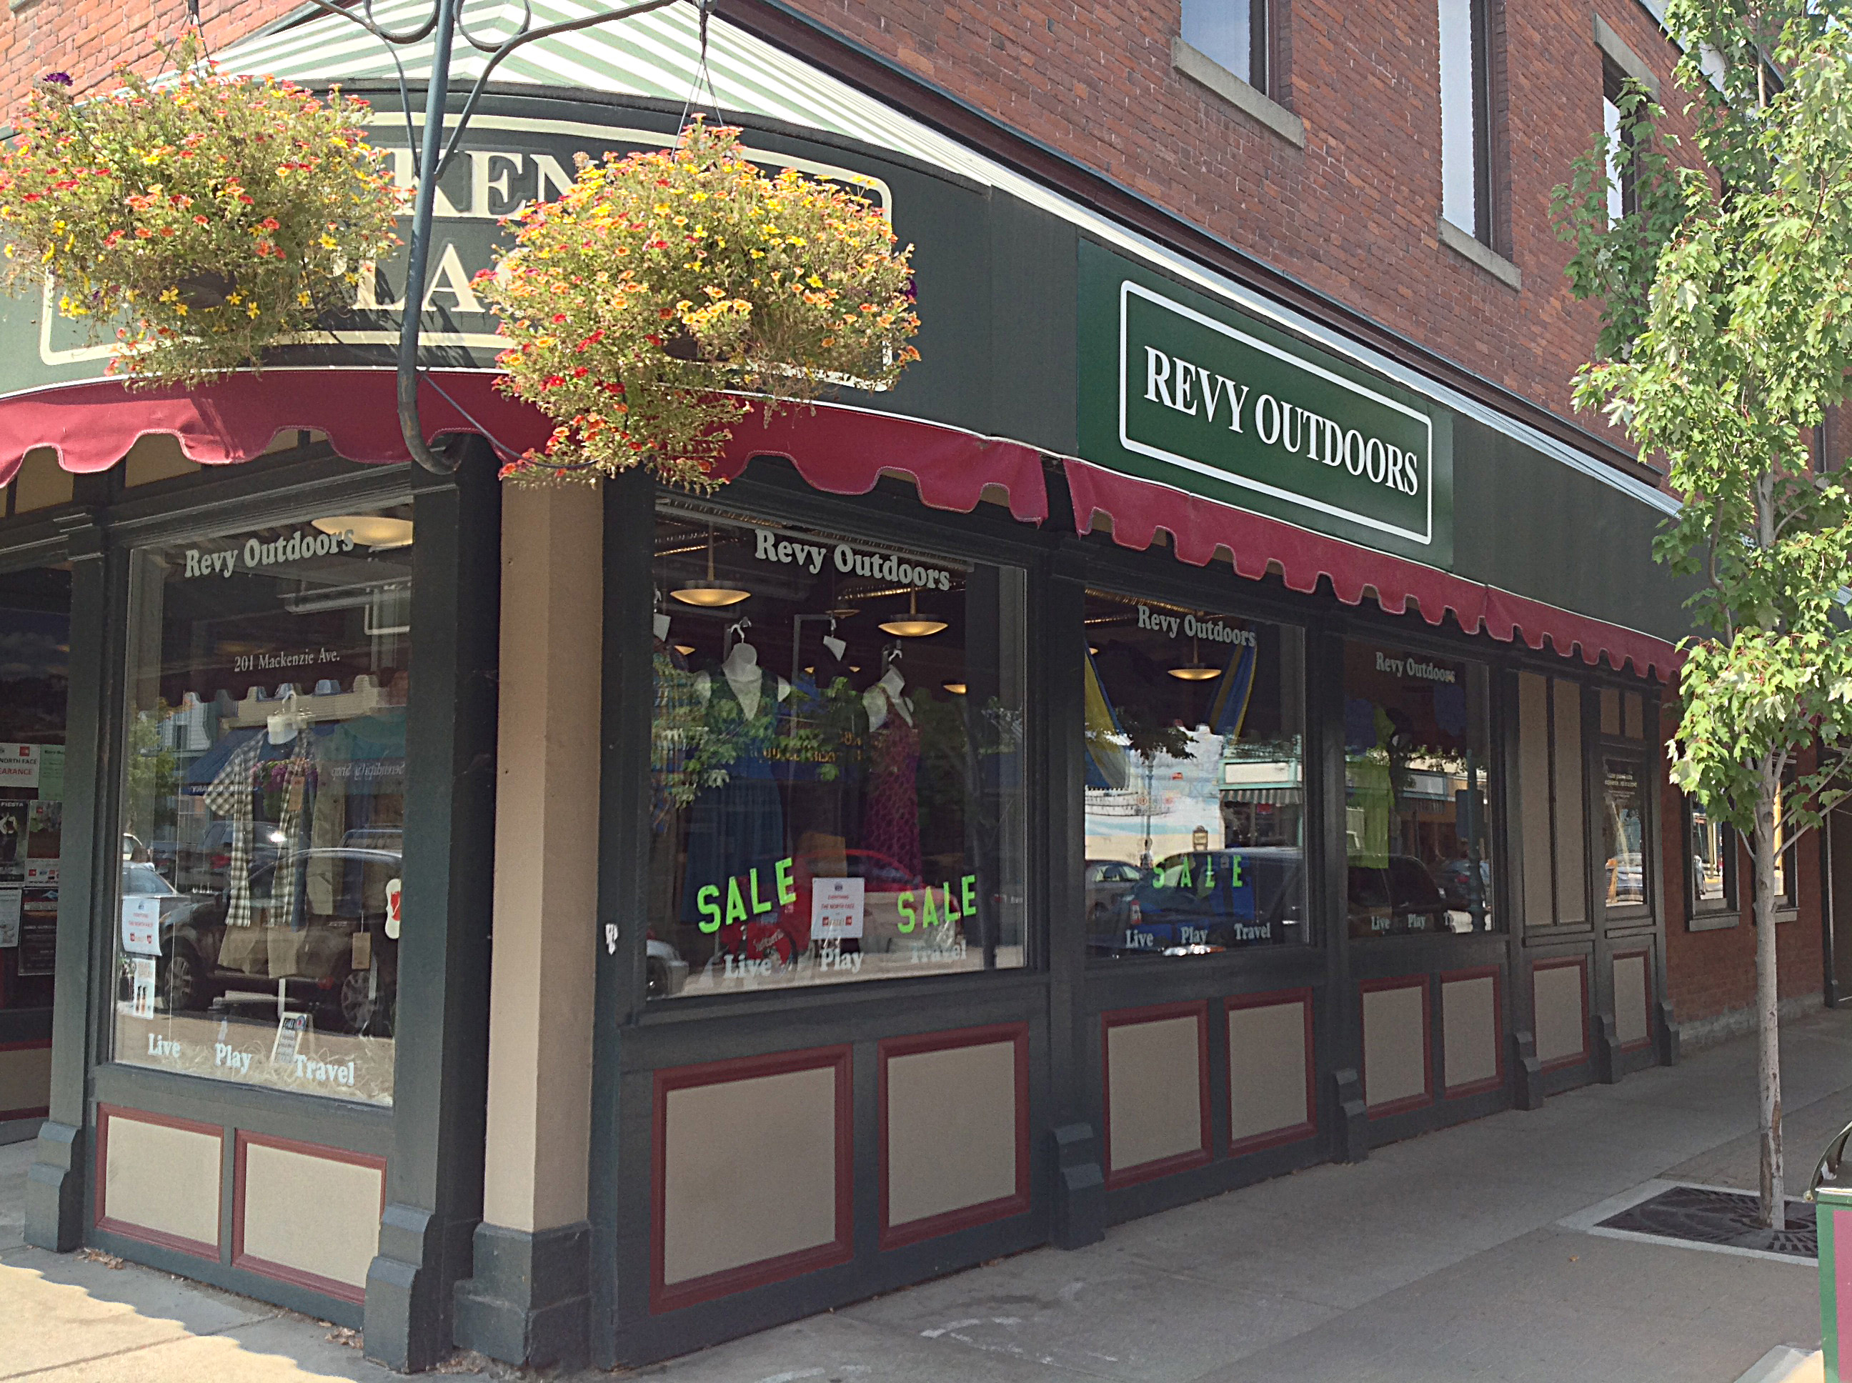
Literature review, best practices research and formation of a regional advisory group to guide the pilot project
Development & refinement of:
training materials & workshops for BR+E researchers
implementation framework and related processes & tools
analytic & reporting framework
reporting & follow-up products
metrics to measure local and regional impact
In-kind research support from RDI and additional community-level funding from CBT to support local implementation and follow up costs
Co-Constructing the Model

Slide 7
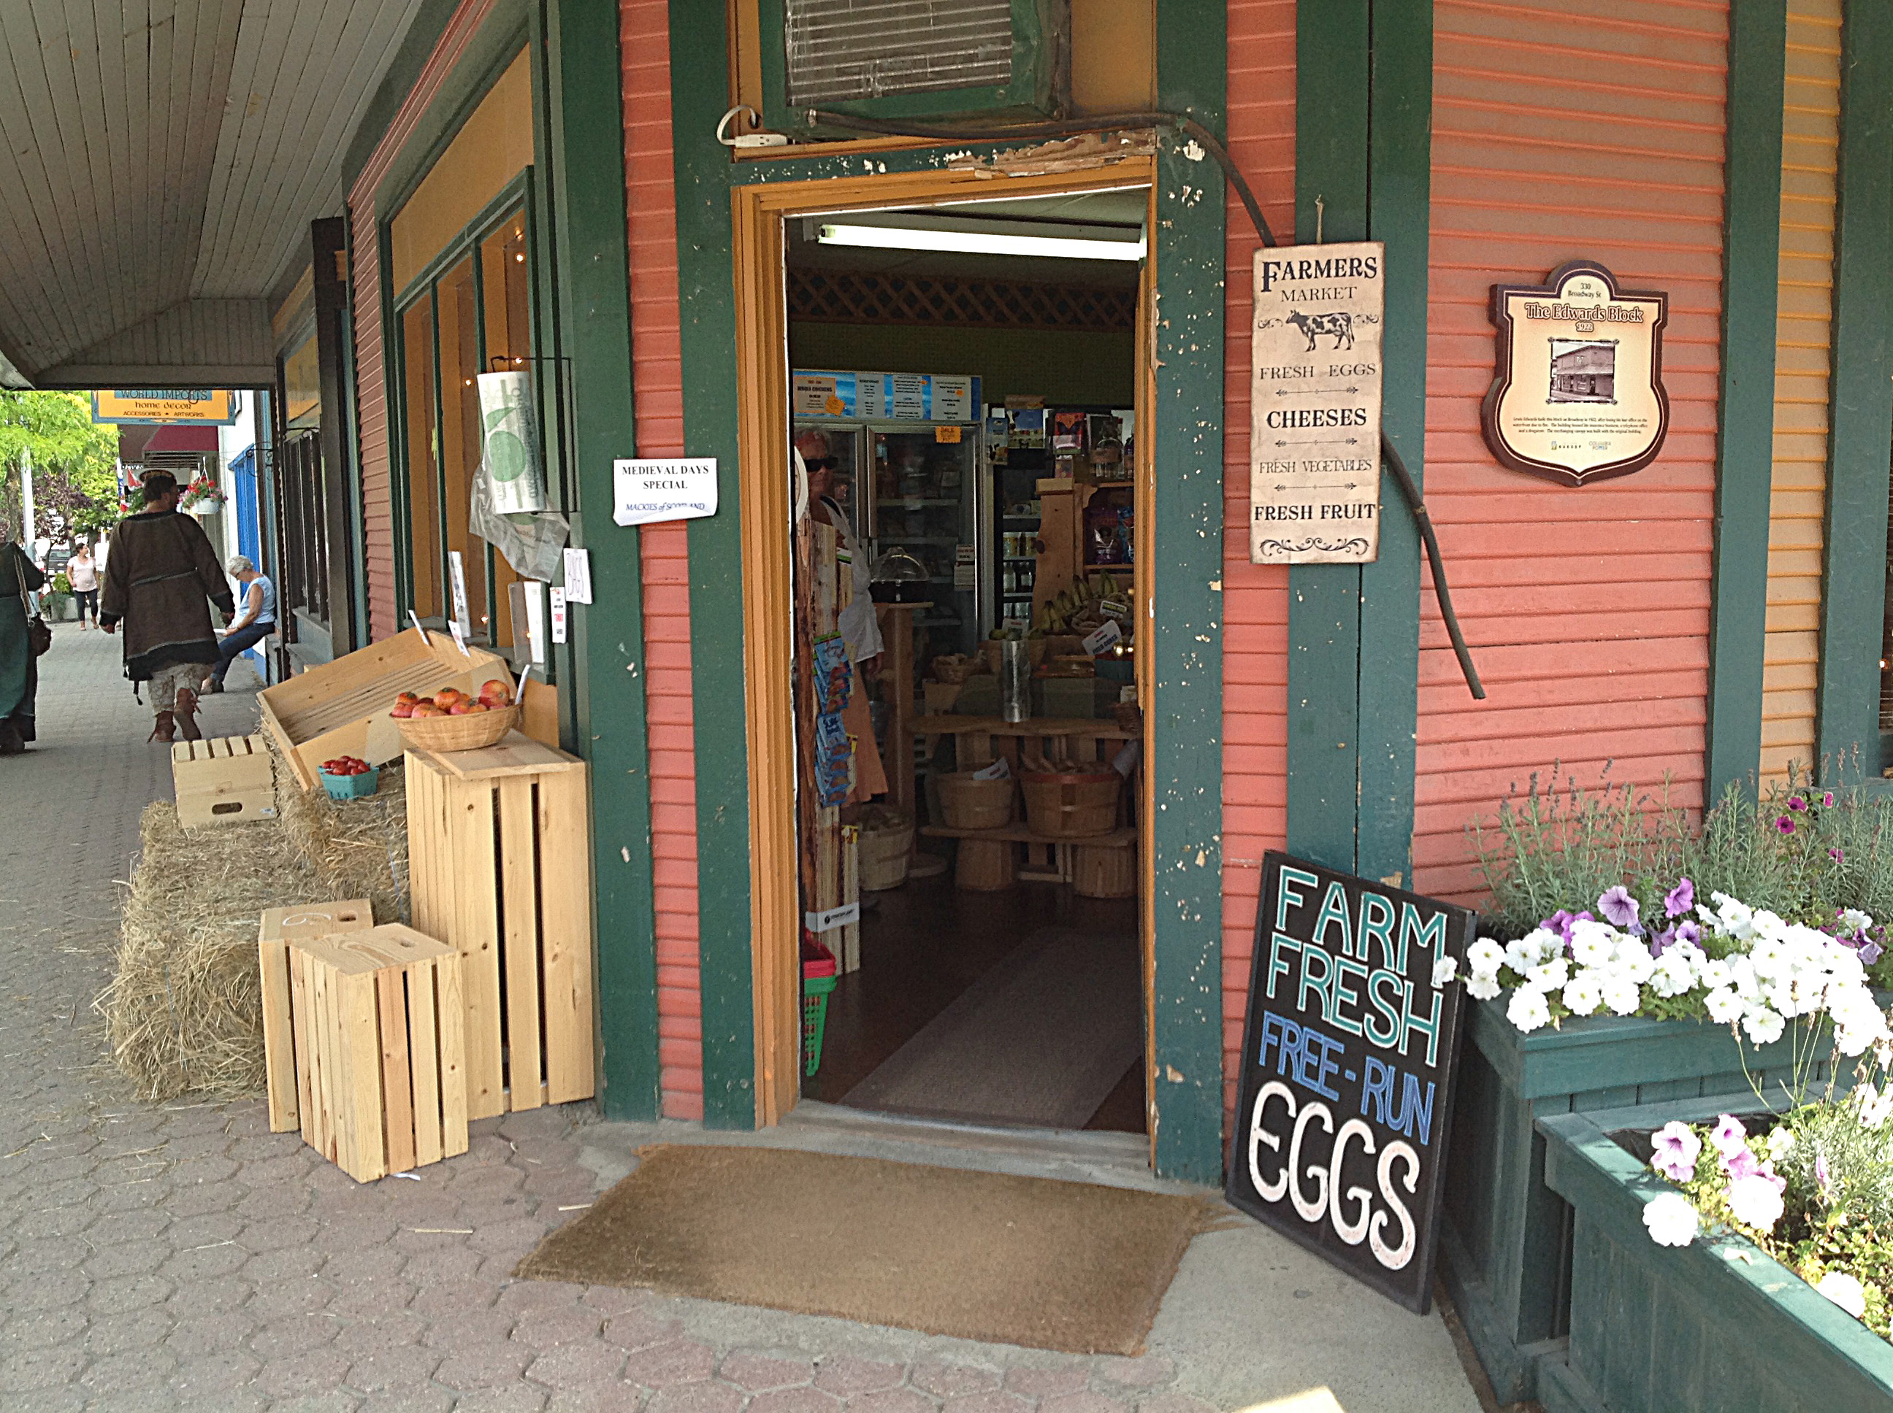
Structured, survey driven interviews by EDPs, service providers and / or paid researchers (data focused but not compromising building of relationships)
Rigorous research protocol and analysis to allow for trust and confidence in BRE results
Collaborative regional model, community-based implementation encouraging sharing of lessons learned and cross-referrals
Evolving model based on ongoing feedback from BRE partners
Our Regional, Community-Driven Model

Slide 8
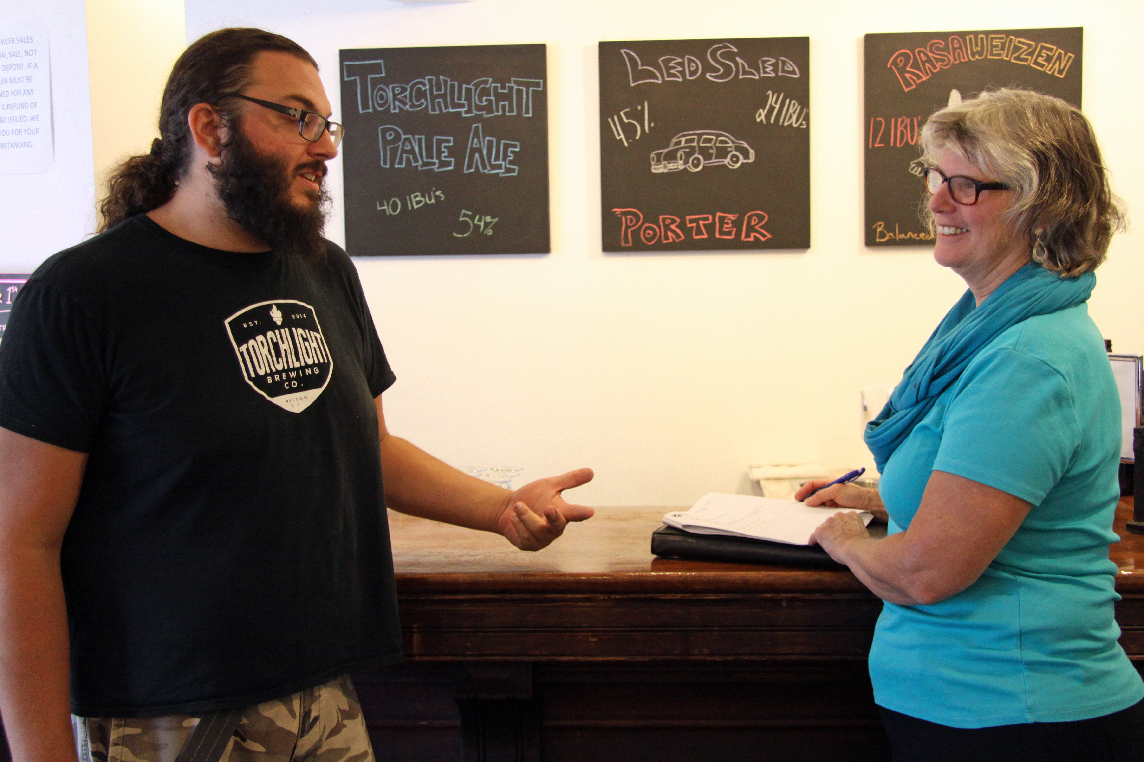
Do we have a core group who understand BR+E and will commit the time to champion local implementation? (including CF, local government, Chamber, EDO or ED group)
Do we have an established volunteer base with the ability, willingness and time to be active participants in the process?
Do we have adequate financial resources to carry out a BR+E?
Are we committed to follow-up on recommended actions and links to planning?
Assessing Community Readiness

Slide 9
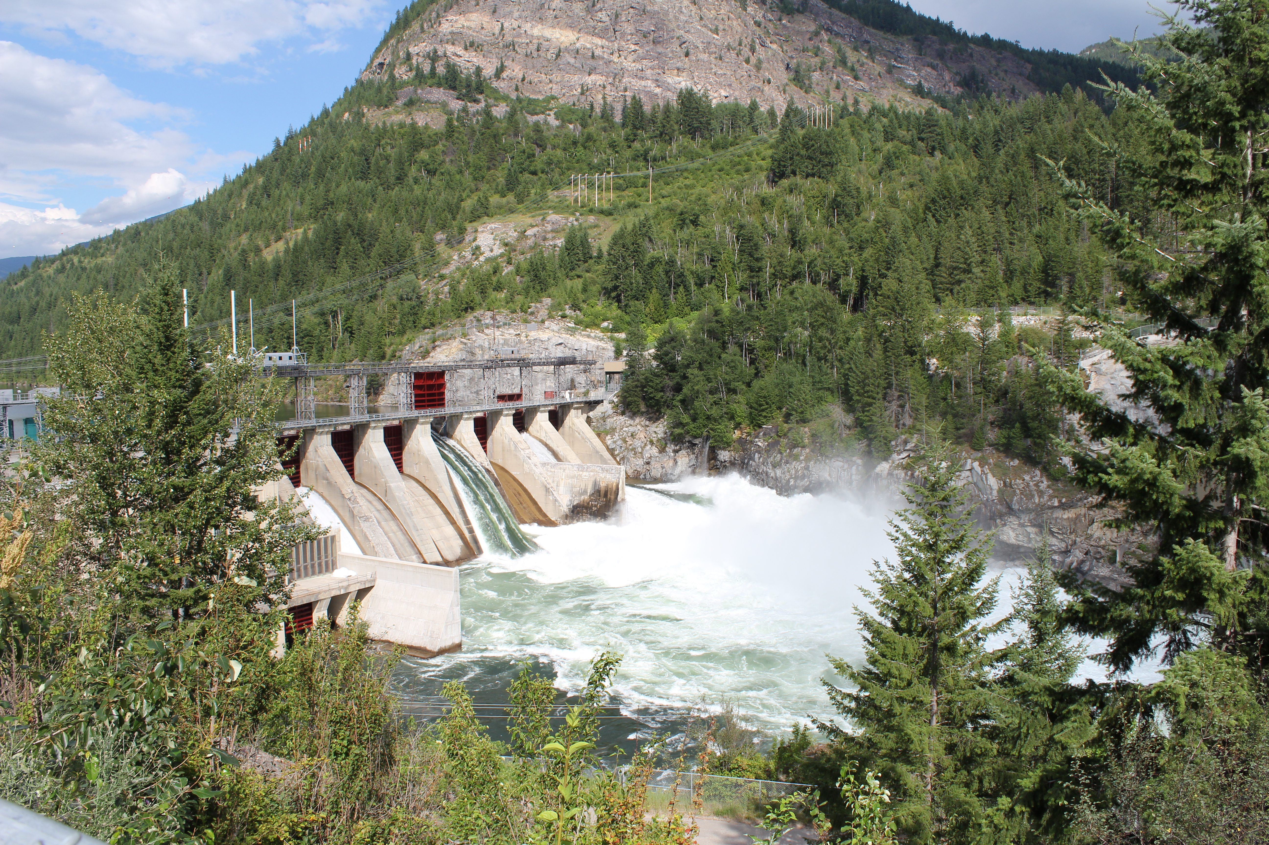
Pre-Planning: Defining Community Objectives
Identify the purpose of the project
To understand the business climate in general
To understand the businesses with the most growth potential
To understand a sector or sectors with the most potential
To understand major employers
Identify the geographic scope of your project
Municipality only
Municipality and adjacent regional district area(s)
Corridor (i.e. municipalities and adjacent regional district area(s)
Regional District or Economic Region
Identify the businesses in your ‘community’ & scope of project
Business license database (in municipalities only)
Steering committee to brainstorm list of businesses (RD areas)
Identify target number of businesses (minimum 35)
Random sampling or targeted approach
Consider both sector and size of business for random sampling

Slide 10
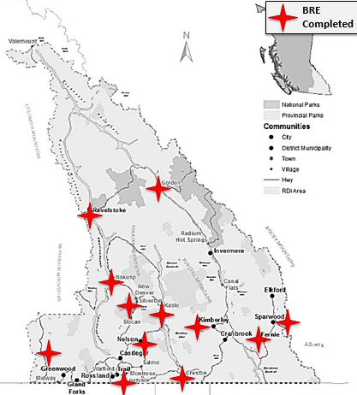
Business Retention & Expansion
Over 1100 businesses interviewed
30+ partnerships (local government, Community Futures, Chambers of Commerce, Development Boards, provincial government, provincial economic development association, Columbia Basin Trust)
Primary sectors include retail trade, professional services, manufacturing, and accommodation & food services
Over 140 hour on implementation tools,700 hours of direct research support and over 150 hours of training
7 faculty and students involved
5 faculty
2 co-op students
Notes:
Communities implement their BRE projects using tools and processes developed by the RDI. RDI provides training and direct research support (data analysis, report writing, presentation of findings to community) and links to resources to assist in related economic development planning and action.

Slide 11
BRE Communities
Economic Region | Companies
Boundary (Grand Forks, Greenwood, Midway) | 41
Cranbrook (Innovation Councils – sector specific) | 27
Castlegar (Innovation Councils – sector specific) | 6
Regional District of Central Kootenay | 68
Columbia Valley | 9
Creston | 43
Fernie | 81
Golden | 109
Kaslo | 80
Kimberley | 60
Regional District of Kootenay Boundary | 19
Lower Columbia (Trail, Rossland, Fruitvale, Montrose) | 167
Nakusp | 46
Nelson | 107
Revelstoke | 134
Slocan Valley | 81
Sparwood | 65
Grand Total | 1143

Slide 12
What retention and expansion challenges and opportunities are the region’s businesses experiencing?
How have economic development practitioners and business support providers responded to these needs and what challenges have they faced?
In what ways can locally collected data on businesses inform local and regional level planning?
Notes:
There is a strong theme through all interviews: gratefulness for access to well resourced EDOs, or frustration with the lack of access to a resourced EDO.
In communities with strong and committed EDOs, successful programs and activities are more likely to occur.

Slide 13
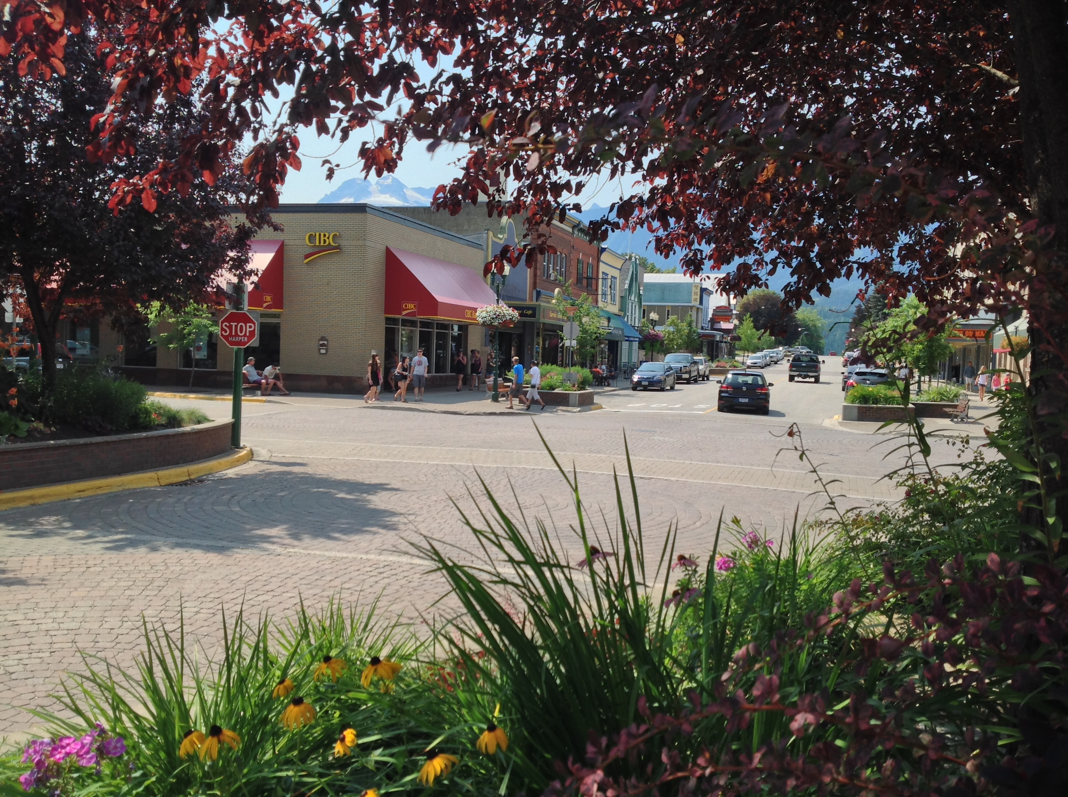
Lessons Learned from RDI BRE Pilot
Businesses do want to talk
It has been more about green flags than red
Expect 4 hours from start to finish for each business, implementation of project estimated 6 months with follow-up ONGOING
The findings are useful in informing ED planning and do point to concrete action
Context matters – process needs to be customized to meet the unique needs of each community

Slide 14
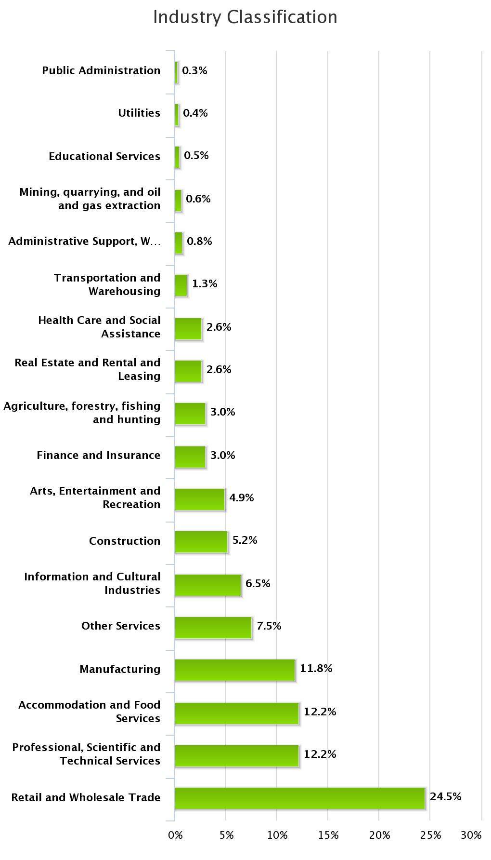
Highlights from Three Years of BRE
Re: Company Information
Biggest representation was from the Trade Sector: both Retail and Wholesale
(195 businesses)
Almost even representation from:
Professional, Scientific, and Technical Services
(97 businesses)
Accommodation and Food Services
(97 businesses)
Manufacturing (94 businesses)

Slide 15
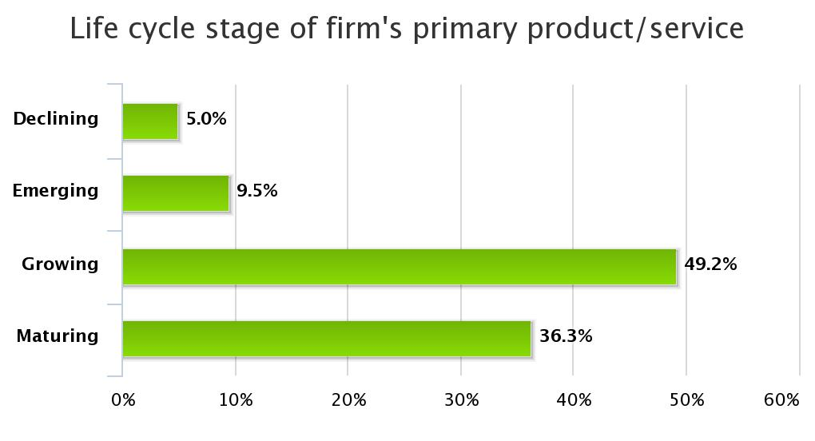
Highlights from Three Years of BRE
Re: Company Information
Almost half of businesses surveyed are in a growth phase

Slide 16
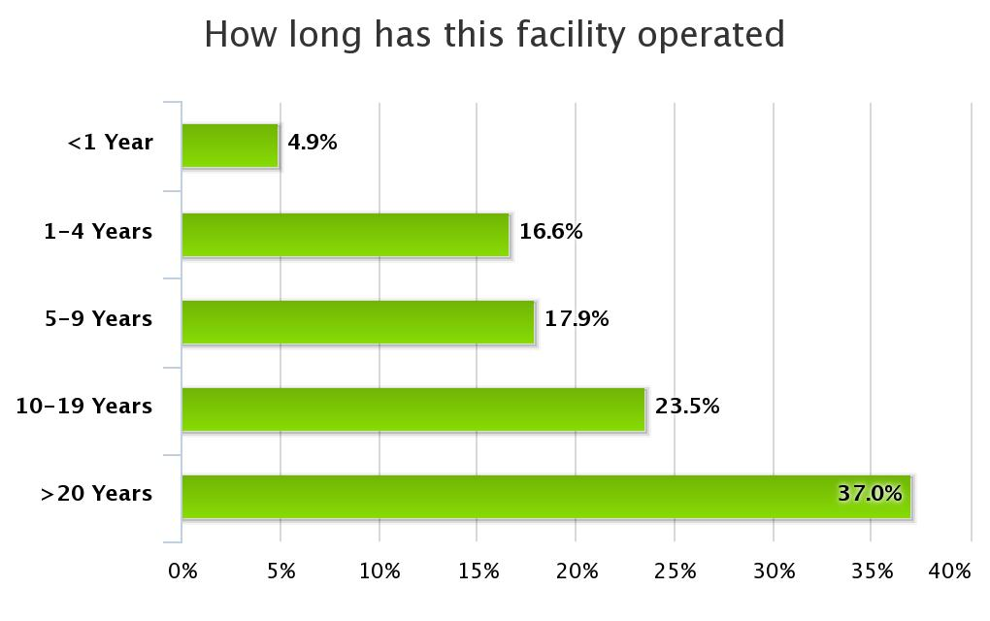
Highlights from Three Years of BRE
Re: Company Information
Impressive stability in the business climate
Over half the businesses have been operating for over 10 years!

Slide 17
Highlights from Three Years of BRE
Re: Company Information
Does your company have a current business plan?
Over half of the region’s businesses (383) have a current business plan
Only 17% (114 businesses) have a current succession plan
125 businesses plan an ownership change in the next three years

Slide 18
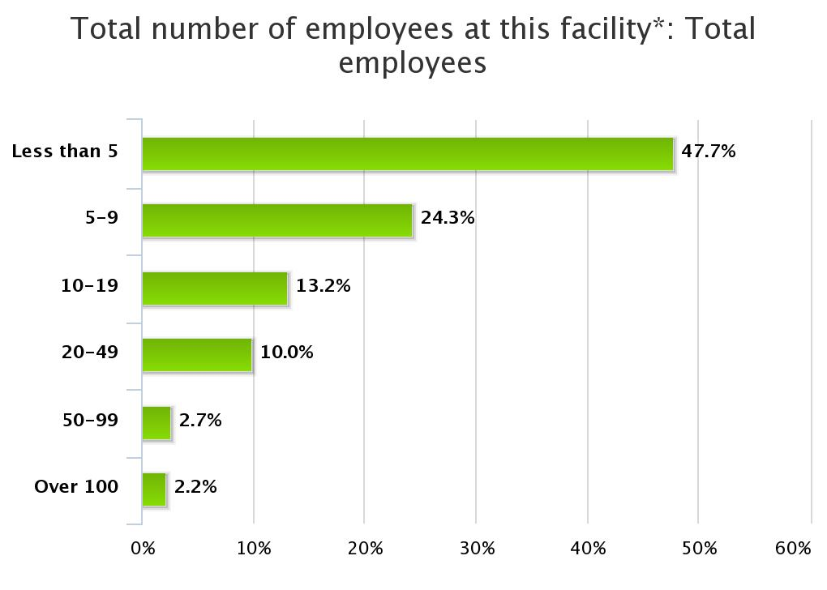
Highlights from Three Years of BRE
Re: Local Workforce
Most of the region’s businesses (373) are smaller employers (fewer than 5 employees)
2.2% (17 businesses) are large employers, with over 100 employees

Slide 19
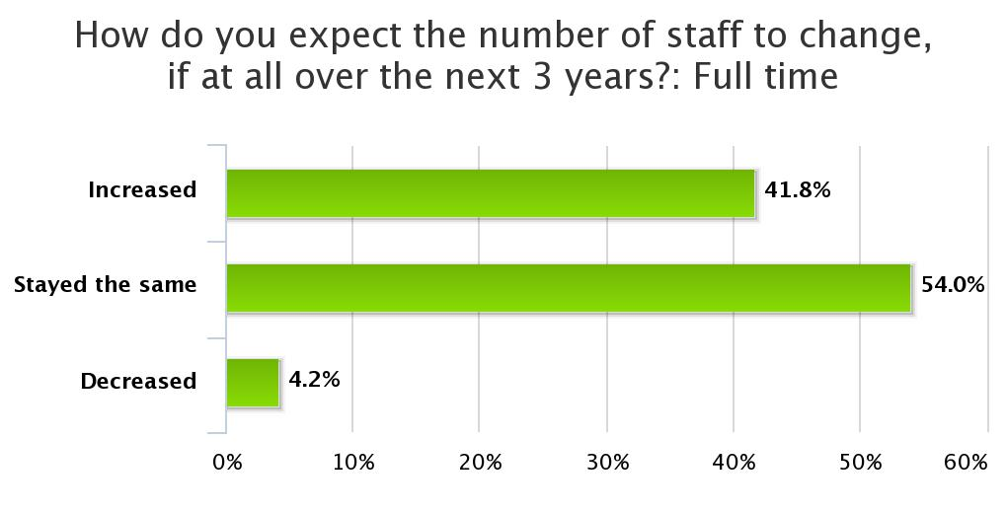
Highlights from Three Years of BRE
Re: Local Workforce
42% (266 businesses) expect the size of their full-time workforce to increase
54% (344 businesses) expect the full-time workforce to remain steady

Slide 20
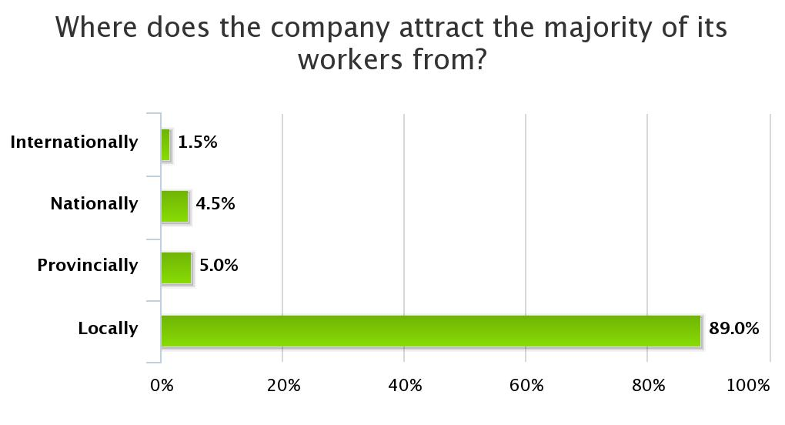
Highlights from Three Years of BRE
Re: Local Workforce
Almost all recruitment is occurring in the local job market

Slide 21
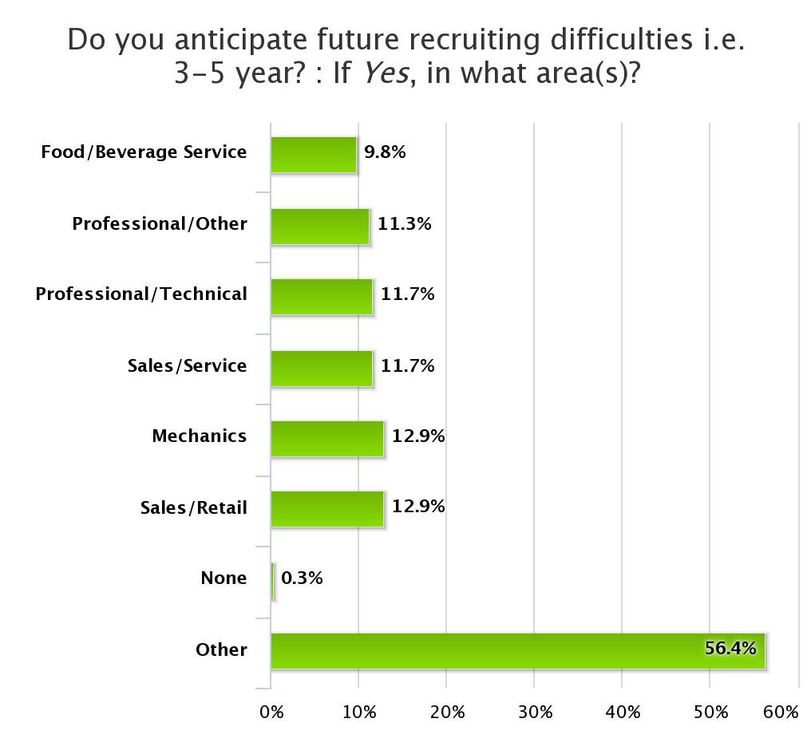
Highlights from Three Years of BRE
Re: Local Workforce
There are foreseen workforce shortages
Service industry (retail, food & bev, and service sales)
Technical training (mechanics, professional and high-tech)

Slide 22
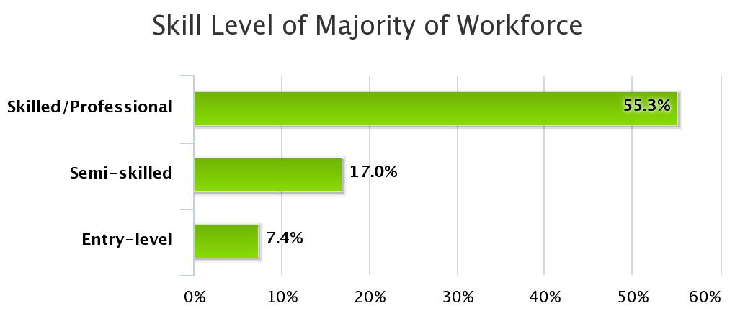
Highlights from Three Years of BRE
Re: Local Workforce
Most opportunities are in the skilled or professional category
368 businesses say the majority of their workforce is skilled or professional

Slide 23
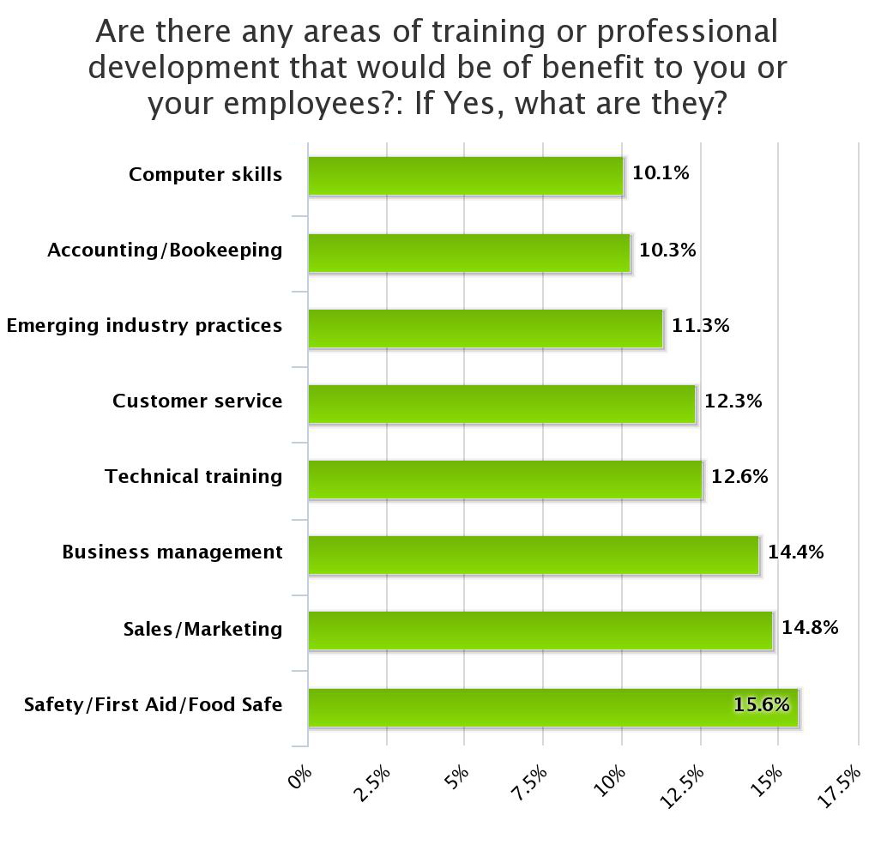
Highlights from Three Years of BRE
Re: Local Workforce
Training needs mostly line up with workforce skills shortages, but…
Support for business management skills
Emerging industry practices
Both speak to hunger for more sophisticated management

Slide 24
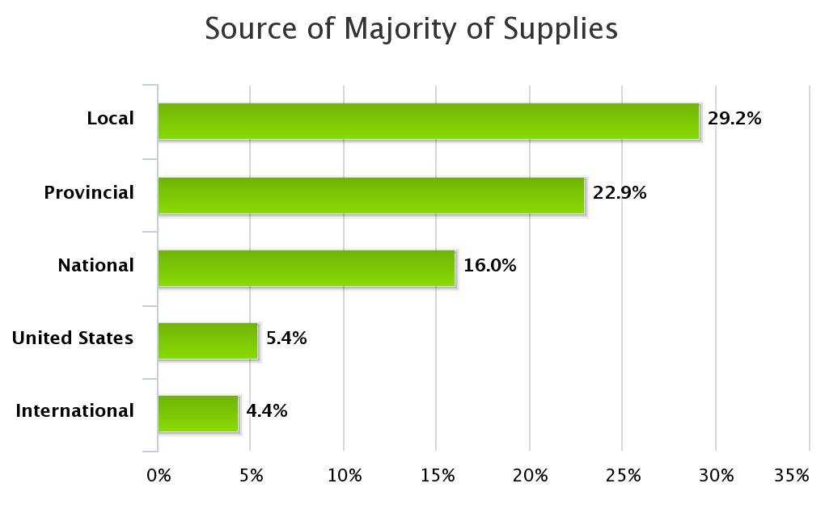
Highlights from Three Years of BRE
Re: Sales
Yet!..
Only 29% (209 businesses) buy their supplies from the local market

Slide 25
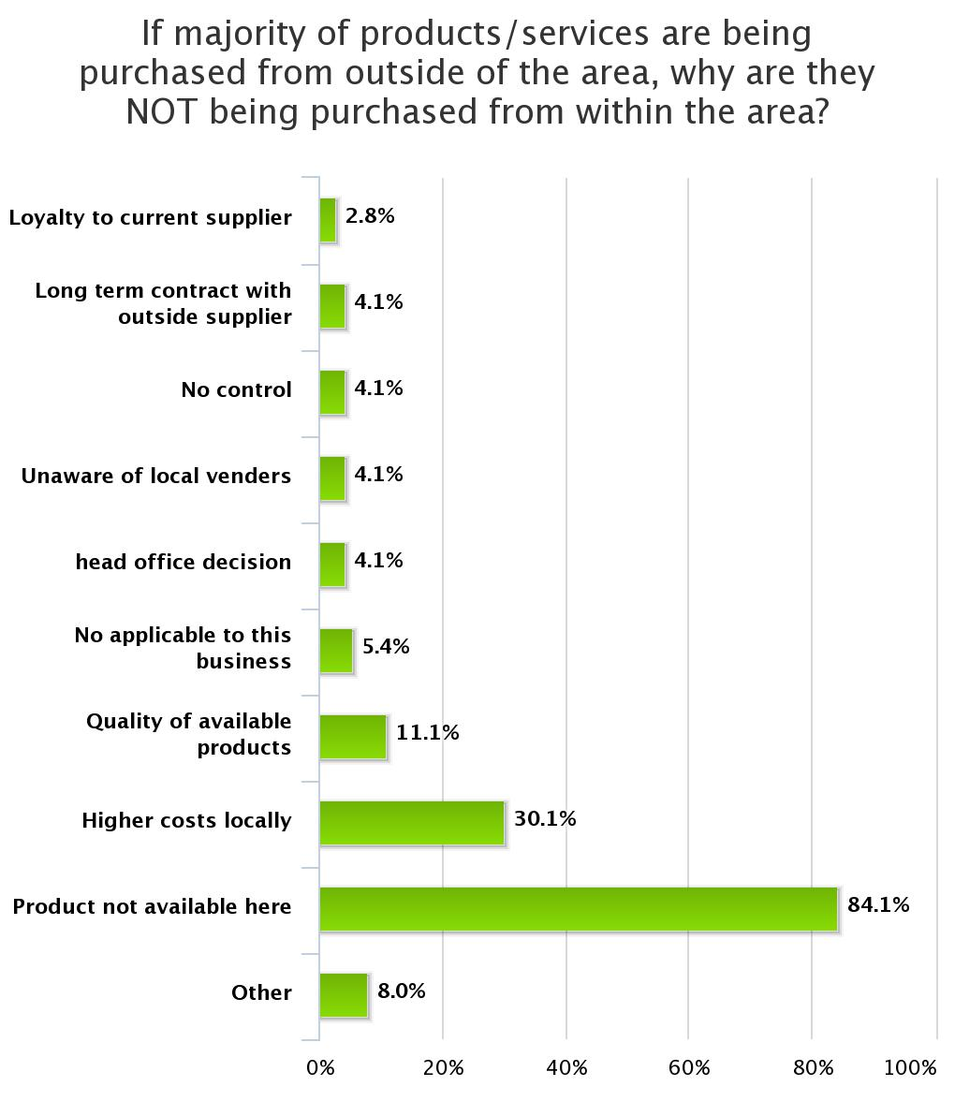
Highlights from Three Years of BRE
Re: Sales
Availability and costs drive local businesses to buy supplies out-of-region

Slide 26
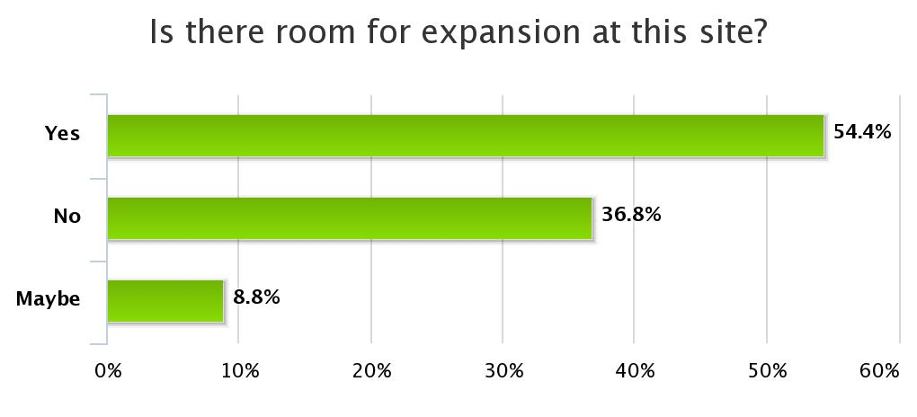
Highlights from Three Years of BRE
Re: Facilities
54% (or 358 businesses) indicate that they have room to expand at their current site
66% (or 227businesses) say their current site is adequate for expansion

Slide 27
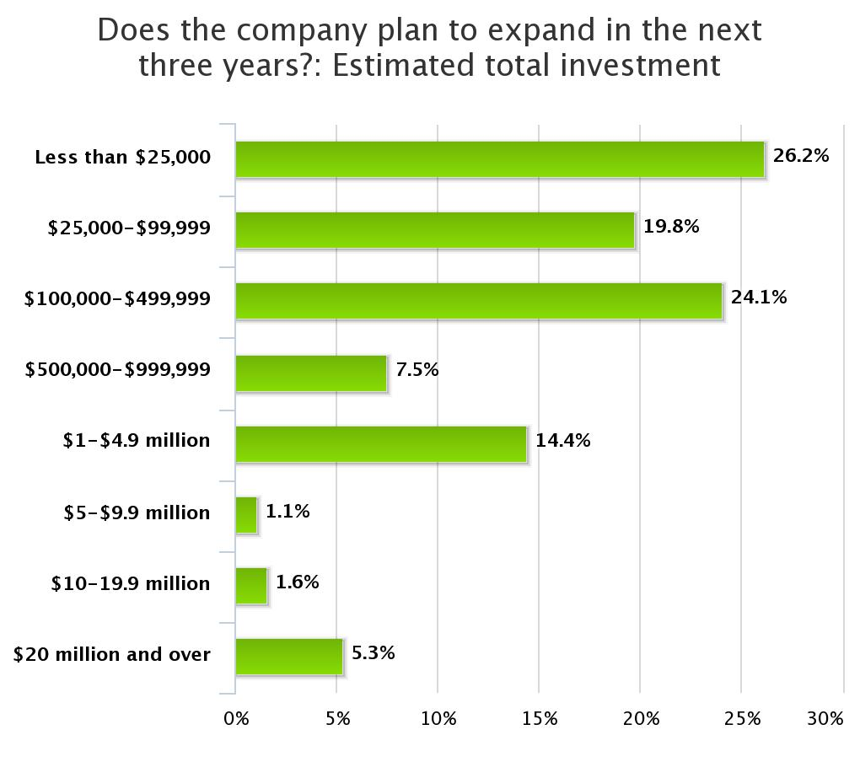
Highlights from Three Years of BRE
Re: Facilities
86% (304 businesses) are planning their expansion within their current communities
Most (70%) of the investments are modest (under $500K)
These represent roughly $420M in regional investment plans

Slide 28
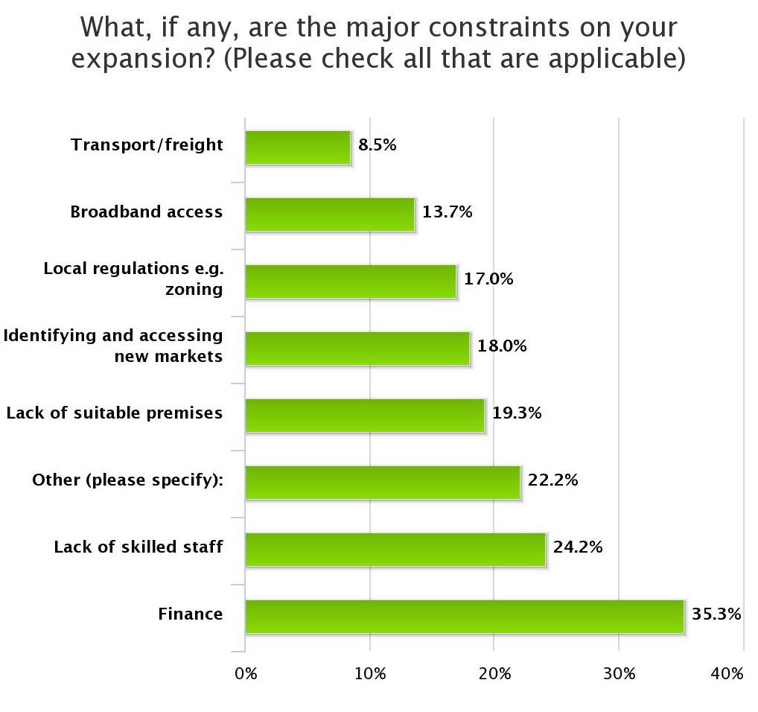
Highlights from Three Years of BRE
Re: Facilities
Finance is the leading barrier to expansion
Followed by
Lack of skilled staff, and
Lack of suitable premises

Slide 29
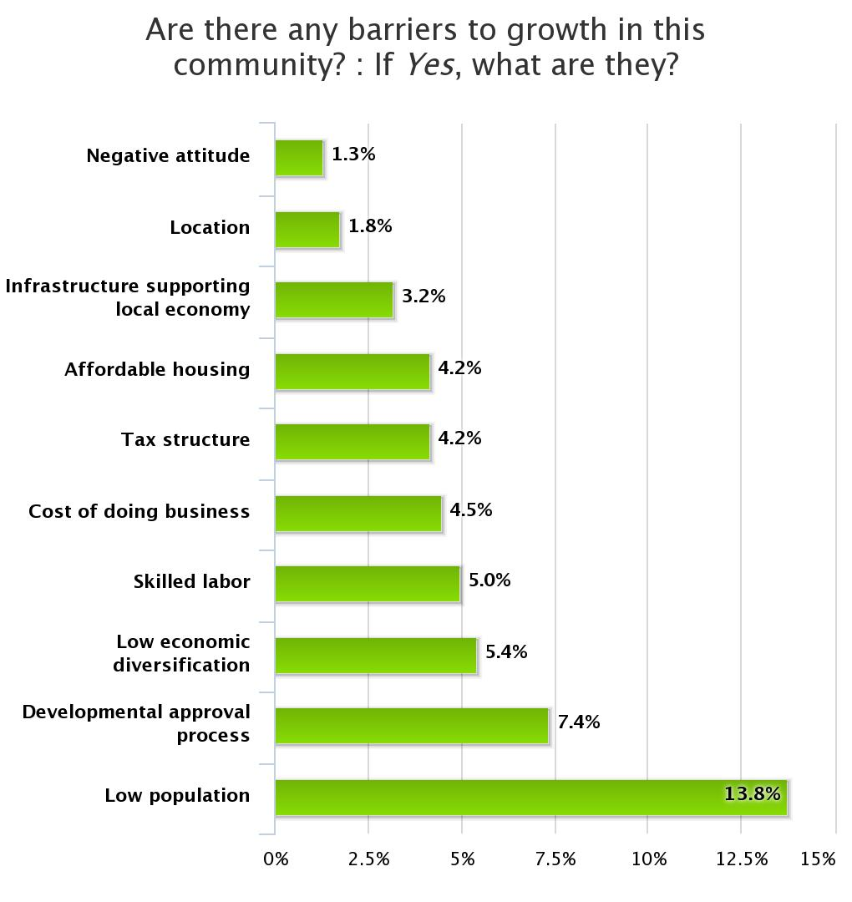
Highlights from Three Years of BRE
Re: Business Climate
Barriers to growth are focused on
demographics,
red-tape,
economic diversity,
workforce skills and
high-costs of rural setting

Slide 30
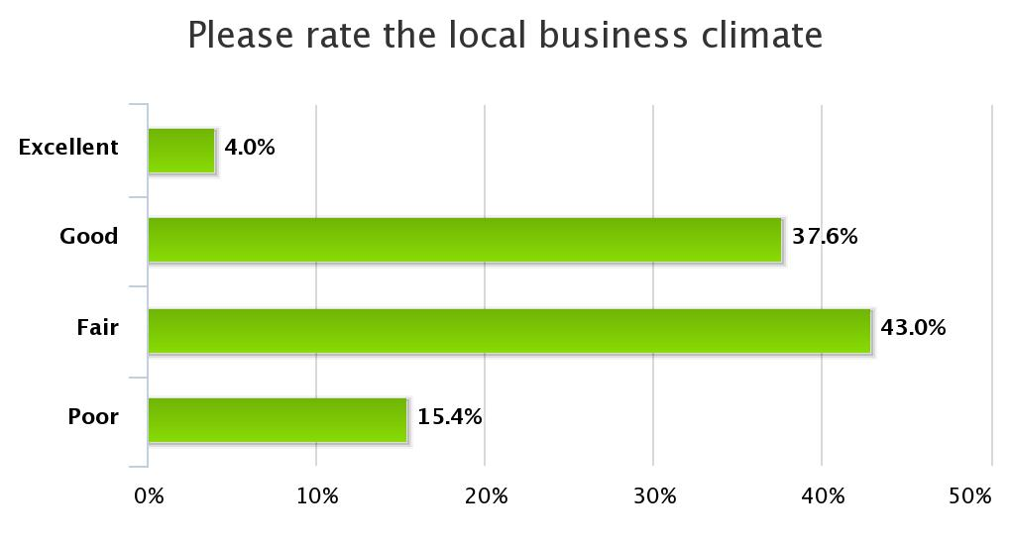
What our Businesses Have to Say: Business Climate
58% rate as poor or fair
N=752
Notes:
Lea

Slide 31
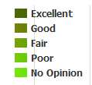
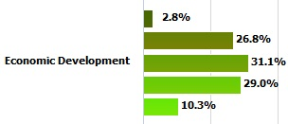
What our Businesses Have to Say: Economic Development
60% rate as poor or fair
Notes:
Lea

Slide 32
Understanding Our Economic Development Capacity
Economic Development Capacity
Planning & Action
Governance & Leadership
Networks & Linkages
Engagement
Shared vision for community’s future
Economic Development Plan
Successful ED Initiatives
Diversity of actors
Level of involvement
Relationship with business community
Understanding of ED
Resources
Committed leadership
Healthy, integrated relationships
Connected to internal supports
Connected to external supports

Slide 33
Economic Development: Lack of Alignment
Notes:
Lea

Slide 34
Performance Measurement
… Are we aligned?
… Are our expectations in check?
… Are we achieving what we set out to achieve?
… Do key stakeholders see value?

Slide 35
Our community has a shared vision for our long-term future?
Capacity Diagnostic: Planning & Action
Strongly Agree
Agree
Somewhat Agree
Neutral
Somewhat Disagree
Disagree
Strongly Disagree
Notes:
Our community has a shared vision for our long-term future. (priorities identified across economic, social, cultural and environmental priorities)

Slide 36
Our community has a current economic development plan and it is connected to broader planning and related action?
Capacity Diagnostic: Planning & Action
Strongly Agree
Agree
Somewhat Agree
Neutral
Somewhat Disagree
Disagree
Strongly Disagree
Notes:
Our community has a current economic development plan and it is connected to broader planning and related action. (ED priorities aligned with social, cultural and environmental priorities)

Slide 37
Economic development initiatives have been successful?
Capacity Diagnostic: Planning & Action
Strongly Agree
Agree
Somewhat Agree
Neutral
Somewhat Disagree
Disagree
Strongly Disagree
Notes:
Economic development initiatives have been successful (as measured using pre-defined metrics).

Slide 38
Elected officials understand how to participate and strategically lead efforts aimed at local and regional economic development.
Capacity Diagnostic: Governance & Leadership
Strongly Agree
Agree
Somewhat Agree
Neutral
Somewhat Disagree
Disagree
Strongly Disagree
Notes:
Elected officials understand how to participate and strategically lead efforts aimed at local and regional economic development. (elected officials knowledge)

Slide 39
Local government staff understands how to participate and strategically lead efforts aimed at local and regional economic development.
Capacity Diagnostic: Governance & Leadership
Strongly Agree
Agree
Somewhat Agree
Neutral
Somewhat Disagree
Disagree
Strongly Disagree
Notes:
Local government staff understands how to participate and strategically lead efforts aimed at local and regional economic development. (local gvt. staff knowledge)

Slide 40
Human and financial resources are in place to advance economic development priorities.
Capacity Diagnostic: Governance & Leadership
Strongly Agree
Agree
Somewhat Agree
Neutral
Somewhat Disagree
Disagree
Strongly Disagree
Notes:
Human and financial resources are in place to advance economic development priorities. (resources are in place)

Slide 41
Our community leaders are committed to actively advancing economic development opportunities.
Capacity Diagnostic: Governance & Leadership
Strongly Agree
Agree
Somewhat Agree
Neutral
Somewhat Disagree
Disagree
Strongly Disagree
Notes:
Our community leaders are committed to actively advancing economic development opportunities, i.e. findings resulting from BRE. (commitment to advancing prioritizes)

Slide 42
Economic, social, cultural and environmental groups work together on successful community projects.
Capacity Diagnostic: Networks & Linkages
Strongly Agree
Agree
Somewhat Agree
Neutral
Somewhat Disagree
Disagree
Strongly Disagree
Notes:
Economic, social, cultural and environmental groups work together on successful community projects. (healthy relationships / integration of sectors/ priorities)

Slide 43
Our community is connected to the networks and supports available within our region.
Capacity Diagnostic: Networks & Linkages
Strongly Agree
Agree
Somewhat Agree
Neutral
Somewhat Disagree
Disagree
Strongly Disagree
Notes:
Our community is connected to the networks and supports available within our region. (i.e. CF, credit unions, employment service provider, colleges) (connectivity regionally)

Slide 44
Our community is connected to the networks and supports external to our region
Capacity Diagnostic: Networks & Linkages
Strongly Agree
Agree
Somewhat Agree
Neutral
Somewhat Disagree
Disagree
Strongly Disagree
Notes:
Our community is connected to the networks and supports external to our region (provincial / federal government / industry associations). (connectivity beyond our region)

Slide 45
A diverse group of stakeholders are involved in economic development planning and action
Capacity Diagnostic: Engagement
Strongly Agree
Agree
Somewhat Agree
Neutral
Somewhat Disagree
Disagree
Strongly Disagree
Notes:
A diverse group of stakeholders are involved in economic development planning and action. (diversity of actors involved)

Slide 46
There is a high level of involvement by stakeholders in economic development.
Capacity Diagnostic: Engagement
Strongly Agree
Agree
Somewhat Agree
Neutral
Somewhat Disagree
Disagree
Strongly Disagree
Notes:
There is a high level of involvement by stakeholders in economic development. (level of involvement)

Slide 47
The business community is actively involved in informing economic development.
Capacity Diagnostic: Engagement
Strongly Agree
Agree
Somewhat Agree
Neutral
Somewhat Disagree
Disagree
Strongly Disagree
Notes:
The business community is actively involved in informing economic development. (alignment with business community)

Slide 48
BRE in Action: Successes & Opportunities
BRE as a mechanism to increase communications across key ED stakeholders
Relationship Building
Government <→ Business
EDPs <→ Government
EDPs <→ Business
Local government has an opportunity to hear from the business community
Discussions between stakeholders expedite future actions …this is the foundation
Capacity Requirement: Low
Notes:
In most cases, the BRE is an important tool to increase communication between these various stakeholders.
Government has an important opportunity to hear the concerns of the business community.
Discussions between stakeholders expedite all future actions -> this is the foundation…

Slide 49
BRE in Action: Successes & Opportunities
Links to Policy, Planning & Action
Economic Development Plans
Municipal Policy
If no plan, still informing actions
BRE findings being used to organize, inform & prioritize
BRE findings informing policy (i.e. zoning, OCP)
BRE findings encouraging discussions AND ACTION on emerging retention and expansion issues (i.e. workforce)
Capacity Requirement: Medium
Notes:
BRE data consideration for discussions on other issues (i.e. zoning, OCP, logistics)
BRE data encouraging discussions on emerging retention and expansion issues (i.e. workforce)

Slide 50
BRE in Action: Successes & Opportunities
Helping to link what employers are needing with what is being provided
Skills Training
Hospitality ‘Tourism Ambassador Program’
Management / Technical Skills Workshops / Finance trade show
Resource-based ‘Bridging to Employment’ training
Businesses need to stay engaged by accessing available skills training
For those not taking advantage of training … why aren’t they?
Capacity Requirement: High
Notes:
From hospitality to heavy machinery operation, training programs have been delivered in various communities in response to data from BRE

Slide 51
BRE in Action: Successes & Opportunities
Business Development
Succession Planning
Shared business support delivery models
Business Climate… learning more
Broader business development issues are being addressed
Collaboration is happening in order to improve business climate and access to supports
Additional research is being undertaken to learn more
Capacity Requirement: High
Notes:
Succession planning, small business finance, and computer skills are all examples of educational programming activities that have fallen out of the BRE:
- small business finance trade show
- service evaluation (investor) by third party
- business support organizations working together on shared delivery models and streamlining location of services
Some business support services are self-evaluating and trying to streamline service provision.

Slide 52
BRE in Action: Successes & Opportunities
Overall businesses are reporting positive climate and projections
Marketing & Communications
Debunking myths… the story is good
Celebrating successes and keeping momentum moving
Using ‘good news’ for investment attraction
Online communications are being used regularly to keep communities informed
Cultural and recreational amenities are important to existing and future businesses
Capacity Requirement: Low/Medium
Notes:
Many BRE leads / EDPs have expressed surprise at the positive business climate indicated by BRE results. This flies in the face of much anecdotal opinion that the business climate in small towns is weak and business is poor.
Cities are using BRE data to inform their communications, through web sites.
Invest Kootenay then has stats to back up investment attraction activitiesl
Surprisingly good sales growth forecasts are common
Marketing the good news, could help with investment attraction
Celebrating small successes

Slide 53
The POWER of the BRE Database
Community / Corridor | Total Respondents | Plans to Expand (3yrs) | Land Constraints | % | Primary Sectors Constrained
Elk Valley | 49 | 25 | 13 | 52% | manufacturing (3), construction (2), Other services (2)
Creston/ Cranbrook/Kimberley | 101 | 60 | 14 | 23% | professional services (6), retail trade (3)
Columbia Valley
Golden | 108 | 54 | 16 | 30% | accommodation & food services (3), retail trade (3), transportation & warehousing (2), construction (2)
Revelstoke
Nakusp | 46 | 17 | 12 | 71% | retail trade (3), agriculture (3)
Slocan Valley | 80 | 35 | 8 | 23% | retail trade (4)
Nelson | 30 | 9 | 2 | 22% | professional services (1), manufacturing (1)
Castlegar
Lower Columbia | 150 | 52 | 8 | 15% | retail trade (3)
Boundary | 59 | 26 | 4 | 15% | Other services (i.e. repair, maintenance)

Slide 54
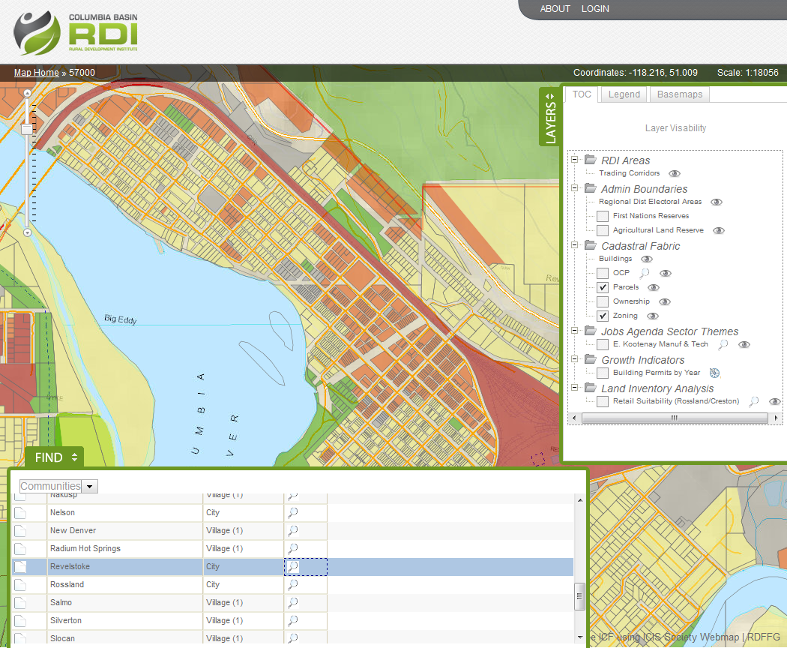
Digital Basin & Employment Lands
Over 200 economic, social, cultural & environmental data layers, charts, & related analysis
Creation of a seamless parcel fabric at a regional level with query functionality
35+ partnerships (local government, Community Futures, Chambers of Commerce, provincial government, First Nations, Columbia Basin Trust)
Over 1500 hours on research and development
10 faculty and students involved
6 faculty
4 co-op students
Notes:
The project defines employment lands as lands that generate economic wealth, including: agricultural lands; lands zoned or designated for heavy industry, light industry and commercial; First Nations designated employment lands; brown and greyfield sites; and Crown lands available for development. The SGRC is building a Web Portal that will provide a set of sophisticated query and interactive mapping tools for exploring the economic landscape of the Canadian Columbia Basin Region. The portal is aimed at decision makers, investors and business owners in the region.
The platform that has been built for this project is incredibly flexible
The public will have access to location services
performing their own custom queries – looking for landbase with their desired attributes
We have a spatially explicit platform for economic/environmental/social/cultural indicator data
public has an appetite to understand the context where they live
business community uses this information to analyse their operations
EDOs, public policy-makers, and researchers will have an advanced platform for data delivery

Slide 55
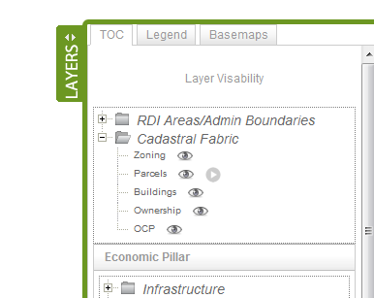
The Site Selector Tool

Slide 56
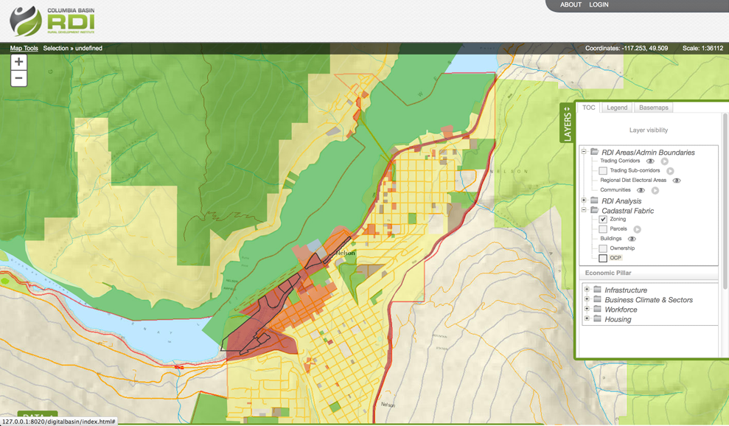
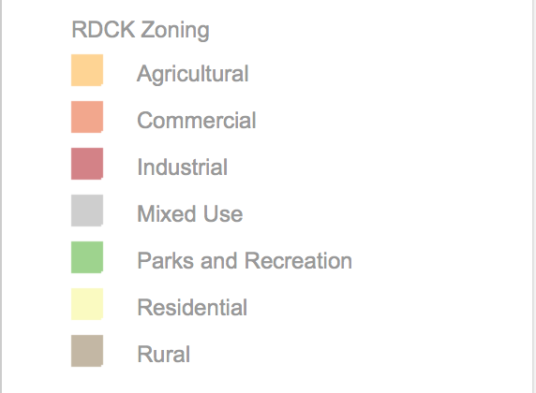
Search Results
Nelson zoning only:
- Nelson and 10 Km surrounding.
- Industrial zoned (center of parcel is on zone)
- Min size 10 Ha
- Within 1Km from power
- Within 3 Km from Major Hwy
- Within 1 Km from water service
- 30 % Area of parcel must be at or below 10% grade
Parcels outlined in black meet the filtering criteria

Slide 57
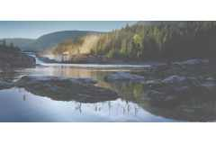
Parting Thoughts…
Bring partners in early, utilize as advisors throughout
Engage in honest, up front conversations to manage expectations
Build projects on identified needs and existing college capacities
Identify & articulate where you fit into the landscape
Identify metrics prior to start & commit to measuring long term impact
Take a Learning Regions approach based on innovation and collaborative learning
Build capacity – of ourselves & our partners

Slide 58
UNDERSTAND • CONNECT • MOBILIZE
Colleges Supporting Economic Development
The Case of a Regional Business Retention and Expansion Pilot Project
Dr. Terri MacDonald
Regional Innovation Chair in Rural Economic Development
Selkirk College

