Slide 1


UNDERSTAND • CONNECT • MOBILIZE
Preparing for the Future
Building Resilient Rural, Remote and Northern Communities
Dr. Terri MacDonald
Regional Innovation Chair in Rural Economic Development
Selkirk College

Slide 2



Agenda
The State of Rural Canada
Emerging Opportunities for Colleges
Rural Colleges in Action

Slide 3


State of Rural Canada
How is rural Canada changing?
How does rural contribute / benefit broader society as a whole?
What has been happening to programs/policies, and do they enhance or inhibit rural development?

Slide 4


Partners!
Canadian Rural Revitalization Foundation
Rural Policy Learning Commons
Rural Development Institute

Slide 5
Thank You!
Lars Hallstrom
Jennifer Stonechild
Wilissa Reist
Greg Halseth
Laura Ryser
Sean Markey
Bill Ashton
Wanda Wuttunee
Stephanie LaBelle
Ruth Mealy
Tom Beckley
Rob Greenwood
Alvin Sims
Nina Nunez
Chris Southcott
Ashley Mercer
Pertice Moffitt
Al Lauzon
David Douglas
Norm Regatlie
Wayne Caldwell
Jim Randall
Don Desserud
Katharine MacDonald
Bruno Jean
Laurie Guimond
Heather Hall
Rose Olfert
Amanda Graham
Ken Coates
Alida Grelowski
Roger Hayter
Glen Schmidt
Terri Macdonald
Pat Curran
Bill Reimer
Ernest Heapy
Russ McPherson
Sarah-Patricia Breen
Bojan Furst
Ray Bollman
Ryan Gibson
Jo Fitzgibbons
Mark Watson
Elizabeth Fast

Slide 6
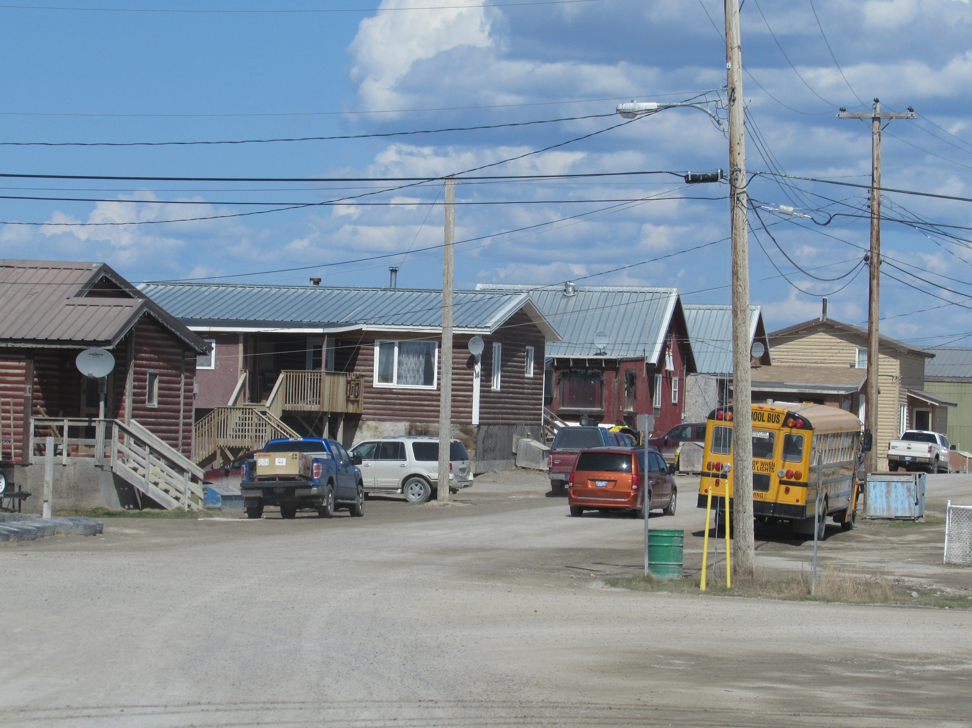
Report Structure, Intent
Opinion, reflection vs. statistical report
Thematic coherent:
  Demographic, Economic, Infrastructure and Services, Aboriginal
  Key provincial, territorial
  issues
  Analysis, synthesis

Slide 7
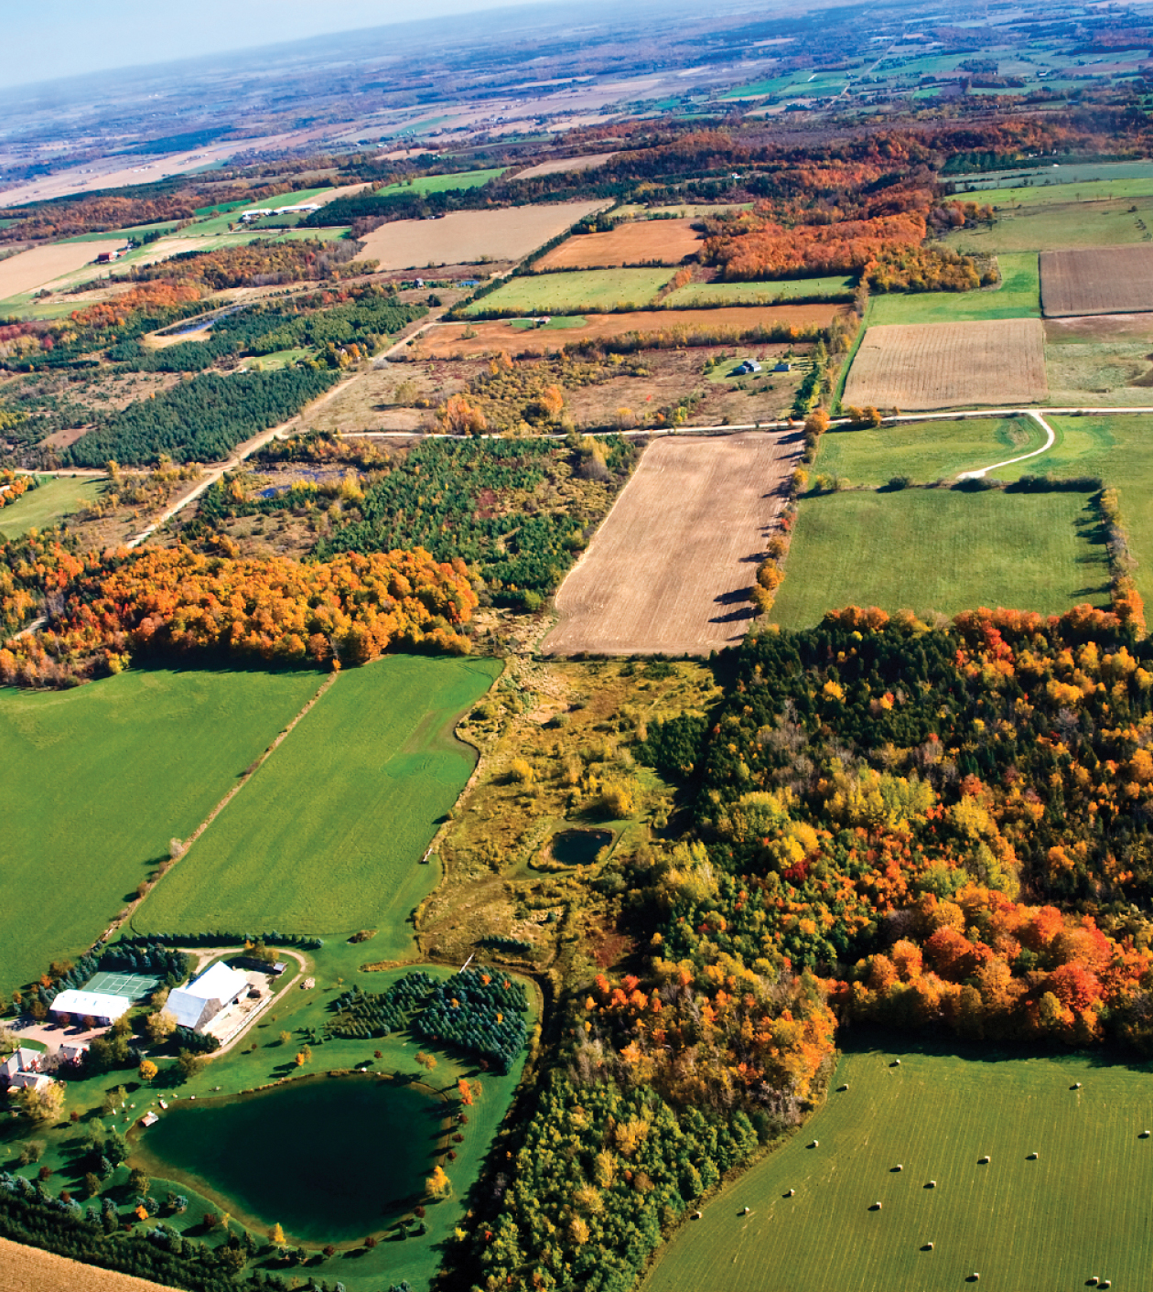
Rural Context
ECONOMIC RESTRUCTURING
Reliance on commodity exports characterized by boom bust
Globalization policies of the 1980s and 1990s have changed the game
Notes:
As was noted in the beginning, rural Canada is encountering a new reality. This new reality did not come over night, nor did it arrive within the last year. This new reality has been shaped by a number of factors, each taking place for a number of years. Today I want to highlight four of these factors contributing to the new reality or the critical turning point for rural communities.
Economic restructuring: Since the time of European settlement, rural Canada has always been about trade. From fish, fur, butter, and wood to grain, minerals, energy, and petroleum, our economic health has relied on commodity exports – most often in a boom and bust context. Our national and provincial policies have largely supported this strategy with only minor variations – often driven by international events and policies.
The most recent expression of this legacy occurred throughout the 1980s and 1990s. Rural communities were required to restructure their economic bases in response to practices and policies favouring globalization. During this period, Canadian rural communities witnessed the consolidation and decline of natural resource industries along with their increased mechanization. Business competition was no longer with a neighbouring community, but with communities from across the world. Rural communities have responded to this economic restructuring in a variety of manners, ranging from quite well (such as Winkler, Manitoba), to quite poorly (such as Tumbler Ridge, BC).

Slide 8

Rural Context
OUT MIGRATION
Transition from ‘rural to urban’ society resulting in youth and skilled workers outmigration
Increased proportion of seniors, reduced municipal funds, redirected long-term (Inter-generational) transfer of wealth
Notes:
As was noted in the beginning, rural Canada is encountering a new reality. This new reality did not come over night, nor did it arrive within the last year. This new reality has been shaped by a number of factors, each taking place for a number of years. Today I want to highlight four of these factors contributing to the new reality or the critical turning point for rural communities.
Out migration: Rural communities have also experienced an out-migration of people over the past two decades, particularly youth and skilled workers – as Canada has been transformed from a rural to urban society. This has in turn increased the proportion of seniors within rural communities, reduced municipal funds, and redirected the long-term (inter-generational) transfer of wealth.

Slide 9
Rural Context
Economic restructuring
Out-migration
Focus on natural resources
Retreat from rural and the dismantling of rural institutions
Notes:
As was noted in the beginning, rural Canada is encountering a new reality. This new reality did not come over night, nor did it arrive within the last year. This new reality has been shaped by a number of factors, each taking place for a number of years. Today I want to highlight four of these factors contributing to the new reality or the critical turning point for rural communities.
Economic restructuring: Since the time of European settlement, rural Canada has always been about trade. From fish, fur, butter, and wood to grain, minerals, energy, and petroleum, our economic health has relied on commodity exports – most often in a boom and bust context. Our national and provincial policies have largely supported this strategy with only minor variations – often driven by international events and policies.
The most recent expression of this legacy occurred throughout the 1980s and 1990s. Rural communities were required to restructure their economic bases in response to practices and policies favouring globalization. During this period, Canadian rural communities witnessed the consolidation and decline of natural resource industries along with their increased mechanization. Business competition was no longer with a neighbouring community, but with communities from across the world. Rural communities have responded to this economic restructuring in a variety of manners, ranging from quite well (such as Winkler, Manitoba), to quite poorly (such as Tumbler Ridge, BC).
Out migration: Rural communities have also experienced an out-migration of people over the past two decades, particularly youth and skilled workers – as Canada has been transformed from a rural to urban society. This has in turn increased the proportion of seniors within rural communities, reduced municipal funds, and redirected the long-term (inter-generational) transfer of wealth.
Focus on getting resources out of rural: In spite of occasional efforts to diversity rural economies, our policies, infrastructure, and basic dependencies have continued to reinforce our fall-back position of commodity production.

Slide 10
Canadian Balance of Trade 1997-2015
FOCUS ON NATURAL RESOUCES
From: CANSIM Table 376-0006 Balance of international payments, current account, goods, annual (dollars x 1,000,000)
Notes:
As illustrated in this graph, we have consistently relied on our rural-based industries like agriculture, energy, mining and forestry to support our thirst for consumer goods, electronics, and machinery. Domestically, our food, water, energy, housing, and medicines rely on rural products. In spite of this reality, investments into rural communities have historical been viewed as subsidies, whether they be provided to communities or businesses. Where the investment approach has been adopted, it has focused primarily on infrastructure, as most recently illustrated by the Economic Action Plan in response to the 2008 economic recession. These programs often do not address the key priorities or the day-to-day challenges for rural communities.

Slide 11
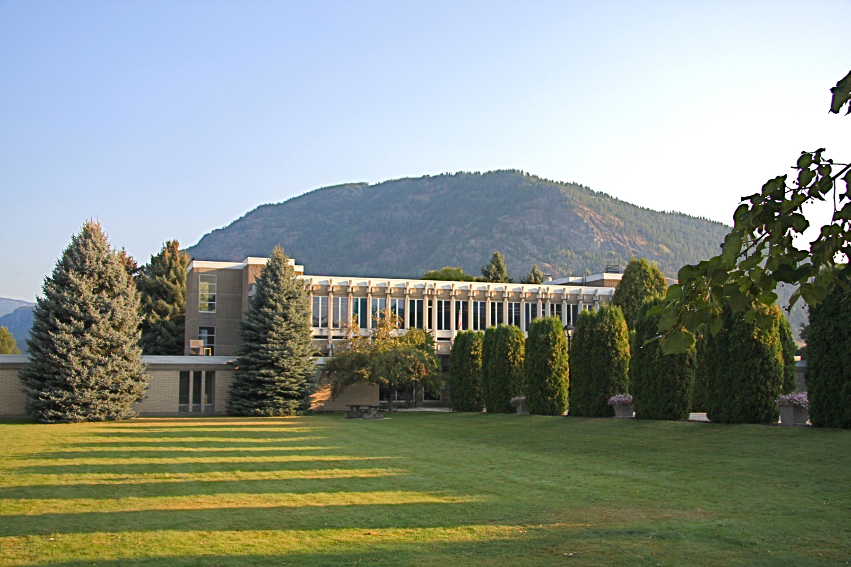
Rural Context
DISMANTLING OF RURAL INSTITUTIONS
Neoliberal approaches and ‘per capita’ arguments used to justify reallocation of resources
Perceptions and power have shifting to urban, rural focused institutions have been shut down
Notes:
Dismantling of rural institutions: In the past ten years, Canada has witnessed the dismantling of a number of key rural institutions. In our enthusiasm for the neo-liberal emphasis on individualism and consumer approaches to service provision (over collective and citizen-based approaches), “per capita” arguments for service delivery have been used to justify the reallocation of resources. Within such a framework the long distance and low density of rural and northern areas will mean they become net losers.
Over the same period, urbanization has meant that perceptions and power have shifted to urban people and issues. The essential interdependence of rural and urban places and people has been lost as these connections become more complex and urban challenges increase. As a result, rural-focused institutions such as the federal Rural and Cooperatives Secretariat, the Rural Analysis Unit at Statistics Canada, and the legacy of regional and rural based programs have been shut down, significantly reduced, or face under-funding.
All of these factors contribute to a new reality and a critical turning point for rural communities.

Slide 12
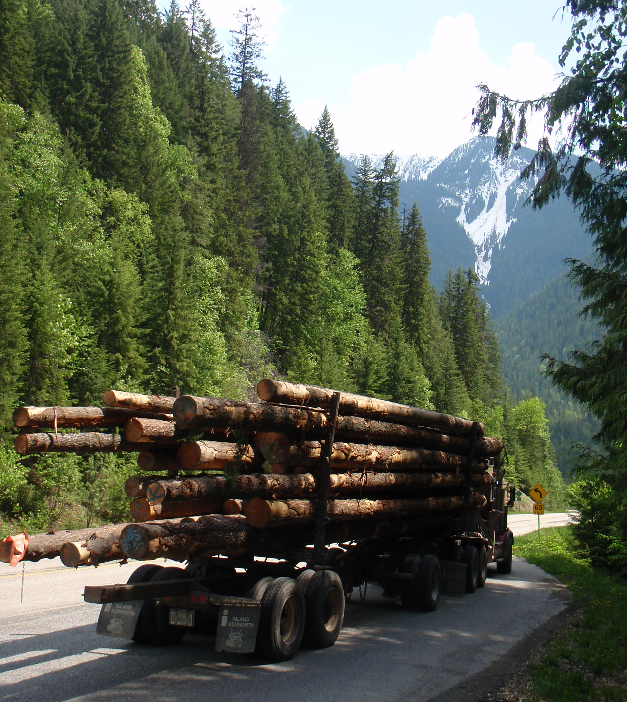
Overarching Themes
RESILIENCE
Migratory working and remittances (NL)
Local self-reliance and informal economies (Atlantic region)
Cultural enhancement (Indigenous communities)
Regional collaboration (Quebec)
Notes:
As a result of the provincial and territorial scan we have identified three themes that emerged – for the purposes of this presentation. The first we have identified as Resilience.
Given the boom-bust nature of the rural economy, many communities have developed a capacity for resilience. This includes mechanisms such as migratory working and remittances (NL), local self-reliance and a well developed informal economy (Atlantic region), cultural enhancement (Indigenous communities), strategic planning (Inuvik), and regional collaboration (QC) – all often rooted in strong place attachment.
All of items listed here can be seen as potential assets for rural and northern communities to build their resilience- and foci of attention for local leaders, community development practitioners, policy-makers, and researchers.
Initiatives like the Green Communities network focus on environmentally friendly actions to build resilience.
The Rural Futures organization has a long record of employment and community economic development initiatives – one of the few consistent successes in Canadian community development – with its emphasis on community engagement, not just business development.
The Alberta Hub organization integrates the city of Edmonton and its many surrounding communities in recognition of their mutual interdependence.
The Québec Rural Policies started with the existing networks and organizations within each region and built upon them rather than trying to create an additional structure.
Many organizations and communities are responding to the neglect of Aboriginal youth by focusing on a wide variety of skills: from employment and business to language and culture. The research shows, however, that the most important ingredient is the community itself – the celebration of its heritage and the support it provides for the future. We are now seeing the early signs of this approach – in the form of Aboriginal leaders – in spite of the continuing neglect from our major institutions.

Slide 13

Overarching Themes
Lack of an investment mentality
Market-oriented policies miss opportunity of collaborative, integrated approach
Running-down core infrastructure
Notes:
Neglect is a second theme that we see in these provincial and territorial scans.
Rural communities are often working within an economic, social, and political climate that does not support such resilience – or relies too heavily on it.
Investment is focused on corporations and sectors (and sometimes individuals), not places. As a result, communities have little control over local resources and assets. The financial support provided is therefore seen as subsidies in spite of the fact that they are often created using local resources and talent.
The most offensive and entrenched example is the federal government’s use and control of the natural resources within First Nations territories. It receives the benefits of these assets then allocates a (often relatively small) portion of them to First Nations communities to manage – but always under Federal Government veto. The dominant perception of these allocations is as subsidies – neither investments nor misappropriation of power.
Outside Aboriginal communities we see examples of this through a preference for corporate rather than community-based management of forestry and other resources.
Market-oriented policies miss collaboration and integrated approaches. At the local and regional levels, economic, social, environmental, and cultural conditions are inter-connected. The town councellor is often the local business-person, coach, and firefighter. A school policy affects health, employment, and environmental conditions directly. We need venues and authority to deal with these inter-sectoral implications, but they are few and far between as entrenched sectoral players compete for scarce resources.
Québec’s use of the regional health clinics as a basis for welfare and employment reorganization provides an excellent example of how policies can fight this tendency. If a nurse discovered the patient was lacking reading skills, it was a simple matter to refer them down the hall to the literacy program conducted by the employment office. Similarly, if the employment counsellor suspected a health problem was making it difficult for the client to hold a job, it was easy to take them to the health clinic.
Running down core infrastructure: Urban-biased service delivery – designed for high density and relatively short distances can often disadvantage rural places.
Health policy engouraging the training of specialists over generalists is one example.
The closure of railroad spur lines and local grain elevators on the prairies is another. This often meant the loss of funds for maintaining roads in some places and the creation of elevated costs for others as truck traffic patterns shifted.
….
BC Ferries example: save $xxx million and lose $2.2 billion; same goes for decisions to close hospitals and schools without a fully integrated, cross-sector anaylsis
Boil water advisories, crumbling roads, and toxic hockey rinks
30 years of neglect – and misguided policy

Slide 14
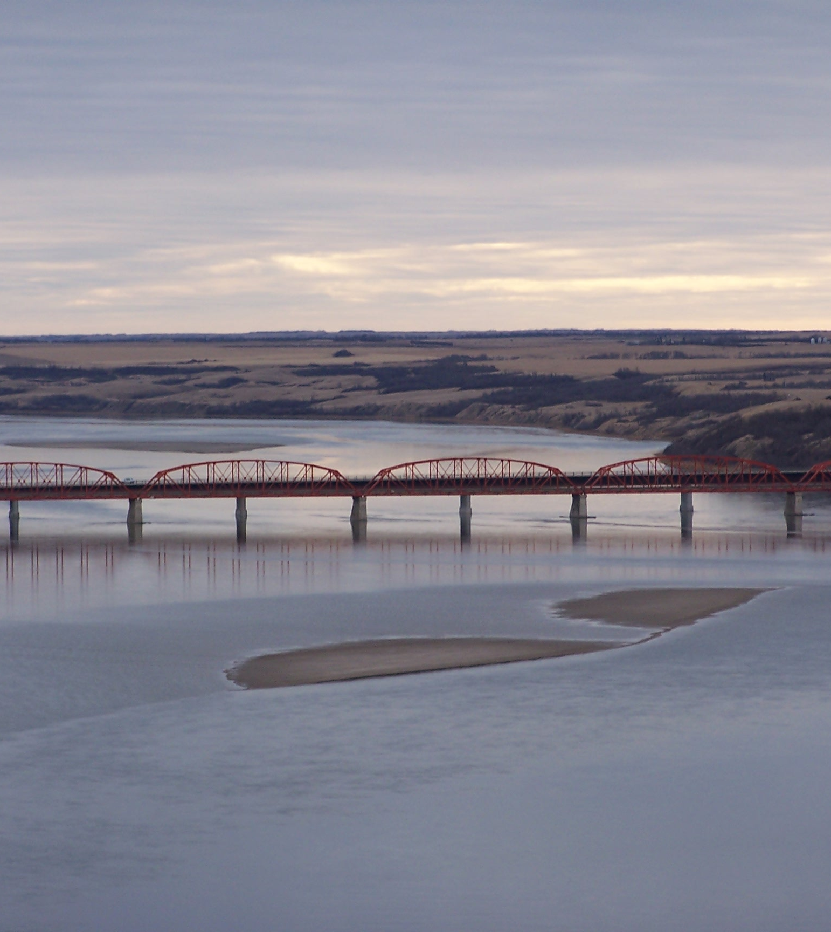
Overarching Themes
STRONG FOUNDATIONS
Demographic –collaborative approaches to workforce development
Economic - entrepreneurship
Social – vibrant social economies
Environmental – community-based forests
Notes:
A third theme in the SORC report is the strong foundation for rural and northern futures that we find throughout the provinces and territories. Each of the regional reports pointed to the opportunities these assets provided for strengthening rural and northern places. This is not new news, of course, since we have always relied on our rural places for the resources, human capital, and innovation that has sustained Canada. The authors are pointing in this report to their potential for the future – and a renewed approach to ensure they are not overlooked or squandered.
In demographic terms, population aging and the recruitment of a “next generation” workforce together require investments that build robust new development foundations. The increased numbers of Aboriginal youth are an especially important opportunity in this regard.
Yukon college stands out as an encouraging model of how this can be done through adult education and training.
Economically speaking, rural and northern places remain important and strong. If we continue to treat their resources as exportable commodities we will continue to feel the boom and busts of demands and markets beyond our control, but if we take advantage of these assets as sources for value-added industries and seek to develop our comparative advantages we are more likely to mitigate the negative effets of changing markets on our communities.
The local entrepreneiur in Matawa, ON who used rejected cores from the local plywood mill to manufacture bowling pins; the community of St. Clement, QC that established itself as a supportive community for handicapped children; and the town of Warner, AB that turned its aging buildings into an international school for girls hockey are just a few of the examples illustrating this approach.
From a social point of view, rural and northern places retain important assets in their strong sense of community, supportive networks, and capacity for self-organization.
In Nova Scotia, we see how this can be developed with a vibrant social economy
In Manitoba, we see how it was used to create a rate of in-migration that rivals Toronto
In BC, we see how a focus on Aboriginal culture, language, and heritage was instrumental in drastically reducing suicide rates among youth
Rural people are also deeply concerned about the environment – and are ready to act on those concerns.
Northern communities in British Columbia have established a specialty timber business that exports internationally.
Community-based forestry has taken on many different forms across the country – in spite of policies that create significant barriers to its expansion.
Our research in the NRE project cautions us to note that rural people’s environmental concerns are not always manifested in the same way as those in urban places. When asked whether they participated in composting programs, relatively few rural people answered “yes” – they composted in their backyards.
……
We also have some examples of successful policy: Québec Rural Policy: 2001-2007; 2007-2014; 2014-2024
Focus on regional collaboration and existing legacy of collaboration (MRCs)
Significant funding for regional collaboration
Capacity-building in weak communities made beneficial for the strong.
Adequate resources for rural agents as supporters and brokers
Long term hrizons (10 years) gives regions confidence to make compromises and collaborate
Recent cut in the Rural Policy Funding is an example of the changes above (neo-liberalism/austerity, urban co-optation of the agenda and resources)
Hopefully, the first 13 years of the policy will have built the rural capacity to the point where it can survive the lean years.
Jean, Bruno and Bill Reimer (2015) "Québec's Approach to Regional Development: An historical analysis" RPLC Webinar, Feb 23. [Link to recording]
http://billreimer.ca/research/files/JeanReimerRPLCWebinarReQuebecPolicy20150223V06.pdf
http://momentum.adobeconnect.com/p6pfr4fl4bn/
Communities in Nunavut, and elsewhere show us how rural residents embrace a resource economy (and are the people in the country who are closest to the impacts associated with different sectors), but not where the environmental impacts threaten a way of life, opportunities for economic diversification, or functioning ecosystems over the long-term.

Slide 15
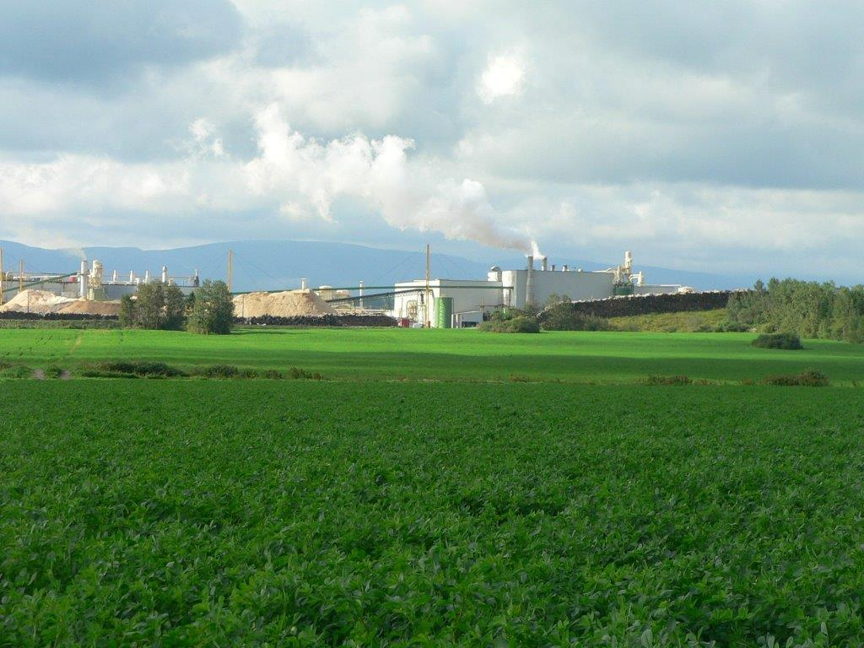
Recommendation #1
Provincial and Federal governments must develop new and robust visions and policy frameworks for rural Canada.
Notes:
In the absence of such visions, inappropriate, short-term, and narrowly perceived policies and investment decisions will continue to waste taxpayer dollars and further burden rural places with failed development decisions.
Québec’s internationally recognized national rural policy is the exception within the country, and we can see
from the Québec chapter how it is working to shape and influence rural development in the province in a myriad of positive ways. (so not only should we learn about being able to purhase beer and wine at the depaneur – we can learn much from Quebecs rural policy.
Implications for CD:
Help communities to challenge inappropriate visions.
Broker their access to tools, groups, and institutions that can do this.
Provide communities with the information and data to challenge inappropriate visions

Slide 16

Recommendation #2
Rural communities must be active participants in understanding, planning and investing in their own futures.
From Case-making
to Place-making!
Notes:
If communities don’t have a plan, how do they expect to engage constructively with senior governments when opportunities for engagement do arise? If communities don’t cooperate with each other at the regional level, or worse, act in a negative competitive fashion with each other, how do they expect to re-build their critical infrastructure? If rural communities are unwilling to invest in their own future, how can they expect senior governments and corporations to play their part?
The chapters in this report make it clear that local action matters. There are wonderful, inspiring stories of community and regional development from coast to coast to coast. We need to get better at telling these stories, sharing (learning from and celebrating) our failures, and working to adapt and scale-up successful models to other areas. And, the investment mentality is not just for policy makers, but rural citizens and communities themsevles
……………..
Implications for CD.
Help communities take initiative to develop, exchange, and communicate more appropriate visions and frameworks
Facilitate inter-community collaboration to identify and articulate common interests
Facilitate alliances between rural and urban people, groups, and organizations (esp around food, water, environment, energy, recreation)

Slide 17
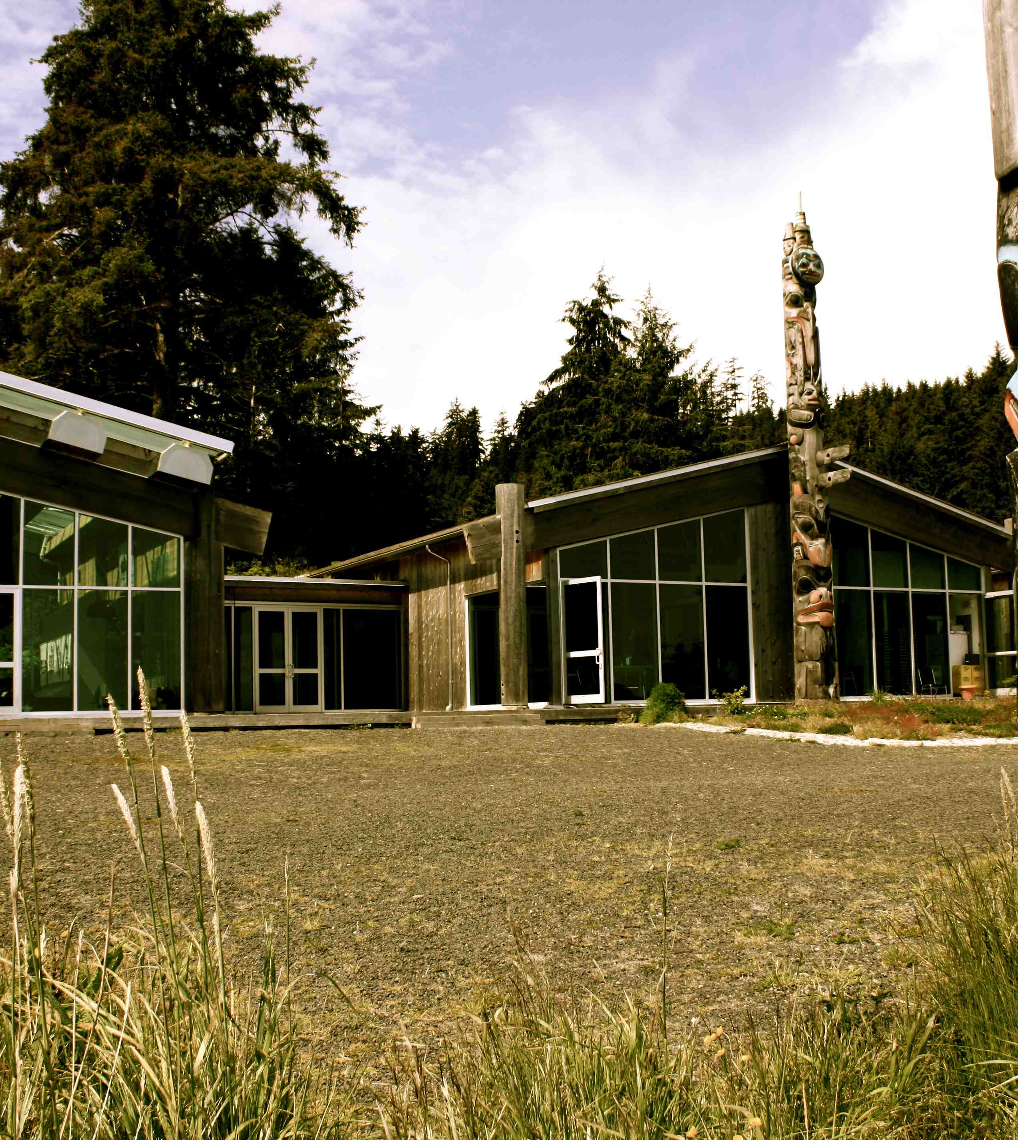
Recommendation #3
All Canadians must participate in the window of opportunity that follows the Truth and Reconciliation Commission of Canada to acknowledge and seek serious corrective steps to heal the “historical trauma” suffered by Aboriginal peoples in this country.
Notes:
Every author in this report has acknowledged the challenges that face Aboriginal peoples, but also the historic opportunities that are being realized because of the efforts and changes going on within Aboriginal communities themselves, the promise held within their young and growing populations, and emerging patterns of self-governance.
The Federation of Canadian Municipalities and the Council for the Advancement of Native Development Officers Community Economic Development Initiative (CEDI) toolkit (profiled in the Manitoba chapter) provides examples of communities working hard toward reconciliation and mutual, respectful development.
…….
Worthwhile to point out?:
Indigenous people provide us with examples of what can be done to change things.
They have informed themselves of the legal and political apparatus available to them
Learned how to use them
Have created opportunities for local, regional, and national development
The West provides us with many opportunities to learn how to better organize our communities
Many groups have been successful in getting control over their governance and resources
Are radically rethinking the ways in which people can organize themselves
Providing us with numerous experiments in self-governance and resource use.
E.g. Carcross-Tagish
Implications for CD
Facilitate communication among Indigenous and non-Indigenous communities so that they can learn from each other and develop collective action.
Use the lessons learned from the history of Indigenous peoples to create welcoming communities for migrants.

Slide 18
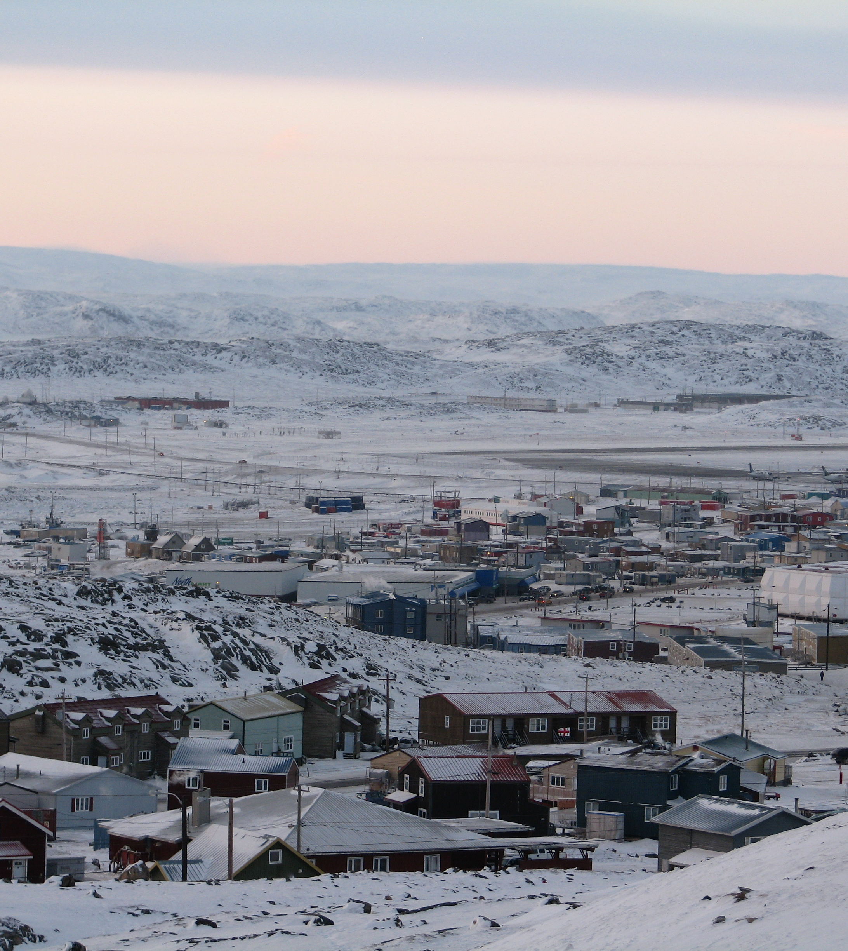
Rural Engagement
Crossroads…
Authentic engagement
Rural institutions
Place-based policy
Real revenue sharing and investment
Notes:
As we approach a re-imagined rural Canada we need to listen to rural peoples, both Aboriginal and non-Aboriginal, about their ideas and aspirations for the future. We cannot re-imagine places and economies without the vision and experience of those who live and work every day in these places. All chapters speak of the necessity of an authentic engagement with rural peoples.
PEI Chapter: we are at a crossroads: for me, this means that we both understand the nature of the challenges facing rural Canada – and we also know enough about the potential solutions – well tested and known solutions that are operating in pockets across the country and internationally – we simply have to choose to act and invest.
1994 – Toward a Whole Rural Policy for Rural Canada – those that have come before us and written similar reports fought for academics, companies, policy makers and politicians to listen to rural people – and not just tell them what’s good for them. It is somewhat ironic that we have to fight for this basic known truth all over again.
Apedaile, Leonard P. and Bill Reimer (1996) "A Whole Rural Policy." Invited presentation to the House of Commons Standing Committee on Natural Resources. May. [http://billreimer.ca/research/files/WholeRuralPolicyMay281996.pdf]

Slide 19
Working with CRRF and RPLC
http://crrf.ca
http://rplc-capr.ca
http://corc.crrf.ca
Notes:
RPLC
Partnership grant: This means we are not doing the work ourselves but we are facilitating others who are already doing the work by:
Supporting meetings, workshops, conferences, exchanges, internships
Facilitating webinars, institutes, publications, media initiatives – including social media
Are eager to work with anyone or any group that shares our concern with critical, useful, effective, sustainable rural and northern policy
Contact me or via our website (http://rplc-capr.ca)

Slide 20
Emerging Opportunities for Colleges

Slide 21
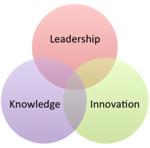
Building Capacity in the New Economy
Rural Canada must reposition itself for the new economy -> sustainability must move beyond resource extraction
The new economy provides opportunities for rural revitalization -> technology opens new markets and enables new networks and knowledge sharing for innovation
Capacity is a social affair -> networks and norms that support regional action are as important as technology and infrastructure
Innovations in institutions are key -> doesn’t typically occur by decree, rather new ways of doing occur because they have to
Nre.Concordia.ca
http://cdnregdev.ruralresilience.ca/

Slide 22
The Knowledge Economy
A challenge and an opportunity for community colleges
Characterised by:
  Mobility (capital)
  Collaboration
  Innovation
Flourishes with:
  Skilled labour force
  Adaptable business and government
Notes:
Challenge: resource-rich communities struggle to compete with skill- or knowledge-rich communities
Opportunity: Offers an alternative approach to economic development. Links formerly peripheral economies to the global marketplace. Provides rural regions with the same access to innovative technologies as urban regions. Improves QoL, which can help keep youth and skilled professionals in the region.

Slide 23
Transitioning to the Knowledge Economy
  Innovative companies and institutions are critical
  Education and collaboration are at the heart of our transition
    Technology to transform learning
    Equip students with digital skills
    Create culture of excellence for all (learning region)
    Educate ‘skilled’ AND ‘knowledge’ workers
Notes:
Strategies to encourage success
Link back to the Intelligent Communities indicators? Ie, how to ensure digital inclusion, how to foster innovation, etc.

Slide 24
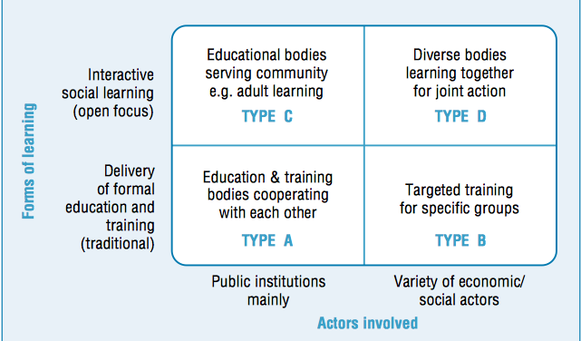
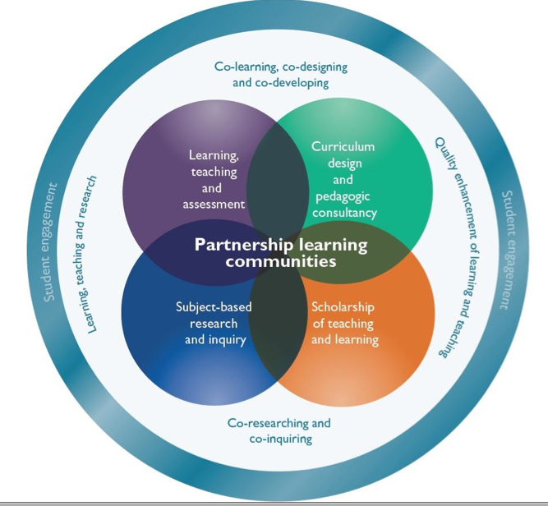
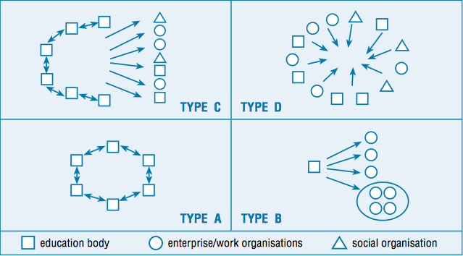
Learning Regions

Slide 25

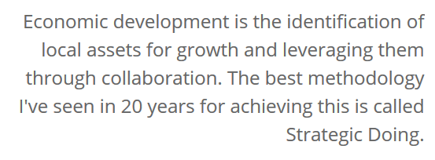
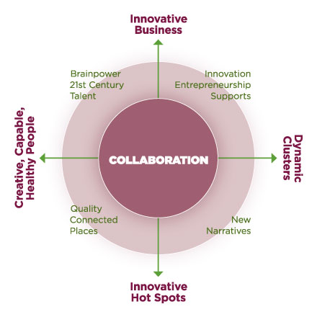
Workforce Innovation in Regional Economic Development
https://www.pcrd.purdue.edu

Slide 26
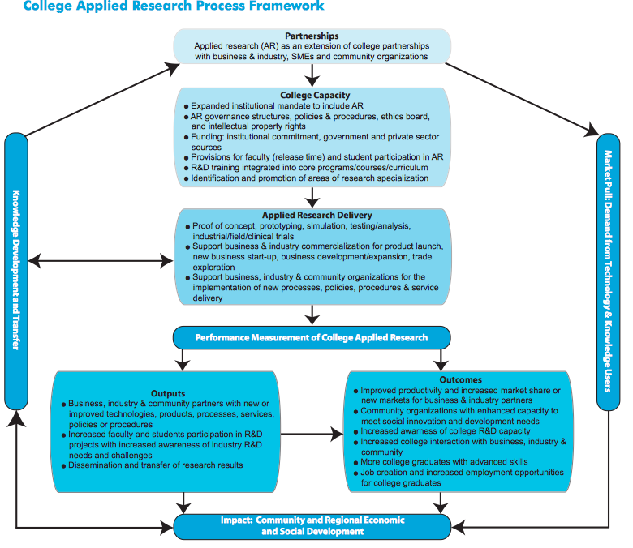
ACCC. (2011). Productivity through Innovation: Applied Research at Canada’s Colleges and Institutes.

Slide 27
Madder’s Typology of Stages of Applied Research (AR) at Colleges
Integrated Innovators
Integrated AR and business support systems regional/ national or international in scope.
Established Innovators
Comprehensive AR policies, including HR policies supporting retention of AR personnel, Director of Research, systems support AR and Contract Training, increased operational funding for AR, AR part of college mandate and mission.
Beginner Innovators
Undecided institutional AR commitment, no related AR policies, structures, no AR human resources, no active support from senior administration.
Novice Innovators
Recent launch of AR activities with support from senior admin, Director of Research, AR policies and ad hoc fiscal & HR systems, some cultural conflict on how AR is related to college mandate, some faculty release time, little senior admin support results in 3-7 year unstable, transitional stage.

Slide 28
Building College Applied Research & Innovation (ARI)Capacity
Highly Qualified Personnel • Current & Engaged Faculty • Regional Socio-Economic Development • Spirit of Discovery
College ARI Capacity
Purpose
Institutional Mandate & Culture
Governance
Personnel
Measuring Outputs
Funding
Knowledge Flows
Forms
Applied Research • Scholarship of Teaching and Learning • Collaborative Partnerships & Professional Linkages
ARI in College Strategic Plan • Opportunities to Celebrate ARI • Mechanisms to Encourage ARI Involvement
Collaborative Learning • Opportunities for Critical Reflection
Administration • Policies & Procedures • Faculty Participation • Research Ethics • Intellectual Property Rights
Applied Research • Scholarship of Teaching and Learning • Collaborative Partnerships & Professional Linkages
Faculty Release Time • Administrative Procedures • Research Assistants • Non-Faculty Roles • Student Participation •Teaching/Research Nexus
Institutional Commitment • Government Agencies (college dedicated) • Market (Collaborative Partnerships • Quebec CCTT model
*Adapted from Madder (2005) and Fisher (2010)

Slide 29

Has your institution clearly defined its applied research and innovation purpose?
Capacity Diagnostic: PURPOSE
Strongly Agree
Agree
Somewhat Agree
Neutral
Somewhat Disagree
Disagree
Strongly Disagree

Slide 30
Does your institution support ARI through its mandate / strategic plan and engage in effort to improve ARI culture?
Capacity Diagnostic: INSTITUTIONAL MANDATE
Strongly Agree
Agree
Somewhat Agree
Neutral
Somewhat Disagree
Disagree
Strongly Disagree

Slide 31
Does your institution have key governance mechanisms in place to support ARI (policies, procedures, IP rights)?
Capacity Diagnostic: GOVERNANCE
Strongly Agree
Agree
Somewhat Agree
Neutral
Somewhat Disagree
Disagree
Strongly Disagree

Slide 32
Are there mechanisms in place to support faculty and student participation in ARI (i.e. release time, research assistants, student participation)
Capacity Diagnostic: PERSONNEL
Strongly Agree
Agree
Somewhat Agree
Neutral
Somewhat Disagree
Disagree
Strongly Disagree

Slide 33
Has your institution been successful in securing funding to support applied research and innovation?
Capacity Diagnostic: FUNDING
Strongly Agree
Agree
Somewhat Agree
Neutral
Somewhat Disagree
Disagree
Strongly Disagree

Slide 34
Does your institution engage in various forms of ARI (i.e. applied research, scholarship of teaching and learning, collaborative partnerships)?
Capacity Diagnostic: FORMS
Strongly Agree
Agree
Somewhat Agree
Neutral
Somewhat Disagree
Disagree
Strongly Disagree

Slide 35
Does your institution provide collaborative learning opportunities to facilitate the flow of knowledge across faculty, students and partners?
Capacity Diagnostic: KNOWLEDGE FLOW
Strongly Agree
Agree
Somewhat Agree
Neutral
Somewhat Disagree
Disagree
Strongly Disagree

Slide 36
Are you measuring metrics to better understand impact of ARI activities?
Capacity Diagnostic: MEASURING OUTPUTS
Strongly Agree
Agree
Somewhat Agree
Neutral
Somewhat Disagree
Disagree
Strongly Disagree

Slide 37
Rural Colleges in Action

Slide 38
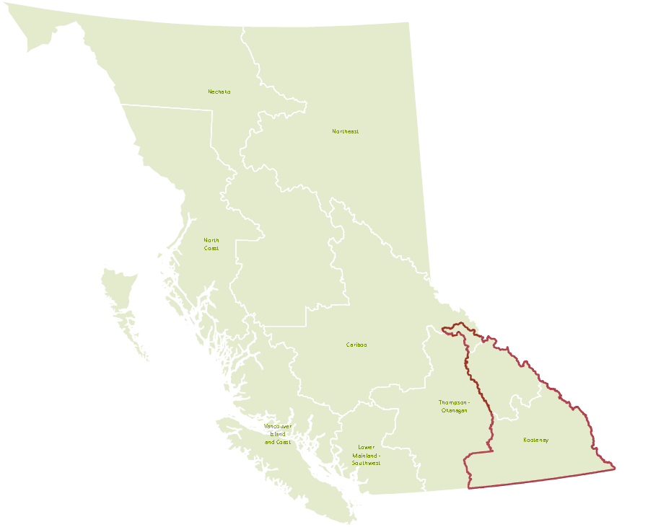

The Columbia Basin
Rural Development Institute
Promote evidence-based decisions that lead to enhanced regional well-being through research and information provision

Slide 39
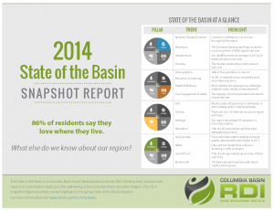
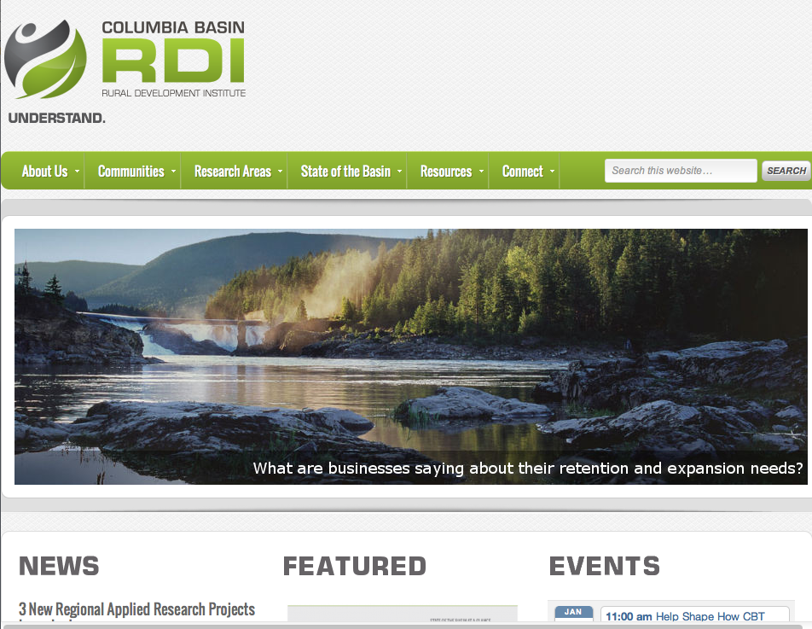
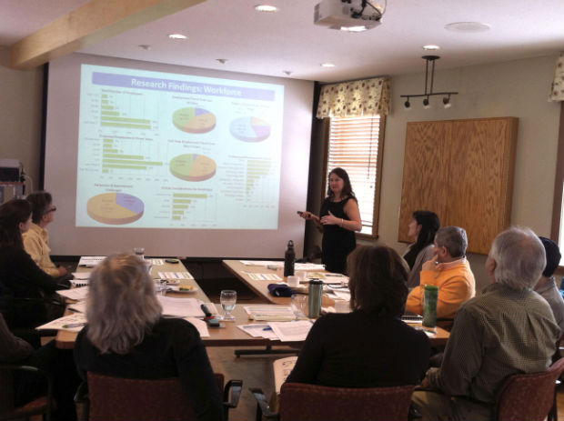
Rural Development Institute
Consolidate, Identify Gaps & Build Regional Knowledge
Regional Revitalization-Focused Applied Research
Innovation, Knowledge Transfer, Capacity Building & Collaborative Learning

Slide 40
Applied Research & Innovation at Selkirk College
Applied Research & Innovation
Selkirk Geospatial Research Centre
(SGRC)
Columbia Basin Rural Development Institute
(RDI)
Community Education & Workforce Training
(CEWT)
Teaching & Learning Institute
(TLI)
CCI and ARD funding to SGRC, primarily forestry, SSHRC partnerships via RDI
National Research Council funding to support college capacity to support companies
RDI and TLI have regional mandate, partner with College of the Rockies, College of New Caledonia, Okanagan College
Notes:
We have identified need through various processes… manufacturing & technology sector specific BRE research, extensive Industrial Research Chairs for Colleges consultations, ongoing outreach & extension via CEWT, RDI and TLI, and these identified needs will build the foundation for future proposal development. Our ‘institutes’ have identified the need to work more closely together to ensure effective external communications and seamless service to the companies and communities we serve.

Slide 41

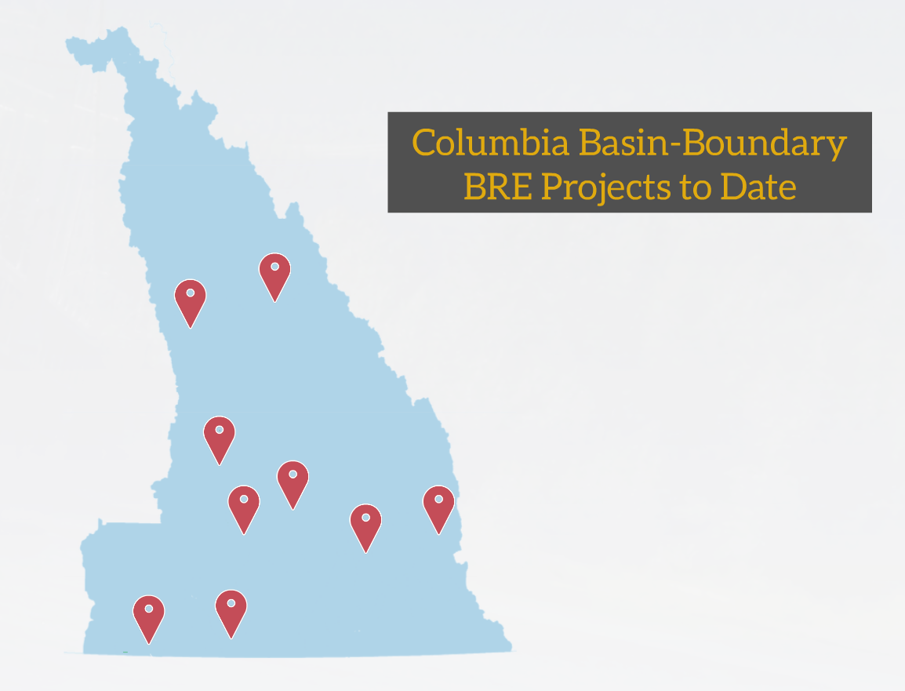
Business Retention & Expansion
Over 1000 businesses surveyed
30+ partnerships (local government, Community Futures, Chambers of Commerce, Development Boards, provincial government, provincial economic development association, Columbia Basin Trust)
Primary sectors include retail trade, professional services, manufacturing, and accommodation & food services
Over 140 hour on implementation tools,700 hours of direct research support and over 150 hours of training
7 faculty and students involved
  5 faculty
  2 co-op students
Notes:
Communities implement their BRE projects using tools and processes developed by the RDI. RDI provides training and direct research support (data analysis, report writing, presentation of findings to community) and links to resources to assist in related economic development planning and action.

Slide 42

Economic Assets

Slide 43
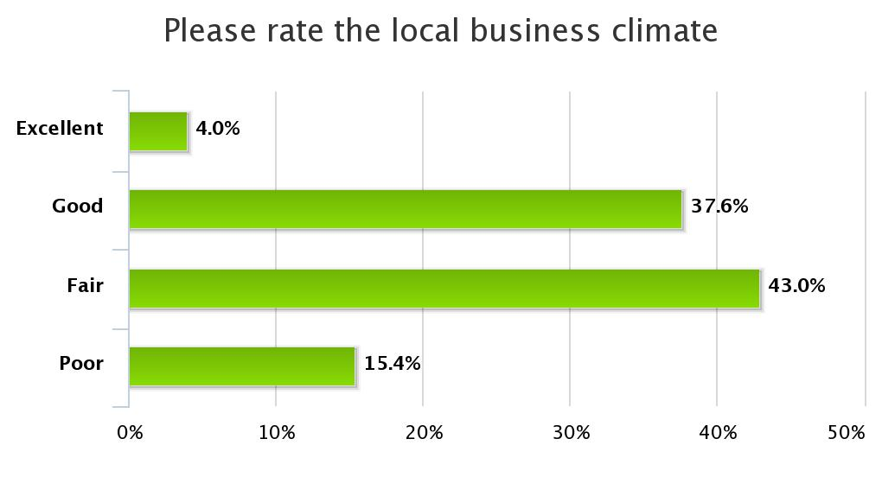
What our Businesses Have to Say: Business Climate
58% rate as poor or fair
N=752
Notes:
Lea

Slide 44
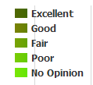
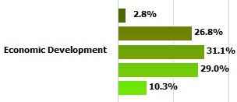
What our Businesses Have to Say: Economic Development
60% rate as poor or fair
Notes:
Lea

Slide 45
Understanding Our Economic Development Capacity
Economic Development Capacity
Planning & Action
Governance & Leadership
Networks & Linkages
Engagement
Shared vision for community’s future
Economic Development Plan
Successful ED Initiatives
Diversity of actors
Level of involvement
Relationship with business community
Understanding of ED
Resources
Committed leadership
Healthy, integrated relationships
Connected to internal supports
Connected to external supports
Notes:
There is a strong theme through all interviews: gratefulness for access to well resourced EDOs, or frustration with the lack of access to a resourced EDO.
In communities with strong and committed EDOs, successful programs and activities are more likely to occur.

Slide 46
Economic Development: Lack of Alignment
Notes:
Lea

Slide 47
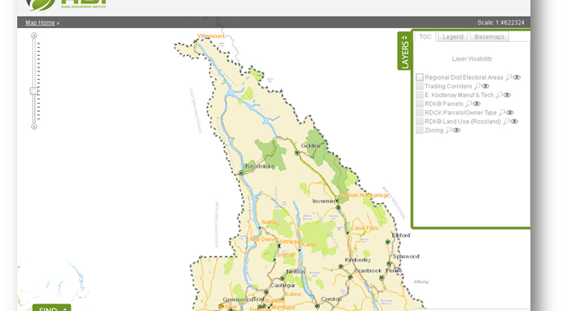
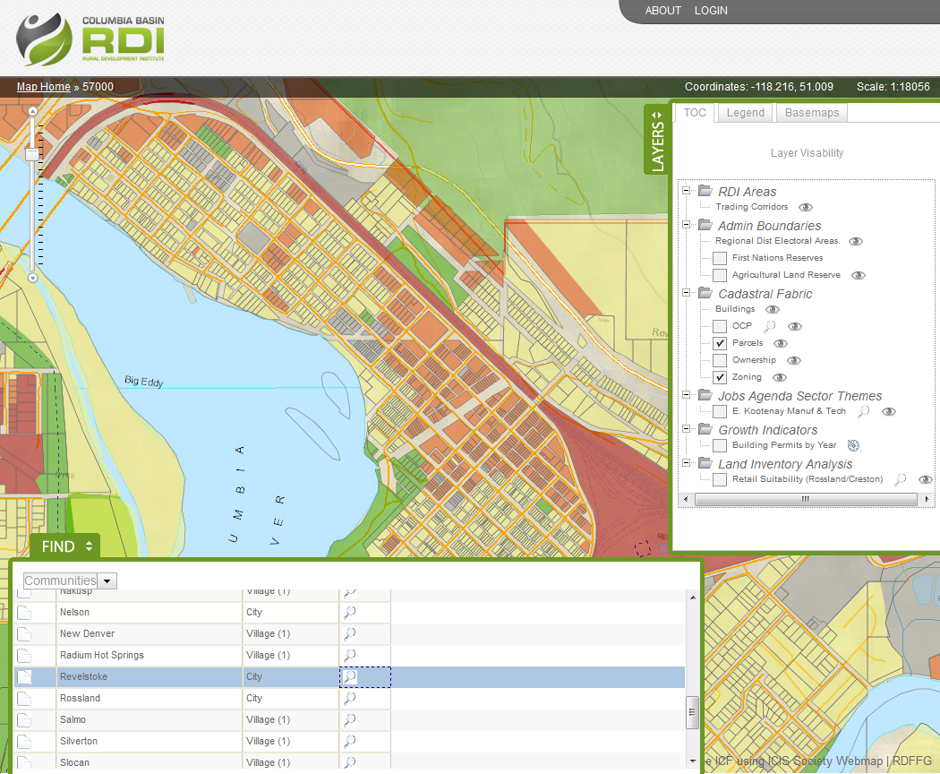
Digital Basin & Employment Lands
Over 200 economic, social, cultural & environmental data layers, charts, & related analysis
Creation of a seamless parcel fabric at a regional level with query functionality
35+ partnerships (local government, Community Futures, Chambers of Commerce, provincial government, First Nations, Columbia Basin Trust)
Over 1500 hours on research and development
10 faculty and students involved
  6 faculty
  4 co-op students
Notes:
The project defines employment lands as lands that generate economic wealth, including: agricultural lands; lands zoned or designated for heavy industry, light industry and commercial; First Nations designated employment lands; brown and greyfield sites; and Crown lands available for development. The SGRC is building a Web Portal that will provide a set of sophisticated query and interactive mapping tools for exploring the economic landscape of the Canadian Columbia Basin Region. The portal is aimed at decision makers, investors and business owners in the region.
The platform that has been built for this project is incredibly flexible
The public will have access to location services
performing their own custom queries – looking for landbase with their desired attributes
We have a spatially explicit platform for economic/environmental/social/cultural indicator data
public has an appetite to understand the context where they live
business community uses this information to analyse their operations
EDOs, public policy-makers, and researchers will have an advanced platform for data delivery

Slide 48
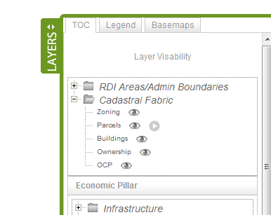
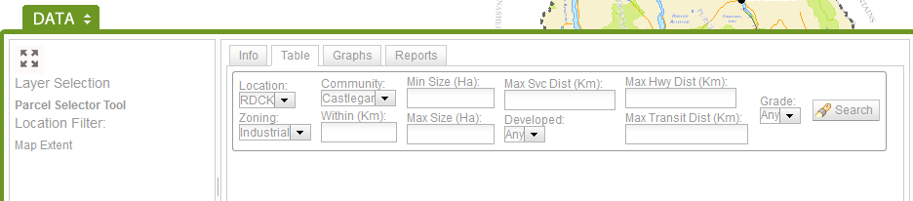
The Site Selector Tool

Slide 49
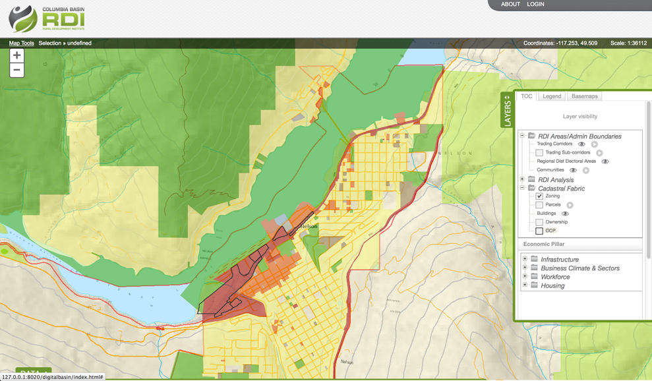
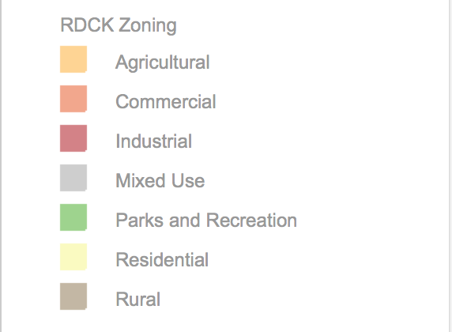
Search Results
Nelson zoning only:
- Nelson and 10 Km surrounding.
- Industrial zoned (center of parcel is on zone)
- Min size 10 Ha
- Within 1Km from power
- Within 3 Km from Major Hwy
- Within 1 Km from water service
- 30 % Area of parcel must be at or below 10% grade
Parcels outlined in black meet the filtering criteria

Slide 50

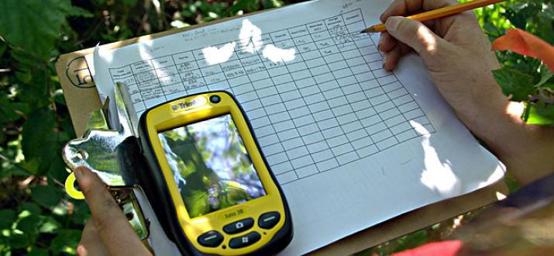
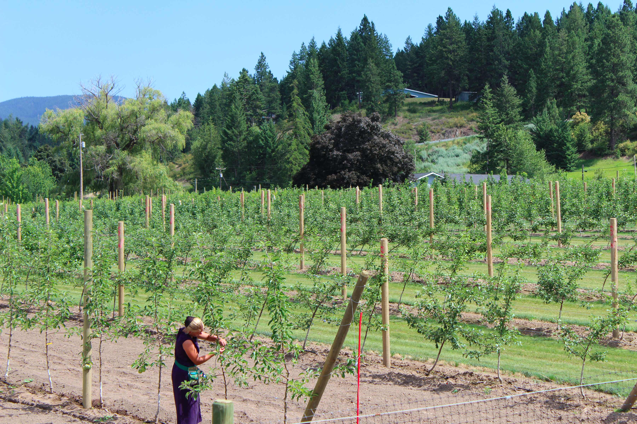
NRC-funded Technology Transfer Projects
Interacted with 222 companies
10 partnerships (including other post-secondary institutions, Community Futures, Chamber of Commerce)
Over 1000 hours of direct geospatial or digital media project support & 340 hours of advisory support
Over 1300 hours of training
20 faculty and students involved
  14 faculty (1FT hired for project)
  4 co-op students (all 4 hired for project)
  2 admin / technical support staff (both hired for this project)
Notes:
Building on ADT and our improved applied research capacity, we are now strategizing on funding proposals to access some of these larger funding envelopes (i.e. Western Economic Diversification’s Economic Development Program, NSERC, Canada Innovation Fund).
Huge learnings on opportunities related to the Digital Media department, exploring opportunities to provide digital fabrication support to companies
New opportunities identified for SGRC in areas such as ‘Mapping Market Opportunities’ – addresses a need identified via BRE, marries market research with geospatial mapping

Slide 51

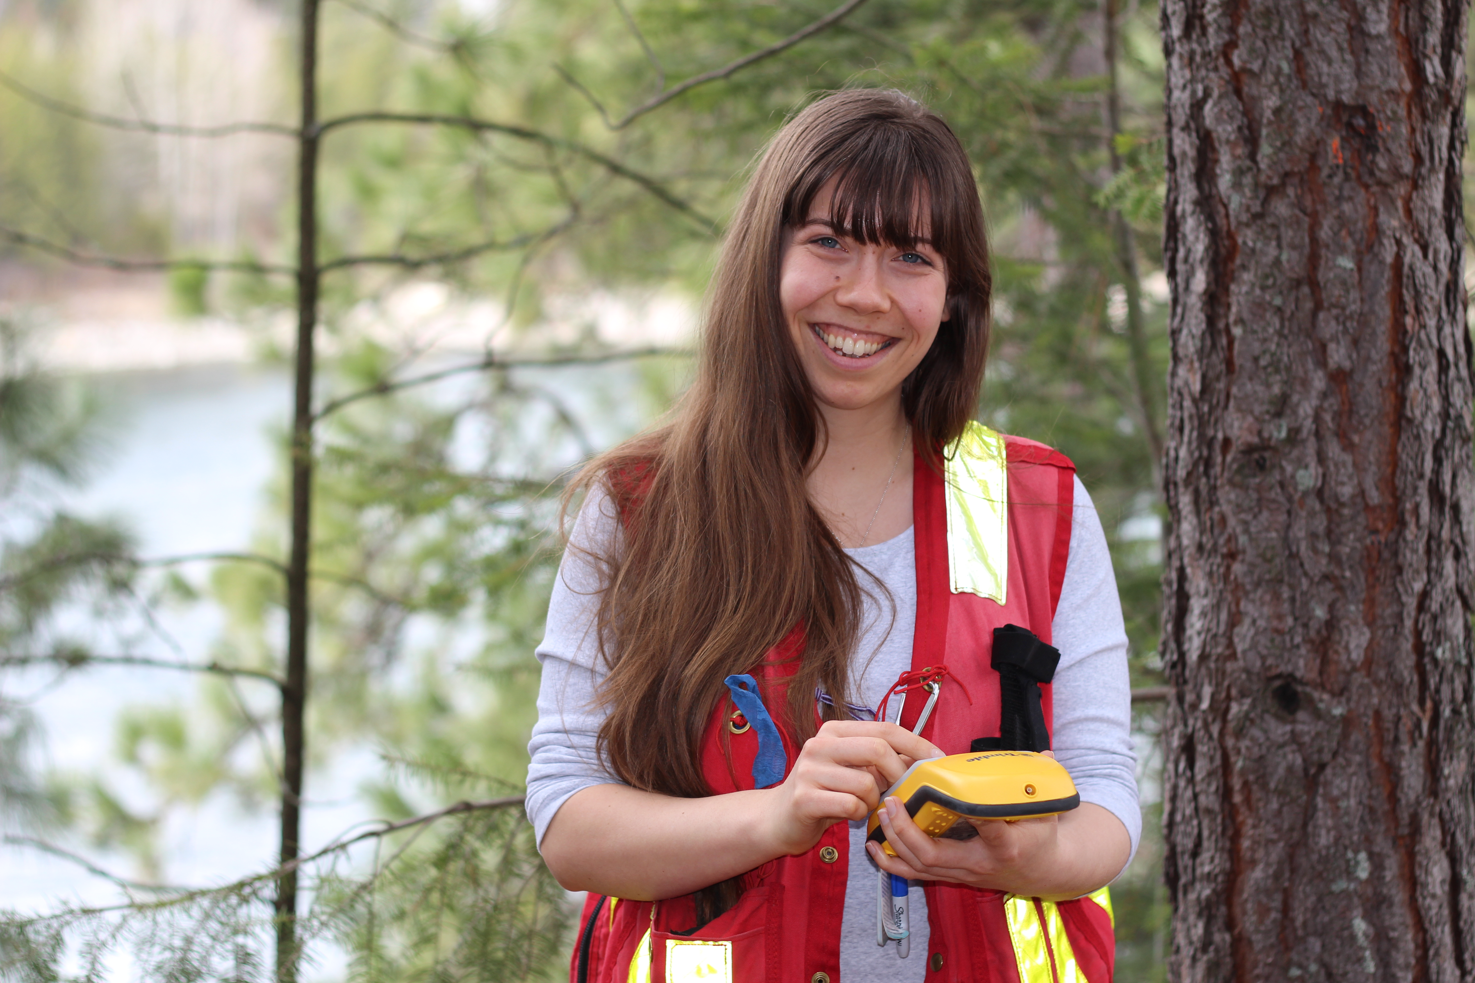
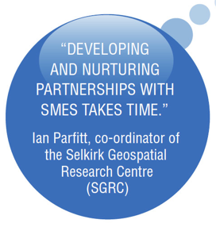
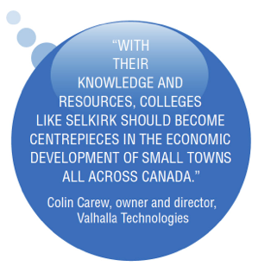
Learning by Doing
Student learning is the glue that binds!
Policies, procedures and integration of administrative functions provides a critical backbone
Manage expectations, engage in clear communications, state intentions up front
Use a collaborative learning approach

Slide 52
Parting Thoughts…
Bring partners in early, utilize as advisors throughout
Engage in honest, up front conversations to manage expectations
Build projects on identified needs and existing college capacities
Identify & articulate where you fit into the landscape
Identify metrics prior to start & commit to measuring long term impact
Take a Learning Regions approach based on innovation and collaborative learning
Build capacity – of ourselves & our partners

Slide 53
UNDERSTAND • CONNECT • MOBILIZE
Preparing for the Future
Building Resilient Rural, Remote and Northern Communities
www.cbrdi.ca
Dr. Terri MacDonald
Regional Innovation Chair in Rural Economic Development
Selkirk College

