Slide 1
Infrastructure Canada launched their Smart Cities Challenge - a competition inviting communities across the country to showcase their best "smart" ideas. The Government of Canada will work in collaboration with cities and communities that are ready to innovate and take risks – providing financial and in-kind support for their Smart Cities transformation. The winning proposals are eligible to win prizes of $5, $10, or $50 million.
Video

Slide 2
Communities Lead the Way
Empowering communities across the country to address local issues their residents face through new partnerships, using a smart cities approach - achieving meaningful outcomes for residents through the use of data and connected technology. This approach can be adopted by any community, big or small.
Finalists will receive support to develop their smart cities proposals. Winning communities will be awarded with prize money to help implement them.
Realize outcomes for residents - Empower communities to innovate - Forge new partnerships and networks Spread the benefit to all Canadians

Slide 3
What is a smart cities approach?
Achieving meaningful outcomes for residents by leveraging the fundamental benefits that data and connected technology have to offer:
Openness
Integration
Transferability
Collaboration
The Challenge Statement is a single sentence that defines the outcome or outcomes a community aims to achieve by implementing its smart cities proposal.
Measurable – Ambitious – Achievable

Slide 4
Application Process
Engage with residents about the most pressing issues their community faces.
Define Challenge Statement based on these consultations
Develop ideas and activities that will make up their preliminary Smart Cities Challenge proposal
Applications due April 24th, 2018 on Impact Canada Challenge Platform
Appendix: Application Instructions

Slide 5
Who can apply?
Municipalities, local or regional governments
Indigenous communities
Groups of organisations above
Prizes
One prize of up to $50 million
Two prizes of up to $10 million each
One prize of up to $5 million

Slide 6
The South Island Prosperity Project’s (SIPP) mission is to facilitate and promote the development of a strong, regionally diversified economy on South Vancouver Island.
Our vision is to do everything we can to build a collaborative, vibrant place to live and work. We intend to bolster our region’s economic and social prosperity by catalyzing the creation of high-quality, household-sustaining jobs, so that more families can afford to live, work and build a life here.
Website
One region, one vision, one purpose.
Organizers

Slide 7
Smart Cities Penticton
Healthy Penticton – Smart Cities Theme
10 solutions, 10 projects for $10 million
pursuing technology and open data.
Effort is being led by volunteers in the community.
Community engagement took place Jan. – Feb. 2018

Slide 8
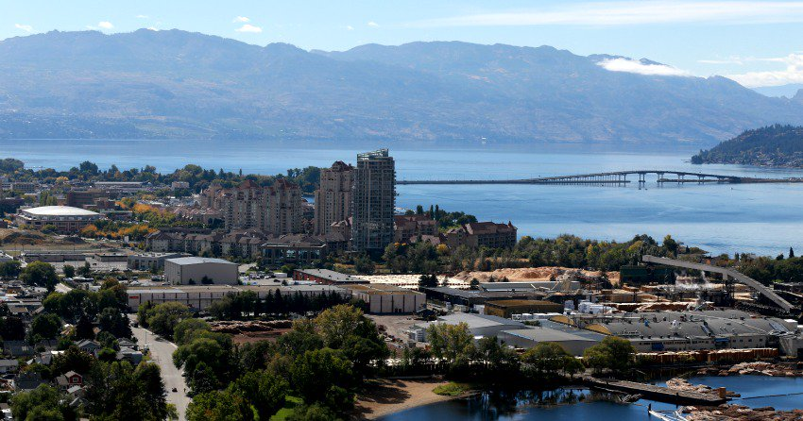
3 Areas of Focus:
Addressing homelessness
Resilience in the face of climate change; or,
The growth and development of neighborhoods
Consultant to run workshops with community stakeholders involvement.
Topic with the highest potential will be defined by early March.

Slide 9
Community participation will be open until March 9th 2018.
Second opportunity to participate and give feedback at the Community Centre (free childcare)
Using an online tool called Thoughtexchange to gather feedback.
Respond to one open-ended question and then have the opportunity to consider and assign stars to the ideas shared by others.
All of our voices matter, so your participation is crucial and valued.

Slide 10
Vancouver and Surrey are partnering together!
Competing for $50 million
Continue to enhance our efforts to integrate innovative, tech-savvy city building approaches.
Smart Surrey Key Initiatives
Smart Surrey Broadband Strategy
Surrey City Energy
Traffic Management Centre
Open Data Catalogue
Citywide Wi-Fi
My Surrey App
Organic Waste Biofuel Processing Facility
Innovation Boulevard
Smart Vancouver Key Initiatives
WiFi for everyone
Wired bike sharing
EV plug-ins
Smooth traffic
Ask, act, participate
Quick response

